Slide 1
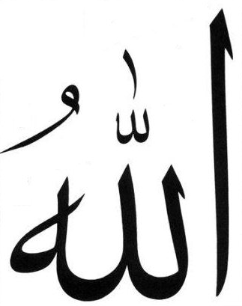
Allah, the Creator
Allah, the Sustainer
Allah, the Supreme
Allah, the Glorified
Allah, the Most Gracious
Allah, the Most Merciful
Allah, the all Powerful
Allah, the Everlasting
Lets get Close to Allah!
Let’s Get Enlightened with Allah’s Noor!
Let’s Connect with Quran!

Slide 2
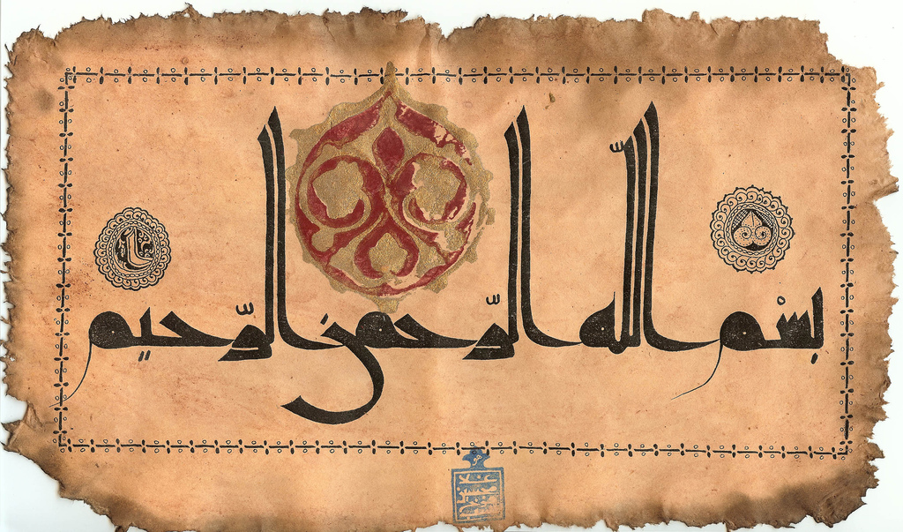

Slide 3
Aren’t we Blessed?

Slide 4
And We have certainly honored the children of Adam and carried them on the land and sea and provided for them of the good things and preferred them over much of what We have created, with [definite] preference.
[Al-Isra 17:70]

Slide 5
The Most Merciful(1) Taught the Qur'an(2), Created man(3), [And] taught him eloquence(4).

Slide 6
What is the Quran?
What does it mean to me and Why do I need it?

Slide 7
Quran- Allah’s light, A clear book!
O People of the Scripture, there has come to you Our Messenger making clear to you much of what you used to conceal of the Scripture and overlooking much. There has come to you from Allah a light and a clear Book.
Notes:
A Book of Guidance….The first introduction to the book…an answer to our prayer…Ihdinassirata

Slide 8
The Ultimate Guiding light!
Alif, Lam, Ra. [This is] a Book which We have revealed to you, [O Muhammad], that you might bring mankind out of darknesses into the light by permission of their Lord - to the path of the Exalted in Might, the Praiseworthy -
14:1

Slide 9
And indeed, your Lord - He is the Exalted in Might, the Merciful. And indeed, the Qur'an is the revelation of the Lord of the worlds. The Trustworthy Spirit has brought it down upon your heart, [O Muhammad] that you may be of the warners -in a clear Arabic language. (Ash-Shu’ra 26: 191-195)

Slide 10
We have certainly sent down to you a Book in which is your mention. Then will you not reason?
(Al-Anbiya 21:10)

Slide 11
Analyze the impact of quran!

Slide 12
The Qur’aan increases your Imaan
“The believers are only those who, when Allah is mentioned, feel a fear in their hearts and when His Verses are recited unto them, they increase their Faith; and they put their trust in their Lord (Alone)”
[Al-Anfaal(8):2]
Notes:
Whoever wishes for an increase in Imaan day after day, then upon him is (recourse) to the
Book of Allaah, for He (subhaanahu wa ta’aala) has said,

Slide 13
Quran – Cure for the Hearts!
Guidance
and Mercy!
O mankind, there has to come to you instruction from your Lord and healing for what is in the breasts and guidance and mercy for the believers.
(Yunus 10: 57)
Notes:
To fulfill the needs of human body…you need food.
One who knows nutrition better, can make use of Allahs blessings better
To fulfill the spiritual needs, not only guidance has been sent, practical role models in the form of Prophets have been sent!
One’s measure of happiness…Money, Material?
When one’s happy? Physical?
It’s the Heart and Spirit or soul that’s happy!
If we are not going to define the true measure of happiness
Wahi = Rooh
Insaan keh andar rooh = Word Rooh
Quran keh liay b word rooh!
Iss rooh ki khushi iss rooh main hai!
Whats in chest?
Heart = Center of Happiness.
Heart Happy = Every thing Happy….

Slide 14
الَّذِينَ آمَنُواْ وَتَطْمَئِنُّ قُلُوبُهُم بِذِكْرِ اللّهِ أَلاَ بِذِكْرِ اللّهِ تَطْمَئِنُّ الْقُلُوبُ
Those who believed (in the Oneness of Allâh), and whose hearts find rest in the remembrance of Allâh, Verily, in the remembrance of Allâh do hearts find rest
Al-Ra’d 28

Slide 15
Say, "In the bounty of Allah and in His mercy - in that let them rejoice; it is better than what they accumulate."
Notes:
People ought to be happy at this blessing…
Whatever you have collected in the world, its better than any other thing…
What are the things that make us happy?
Money, wealth, gifts, friends?
Innal’insaana li rabbihi la kanood… This Quran is much better
Wa innahu li hubbil khairi la shadeed

Slide 16
Understanding our Obligations to the Quran
To understand, read, apply and teach?

Slide 17
Indeed Allâh conferred a great favour on the believers when He sent among them a Messenger (Muhammad SAW) from among themselves, reciting unto them His Verses (the Qur'ân), and purifying them (from sins by their following him), and instructing them (in) the Book (the Qur'ân) and Al¬Hikmah [the wisdom and the Sunnah of the Prophet SAW (i.e. his legal ways, statements, acts of worship)], while before that they had been imanifest error.
[Ale Imran 3:164]
Notes:
Why is this slide here??

Slide 18
OUR OBLIGATIONS TO THE QURAN
To Believe in the Quran
To Read It
To Understand it
To Act upon its Teachings
To Convey its Message and Teachings to Others

Slide 19
Meaning of : Tilawah
Meaning of : Tilawah
is the word that the Qur'an uses to describe the act of its reading.
No single word in English can convey its full meaning.
Its primary meaning is to follow.
Its secondary meaning is to read.
Tilawah as the act of reading in which words must follow each other in order for their meaning to make sense.
Following of the Quran must mean that we learn from the words of the quran and make it a blueprint for our lives.

Slide 20
Total Engagement in tilawah of Quran
“Tilawah or recitation is an act in which your whole person, soul, heart, mind, tongue and body—participates. In short your whole existence becomes involved (p.22)” – Khurram Murad – The Way to the Quran

Slide 21
علم التجويد
The Art and Science of Reciting the HolyQuran

Slide 22
تجويد
ج وَّّ دَ
To Beautify, Bring at the Level of Excellence, To make Superior (in terms of Quality)
Tajweed(n) –is to make our pronunciation of the Quran better, meaning perfect, meaning as it was revealed.

Slide 23
Linguistic and Applied Definition of Tajweed
Linguistic Definition:
Betterment، ‘proficiency’ or ‘doing something well’
Applied definition:
Articulating every letter from its articulation point and giving the letter its rights and dues of characteristics.

Slide 24
Rights and dues of letters
Rights of the letters
Are its required characteristics that never leave it.
Dues of Letters:
are its presented characteristics that are present in it some of the time, and not present at other times. E.g. the madd, idghaam

Slide 25
The Science of Tajweed
Tajweed is one of the most prominent sciences of Qur’an.
It is the science governed by:
deep-rooted static rules
derived from the oral recitation of the Qur’an by the Prophet Muhammad after hearing the revelation from the angel Gabriel.

Slide 26
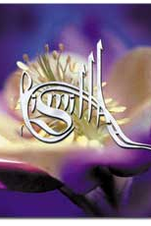
Why Tajweed?
No rules revealed?
The mixture between Arabs and non Arabs.
Preserving the Arabic Tongue
Preserves the recitation of the Qur’an from mistakes
Guarantees the reader of the Qur’an integrity of pronunciation
Most important element in reciting the Quran in a beautiful manner

Slide 27
The Knowledge of Tajweed
The knowledge of Tajweed is contingent on four matters:
Knowledge of the articulation points of the letters
Knowledge of the characteristics of the letters
Knowledge of what rules change in the letters due to the order of letters
Exercising the tongue and a lot of repetition

Slide 28
Importance of Tajweed
The ornament of the Qur’anic recitation is a good melodic voice
Allah loves the recitation with such a voice
Ideal recitation of the Quran
Manner which helps the person to comprehend, surrender, and experience humility
Notes:
It should be recited in Arabic style by strictly observing the rules of the science of Tajweed and by avoiding any playing around with the duration of syllables

Slide 29
What the Quran says?

Slide 30
Surah Al Baqarah, 121:
Those to whom We gave the Book [the Taurât (Torah)] [or those (Muhammad's Peace be upon him companions) to whom We have given the Book (the Qur'ân)]recite it as it should be recited (i.e. followed), they are the ones that believe therein. And whoso disbelieves in it (the Qur'ân), those are they who are the losers.

Slide 31
The obligation of Tajweed Established in quran
And recite the Qur'ân (aloud) in a slow, (pleasant tone and) style
Al-Muzzammil [73:4]
Notes:
The proofs that the scholars bring to show the obligation of Tajweed is that Allah says in the Qur’an
‘And recite the Qur’an (aloud) in a (slow and melodious) style (tarteela)’ (SurahMuzzammil, Ayah 4)
Ali ibnAbiTalib (RA): “at-Tarteel is Tajweed of the letters and knowing where to stop (correctly)”.[An-Nashr of Ibn Al-Jazaree 209:1]
And of the rights of reciting correctly is reciting it the way it was revealed.

Slide 32
According to Sunnah

Slide 33
Reciting the Qur’an melodiously according to the Sunnah (1)
The Prophet (SAW) used to recite the Qur’an in slow, measured, rhythmic tones as Allah had instructed him, not hurriedly, but rather “he would recite a surah in such slow rhythmic tones that it would be longer than it would seem possible.”(Muslim, Muwatta)
He would stop at the end of each ayah (Abu Dawud).
He commanded people to recite in a beautiful voice in a pleasant melodious tone.
Notes:
Unfortunately all too often we find people reciting the Qur’an quickly and without changing their tone and without any feeling.
We should put all our efforts into reciting the Qur’an with as much feeling as we can!

Slide 34
Reciting the Qur’an melodiously according to the Sunnah (2)
Prophet (PBUH) said
“Beautify the Qur’an with your voices [for a fine voice increases the Qur’an in beauty].”(Bukhari)
“He who does not recite the Qur’an in a pleasant tone is not of us.” (Abu Dawud)
“Truly the one who has one of the finest voices among the people for reciting the Qur’an is the one whom you think fears Allah when you hear him recite.” (Daarimi, Tabaraani)
Notes:
Unfortunately all too often we find people reciting the Qur’an quickly and without changing their tone and without any feeling.
We should put all our efforts into reciting the Qur’an with as much feeling as we can!

Slide 35
Quran in My Life
Analyzing the Place of Quran in our Lives
Why do I read the Quran?
When and How much do I Read the Quran?
Why should we read the Quran?

Slide 36
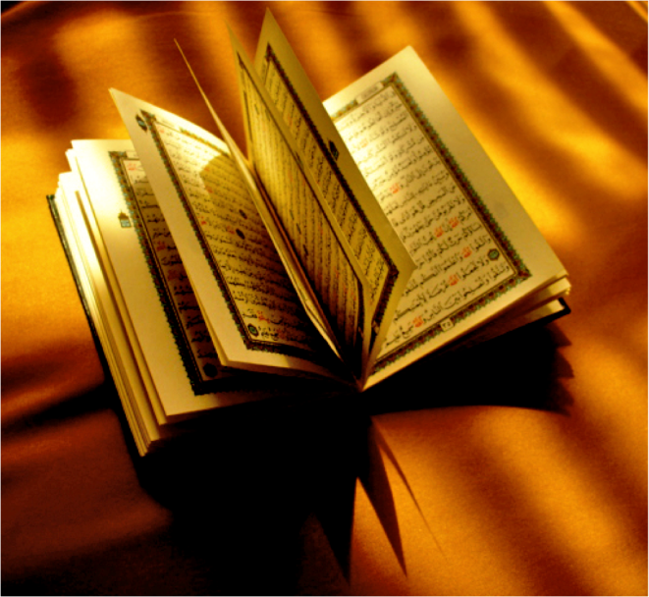
KEY TO IMPROVING RELATION WITH QURAN
Formula for bonding with Quran
Correct Recitation
Understanding

Slide 37
WHY IS CORRECT RECITATION SO IMPORTANT IN GETTING CLOSE TO THE QURAN?
The beauty of the Quran in its original Arabic is unmatched – translations cannot do justice.
The essence and the feel of the Quran cannot be captured without recitation in Arabic!
Whatever we speak and hear carries an effect straight to our hearts; some sounds have healing effects, others destructive.
The sound of the Quran is the most beautiful, healing, sound we can hear in this world, but only if recited correctly!
Truly becomes a source of peace and closeness to Allah if recited beautifully. We start to enjoy our recitation!

Slide 38
Improving our relation with the Quran
Indispensable!
What can we do to improvise upon our relation with the Quran
How can we make Quran our best friend?

Slide 39
Lets Ask Ourselves and Make a Commitment!
It is obligatory on all of us to learn Tajweed!

Slide 40
Benefits of Tajweed

Slide 41
Benefits of learning Tajweed
The benefits of learning Tajweed are many as reflected in some of the following Ahadeeth:
There are ten rewards for each letter you recite from the Quran “Whoever reads a letter from the Book of Allah, he will have a reward. And that reward will be multiplied by ten. I am not saying that “Alif, Laam, Meem” is a letter, rather I am saying that “Alif” is a letter, “laam” is a letter and “meem” is a letter.” [Tirmidhi]
The Qur’an will lead you to Paradise! The Qur’an is an intercessor, something given permission to intercede, and it is rightfully believed in. Whoever puts it in front of him, it will lead him to Paradise; whoever puts it behind him, it will steer him to the Hellfire.”
[An authentic hadith found in At- Tabaraanee, on the authority of ‘AbdullaahibnMas’ood]

Slide 42
Benefits of learning Tajweed
The reciters of the Qur’an will be in the company of the noble and obedient angels ‘Aa’ishah, may Allah be pleased with her, relates that the Prophet (SAW) said:
“Verily the one who recites the Qur’an beautifully, smoothly, and precisely, he will be in the company of the noble and obedient angels. And as for the one who recites with difficulty, stammering or stumbling through its verses, then he will have TWICE that reward.”
[Al-Bukhari and Muslim]

Slide 43
Messenger of Allah (Peace be upon him) said:
"It will be said to the beholder of the Qur’aan:
‘Recite, ascend, and Rattil (recite slowly and distinctly) as you used to Rattil in the life of this world, for verily your level (in Paradise) is at the last verse you read’”
(Abu Dawud& At-Tirmidhi)

Slide 44
"The best among you is the one who learns and teaches the Holy Qur'an" (Sahih Bukhari)
Notes:
Lov

Slide 45
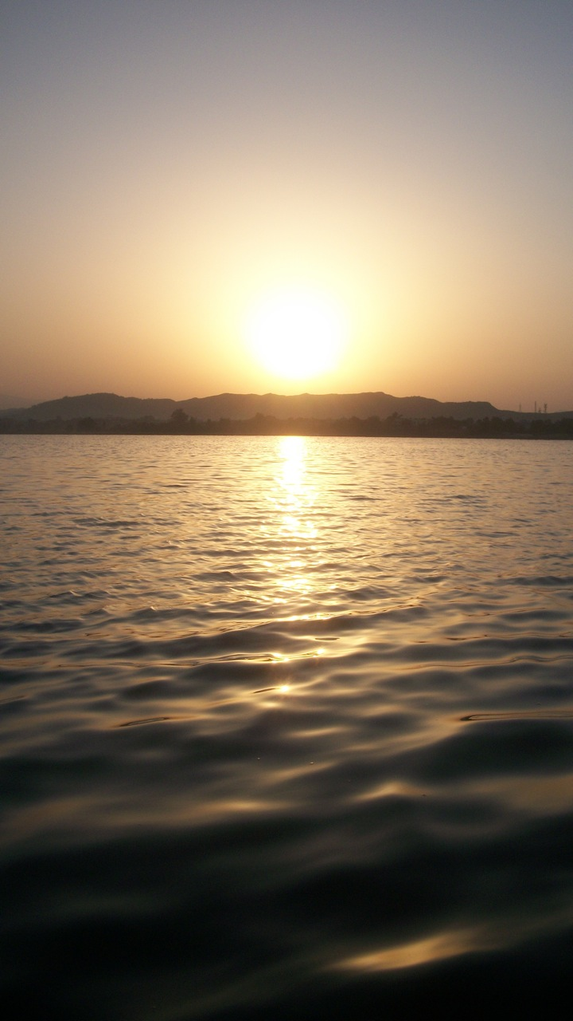
We are Blessed Indeed!
For we are the chosen ones!
Notes:
Love is a blessing if it brings you closer to Allah
And it is a challenge at trial, an azmaish if it takes you away from Allah!

Slide 46
Is Quran Difficult?
To Read, Learn, Teach, Apply?
Notes:
Be it recitation, remembrance, taking heeed…
We have to make a commitment and try

Slide 47
And indeed, We have made the Qur'ân easy to understand and remember, then is there any that will remember (or receive admonition ? )
Al-Qamar (54: 41)

Slide 48
Guarantee… Quran is NOT Difficult!
Be Assured…It’s a Promise from Allah!
Notes:
Be it recitation, remembrance, taking heeed…
We have to make a commitment and try

Slide 49
On the Seekers’ Path to Knowledge

Slide 50
There is only One Guiding Light!
We are in this together!

Slide 51
Quran is Allah’s Noor
… Let’s Enlighten our lives with it!

Slide 52
Become Quran’s Friend
Make Quran your Best Friend

Slide 53
Lets learn to Beautify our Recitations
And start our journey towards better fulfilling our obligations to the Quran!

Slide 54
Lets Live the Quran!

Slide 55
Dua is a Must!
With Open heart…Clear Mind....
Notes:
Quran = Furqan….
Howe it can become furqan unless we read it understand it apply it…teach it!

Slide 56
If We had sent down this Qur'an upon a mountain, you would have seen it humbled and coming apart from fear of Allah . And these examples We present to the people that perhaps they will give thought.

