Slide 1
Surah Al-Feel
The Elephant

Slide 3
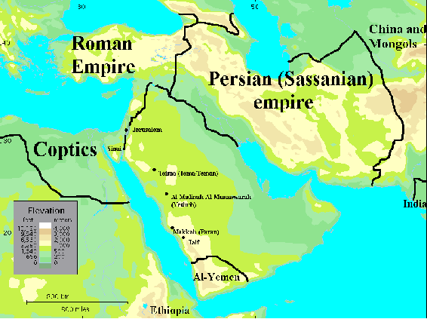

Slide 5
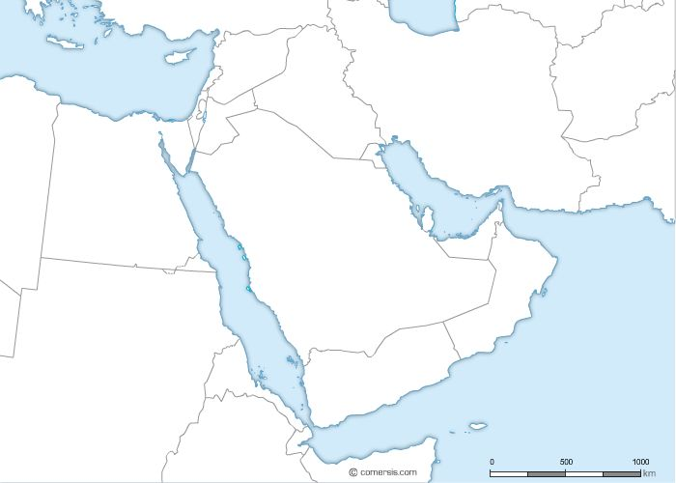

Slide 7
The creation in an Elephant’s foot
The largest land animal on our planet is the elephant, which weighs about five tons. In order for such a heavy creature to be able to walk, it needs a special design. Elephants have to walk long distances to find water, and are equipped for the task with legs that are wonders of engineering. If their legs were a bit thinner, they would not be able to hold the elephant up. But there is an even more interesting design feature in the foot of the elephant. Under the toe bones there is a thick, elastic fatty cushion. The wide sole covered with this fatty cushion distributes the pressure, and the elephant’s weight is spread out evenly over its feet. Because of this, elephants are able to tread very lightly despite their weight. The pressure that an elephant’s foot exerts on the ground is less than that exerted by a woman wearing high-heeled shoes. In short, this is a special shock absorber system designed for elephants. The fact that the sole of the elephant’s foot has been equipped with a cushioning system shows the existence of a plan. The system was designed how the animal would best be able to walk. And this shows us that there is a Creator Who created this system. This is the creative artistry of Almighty Allah.

Slide 8
