Slide 1
Sex Education- An Islamic Viewpoint
Female Sex Organs
Female Puberty
Menstrual Period
Menstrual Period-Islamic Rulings
Male Sex Organs
Male Puberty
Human Reproduction
Islamic Viewpoint
Banan M. Obeid

Slide 2
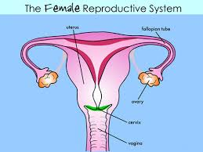
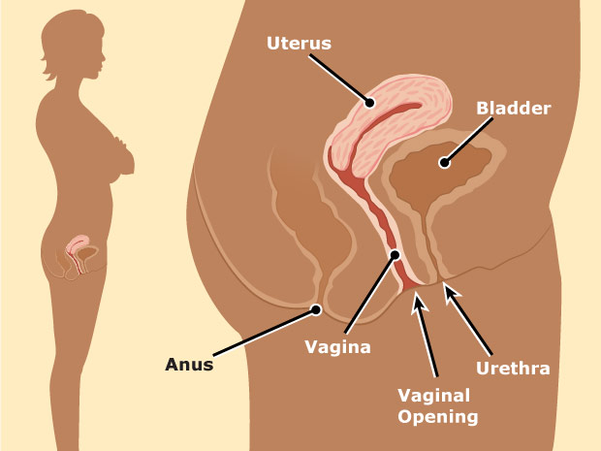
Female Sex Organs
Vagina: birth canal-connects the cervix and uterus.
External part of vagina is where blood from menstrual period exits the body.
Internal part of vagina is Cervix: a circular opening into the lower end of the uterus.
Uterus: The womb- a muscular organ with lining of soft tissue. Inside is the space where a baby develops until it is ready to be born. It leaves the uterus, through the cervix and out of the vagina.
Ovaries: Two internal female glands. They produce female hormones, release eggs. When a female is born her ovaries already have millions of eggs!! They don’t’ get released until she reaches puberty.
Fallopian Tubes: Attached to the sides of the uterus, extending towards the ovaries. Eggs travel from the ovaries to the uterus, through the Fallopian tubes.

Slide 3
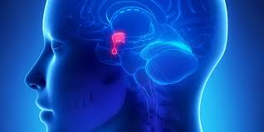
Female Puberty
During puberty, an increase of sex hormones (Estrogen) are released
from the Pituitary Gland in your brain.
These hormones cause drastic changes in male and female bodies.
The physical change from girl to woman is called Puberty. This usually starts between ages 9-11, but can occur later.
Girls often experience a growth spurt; breasts become larger, and hair will grow in the pubic area and under the arms.
Hair on the legs may become darker and thicker.
Hips begin to widen.

Slide 4
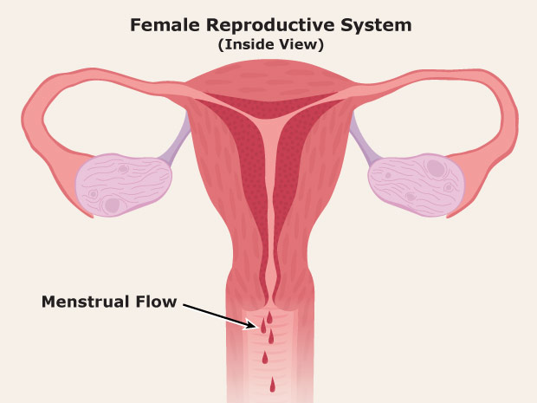
Menstrual Period
The inner lining of the Uterus is called Endometrium. Its role is to protect the fetus growing inside. If the ovary releases an egg that is not fertilized by sperm (no pregnancy takes place) the inside of the uterus sheds the endometrium because is not needed.
Once a month a flow of blood for a period of a few days, (lasting 3-7 days) helps this unneeded lining exit the body.
During Menstruation, females may experience diarrhea, mood swings, depression, tiredness, cramps, and breast soreness. A heating pad, light exercise or a hot bath may help.
Some periods are light, some are heavy.
(Discuss pads and tampons)

Slide 5
Menstrual Periods- Islamic Rulings
It is preferred to not use tampons due to the risk of infections and Toxic Shock Syndrome (TSS). It is healthier to allow the blood to exit the body.
While on her period, a girl can not hold the Mushaf, Enter the Masjid, Pray, Make Tawaf, or Fast. She does not have to make up prayer, but she does have to make up the fast.
Period blood will go from dark red, to pink, to brown as it tapers off. Some girls will see white discharge indicating that the period has ended. Once it has ended, a girl must perform GHUSUL, a ritual purification bath, before returning to Ibadat.
If a period lasts for less than 3 days, or comes twice within 15 days of one another, it is considered ISTIHADA, meaning that the blood is not considered menstrual blood. The girl will continue to pray and fast as she normally would, but must make wudu for every prayer time if she sees any blood being discharged.
If a period lasts longer than 10 days, the following days would also be considered ISTIHADA and the girl would make GHUSUL and continue to pray and fast.

Slide 6
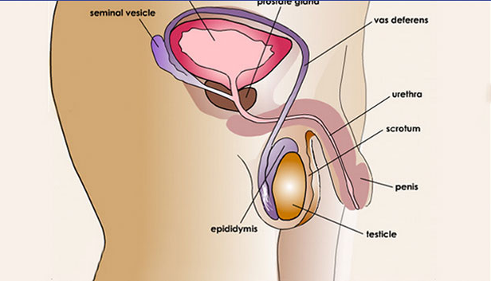
Male Sex Organ
The Male has reproductive organs that are BOTH inside and outside the body.
The Testicles produce the male hormone Testosterone which initiates Male puberty and the production of SPERM- the Male sex cell which carries all his genetic material.
Males produce millions of sperm every day.
The Sperm mixes with a fluid and exits the Male body through the PENIS.

Slide 7
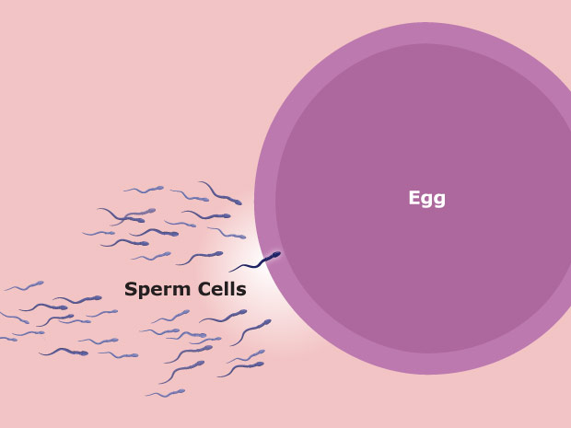
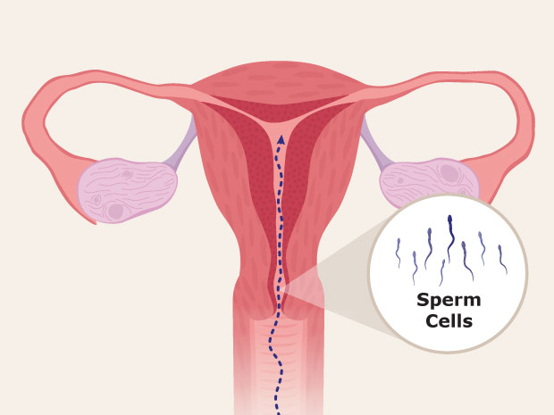
Human Reproduction
Reproduction is the process by which organisms
make more organisms like themselves.
Without it, a species would not exist.
In humans both Male and Female sex cells (THE SPERM AND EGG ) are needed to make a baby.
In order for reproduction to take place, the Male sex organ must meet the Female sex organ.
The male’s penis will enter the female’s vagina. The sperm exits the male’s body through the penis (EJACULATION) and enters into the female’s body through the vagina.
The sperm will continue to make its way up into the Uterus. Each sperm carries the DNA of that father and when it meets the mother’s egg,
FERTILIZATION will take place.

Slide 8
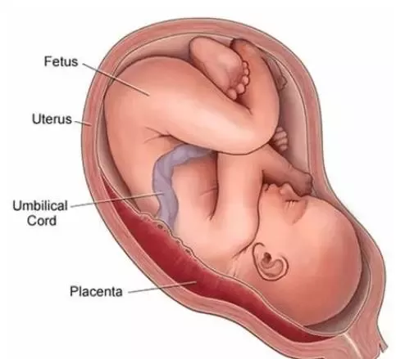
The cells will multiply and multiply… burying themselves into the Endometrium, which becomes thinker and thicker to protect these cells…which are about the size of a pin head! These cells form into an EMBRYO/FETUS, which continues to form into a baby. The baby will have DNA from both parents and will continue to grow there for 9 months, recieving nutrition from the Placenta, through the Umbilical Cord.
A thick mucus forms, closing up the Cervix, and Amniotic Fluid will protect the baby from any bumps.
When the baby is ready to be born it will exit the mother’s body either from the stomach (C-Section), or through the birth canal - the Vagina.

