Slide 1
Journey Towards Light…
Enlightenment of the Hearts!
Quran is Allah’s Noor … Lets Enlighten our lives with it!
Notes:
Quran is Allah’s Noor
… Lets Enlighten our lives with it!

Slide 2
If We had sent down this Qur'an upon a mountain, you would have seen it humbled and coming apart from fear of Allah . And these examples We present to the people that perhaps they will give thought.

Slide 3
Impact of the Quran!

Slide 4
The Qur’aan increases your Imaan
“The believers are only those who, when Allah is mentioned, feel a fear in their hearts and when His Verses are recited unto them, they increase their Faith; and they put their trust in their Lord (Alone)”
[Al-Anfaal(8):2]
Notes:
Whoever wishes for an increase in Imaan day after day, then upon him is (recourse) to the
Book of Allaah, for He (subhaanahu wa ta’aala) has said,

Slide 5
the Qur’aan is better than the world and all that is in it
Say, "In the bounty of Allah and in His mercy – in/ that let them rejoice; it is better than what they accumulate."
Notes:
People ought to be happy at this blessing…
Whatever you have collected in the world, its better than any other thing…
What are the things that make us happy?
Money, wealth, gifts, friends?
Innal’insaana li rabbihi la kanood… This Quran is much better
Wa innahu li hubbil khairi la shadeed

Slide 6
Quran- A healing and Mercy for mankind!
And We send down of the Qur'an that which is healing and mercy for the believers, but it does not increase the wrongdoers except in loss.
(Al- Isra 17: 82)
Notes:
Physical health dependent on healthy heart…
Healthy heart, healthy soul, healthy body, healthy self!
If spriritual wellness and wellbeing entire existence in the heart!
Heart is at the center of emotions,
Love Hate sadness Anger Rage, depression, madness, boils..melts…
If hearts are enlighteneded with the true spirituality…the true spirtit..automatically its effects are going to reach other aspects of life
Rahmat hai…
For those…Mumineen…those who believe!

Slide 7
Analyzing the need of Quran
Why do we not benefit as much as we should from the Quran?

Slide 8
Blessings of the Quran!

Slide 9
◊ The People of Qur’aan hope for a trade that will never perish
Those who rehearse the Book of Allah, establish regular Prayer, and spend (in Charity) out of what We have provided for them, secretly and openly, hope for a commerce that will never fail: (29) For He will pay them their meed, nay, He will give them (even) more out of His Bounty: for He is Oft-Forgiving, Most Ready to appreciate (service). (30)
[Fatir: 29-35]

Slide 10
Allah’s Chosen Ones!
عَنْ أَنَسِ بْنِ مَالِكٍ قَالَ قَالَ رَسُولُ اللَّهِ صَلَّى اللَّهُ عَلَيْهِ وَسَلَّمَ إِنَّ لِلَّهِ أَهْلِينَ مِنْ النَّاسِ قَالُوا يَا رَسُولَ اللَّهِ مَنْ هُمْ قَالَ هُمْ أَهْلُ الْقُرْآنِ أَهْلُ اللَّهِ وَخَاصَّتُهُ
From Anas ibn Malik who said that Allah's Messenger (sas) said: Verily Allah has his family members among people. They said: And who are they, O Messenger of Allah? He (sas) said: They are the people of the Qur'an the people of Allah and his select ones.
ran
Notes:
Every thing in the Universe prays for the one who seeks out knowledge!

Slide 11
al-Qur’aan is one of the causes of salvation from the Hellfire
The Prophet (sallallaahu `alayhi wa sallam) said, “If the Qur’aan was to be gathered inside a vessel (heart),
Allaah will never punishment it with the Hellfire.”
Notes:
17:88The servant of Allaah hastens with all that he has in order to be saved from the punishmen of Hellfire, and Allaah has indeed written for the one who has memorised the Qur’aan – seeking thereby the Face of Allaah – that the Fire will never touch him.
Sab mil ker b iss quran jaisi kitab nai la saktay…
1400…who batain nazil huien, which science has just proven
Az-zariat…asman, hath sai banaya, wusat dai rahay hain…Allah SWT nai farmaya
Aaaj pata chala…New york space museum, with a balloon…and blow the balloon…
The universe is expanding…
How much our hearts expand?
Sooraj Chand, Kullun Fi Falaqin Yasbahun….

Slide 12
An enlightened heart …or a destroyed house?
Messenger of Allah (Peace be upon him) said: "Verily he who has nothing of the Qur’aan in his heart, is like a house (which has been) destroyed.”
(At-Tirmidhi)

Slide 13
Tranquility descends upon the people of Qur’aan and mercy envelopes them
The Messenger (sallallaahu `alayhi wa sallam) said, “No people gather together in one of theHouses of Allaah, reciting the Book of Allaah and studying it among themselves, except that Sakeenah (Tranquility) descends upon them, and Mercy envelops them, and the angelssurround them, and Allaah mentions them amongst those who are with Him.”

Slide 14
الَّذِينَ آمَنُواْ وَتَطْمَئِنُّ قُلُوبُهُم بِذِكْرِ اللّهِ أَلاَ بِذِكْرِ اللّهِ تَطْمَئِنُّ الْقُلُوبُ
Those who believed (in the Oneness of Allâh), and whose hearts find rest in the remembrance of Allâh, Verily, in the remembrance of Allâh do hearts find rest
Al-Ra’d 28

Slide 15
The Haafidh of Qur’aan will be in the company of the Noble Angels
The reciters of the Qur’an will be in the company of the noble and obedient angels ‘Aa’ishah, may Allah be pleased with her, relates that the Prophet (SAW) said:
“Verily the one who recites the Qur’an beautifully, smoothly, and precisely, he will be in the company of the noble and obedient angels. And as for the one who recites with difficulty, stammering or stumbling through its verses, then he will have TWICE that reward.”
[Al-Bukhari and Muslim]

Slide 16
The Qur’aan puts you in the company of the Elite
Indeed, the Prophet (sallallaahu `alayhi wa sallam) said, “A man is upon the way of his friend, so let each one of you look to whom you befriend.”
He (sallallaahu `alayhi wa sallam) informed and spoke of the state of people on the Day of Judgement, he said – as is narrated in the Sahihayn – “A man will be with whom he loves”. So if you love the people of Qur’aan and accompanied them, then you will be from amongst them and raised up with them on the Day of Judgement – inshaa’Allaah ta’aala.
Notes:
It is also well known that the gatherings of the people of Qur’aan, none is present therein except people of righteousness and piety, and hence the Qur’aan puts you in the companionship of (these) elite

Slide 17
“Verily the one who recites the Quran beautifully, smoothly and precisely, he will be in the company of the noble and obedient angels.” (Hadith)

Slide 18
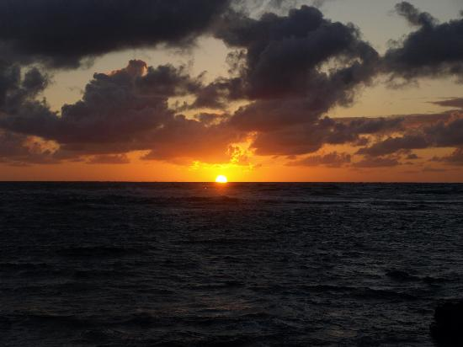
Endless rewards coming your way…
Treasures of goodness in the memorisation of Qur’aan! The Prophet (sallallaahu `alayhi wa sallam) said “Whoever reads a letter from the Book of Allah, he will have a reward. And that reward will be multiplied by ten. I am not saying that “Alif, Laam, Meem” is a letter, rather I am saying that “Alif” is a letter, “laam” is a letter and “meem” is a letter.”

Slide 19
Blessings of the Quran spreading far & wide
It is reported from Buraydah al-Aslami (radhiallahu `anhu) that he said, “The Messenger ofAllah (sallallaahu `alayhi wa sallam) said, “Whoever recites the Qur’an and learns it and then acts upon it is adorned with a crown of light on the Day of Judgement, its radiance is like the radiance of the sun. His parents are adorned with two jewels that the world could nevercontain, so they say ‘Why have we been adorned as such?’ It will be said, ‘For what your childhas acquired of Qur’an.”

Slide 20
Quran will intercede for you
It is narrated from Jabir (radhiallaahu `anhu) that the Prophet (sallallaahu `alayhi wa sallam)said: “The Qur’aan is an intercessor that intercedes and a truthful opponent. Whoever puts it in front of him, it leads him to Paradise and whoever casts it behind him, it drags him to Hell.”
And Abu Umaamah al-Baahili (radhiallaahu `anhu) who said: “I heard the Messenger ofAllaah (sallallaahu `alayhi wa sallam) say, “Read the Qur’aan for indeed it will come on the Day of Judgement as an intercessor for its companion.”

Slide 21
Quran will intercede for you
Prophet (sallallaahu `alayhi wa sallam) said: “Fasting and Qur’aan will intercede for theservant on the Day of Judgement. Fasting will say, ‘O Lord, I prevented from him food anddesires during the day so let me intercede for him’ and the Qur’aan will say, ‘O Lord, Iprevented from him sleep during the night so let me intercede for him’ – so they will both intercede.”

Slide 22
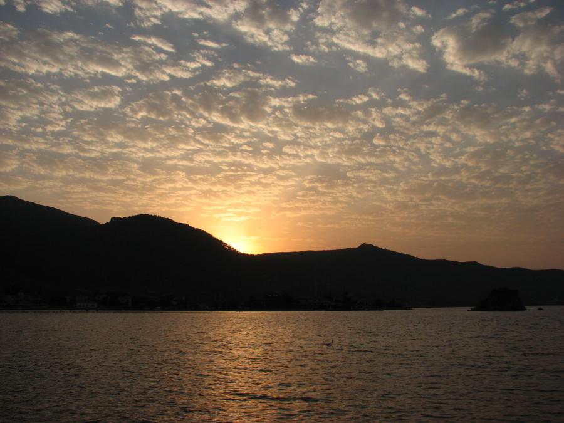
The Prophet (sallallaahu `alayhi wa sallam) said: “The Qur’aan will be brought on the Day of Judgement and it will say, ‘O my Lord, clothe him.’ So he’ll be clothed with the crown of honour. Then it will say, ‘Increase him’ and he’ll be clothed with the garment of honour. Then it will say, ‘O my Lord, be pleased with him so that He (Allaah) will be pleased with him and say, ‘Read & ascend!’ and he’ll be increased in one good deed for every verse.”
Quran will give you honor

Slide 23
Pure hearts will never find satisfaction enough from the book of Allah!

Slide 24
Our objective?

Slide 25
Together to paradise

Slide 26
Imagine…
Notes:
You had to come to this room after climbing 20 50 stairs…And you knew you must reach to have your degree certified etc
Imagine if you were unable to take a single step upwards…imagine your feet clamped!
You would do anything to have that clamp removed!

Slide 27
The Beholder of the Qur’aan ascends through the levels of Paradise
Messenger of Allah (Peace be upon him) said:
"It will be said to the beholder of the Qur’aan:
‘Recite, ascend, and Rattil (recite slowly and distinctly) as you used to Rattil in the life of this world, for verily your level (in Paradise) is at the last verse you read’”
(Abu Dawud & At-Tirmidhi)

Slide 28
The Haafidh of Qur’aan ascends through the levels of Paradise
الترمذي
عَنْ عَبْدِ اللَّهِ بْنِ عَمْرٍو عَنْ النَّبِيِّ صَلَّى اللَّهُ عَلَيْهِ وَسَلَّمَ قَالَ يُقَالُ لِصَاحِبِ الْقُرْآنِ اقْرَأْ وَارْتَقِ وَرَتِّلْ كَمَا كُنْتَ تُرَتِّلُ فِي الدُّنْيَا فَإِنَّ مَنْزِلَتَكَ عِنْدَ آخِرِ آيَةٍ تَقْرَأُ بِهَا

Slide 29
Together to higher levels of paradise!!!

Slide 30
Be amongst the best!
"The best among you is the one who learns and teaches the Holy Qur'an" (Sahih Bukhari)
Notes:
Lov

