Slide 1
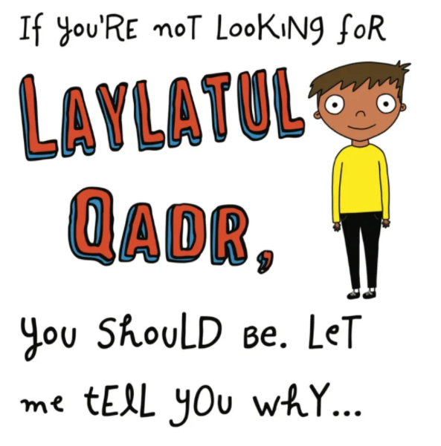
Image from Modestmanstuff.com

Slide 2
Laylat-al-Qadr
is a Ramadan gift from God to humanity!
It’s AMAZING!!!

Slide 3
So what is
Laylat-al-Qadr?

Slide 4
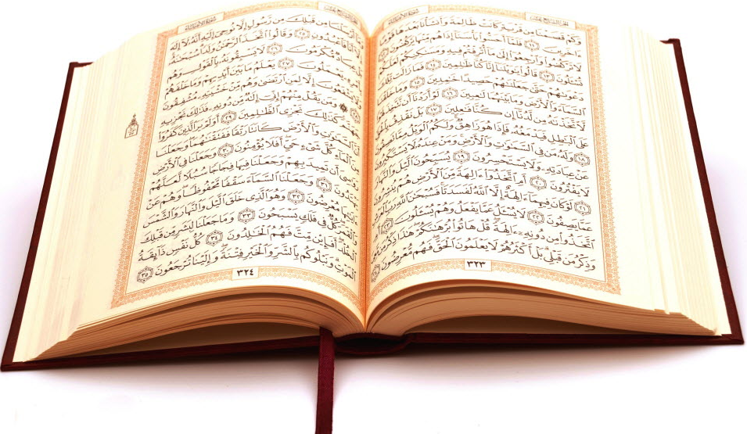
Let’s find out
What the Qur’an says about Laylat-al-Qadr.

Slide 5
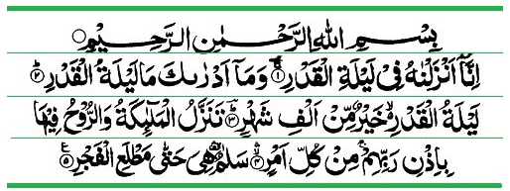
InshAllah, let’s read Surah Al Qadr
Chapter 97

Slide 6
InshAllah, let’s read the English translation
In the Name of God Most Gracious Most Merciful
Indeed We revealed it (the Qur’an) in the Night of Power.
And what can make you know what the Night of Power is?
The Night of Power is better than a thousand months.
The angels and the Spirit descend therein by permission of their Lord for every matter.
Peace until the coming of dawn.

Slide 7
We are told that the Qur’an was revealed during Laylat-al-Qadr. In English we call it the Night of Power.
The Qur’an was revealed over a period of 23 years. Can you remember the name of the angel who brought the first verses of the Qur’an to Prophet Muhammad, peace be upon him, when he was on the Mountain of Light
(Jabal Al Noor)?

Slide 8
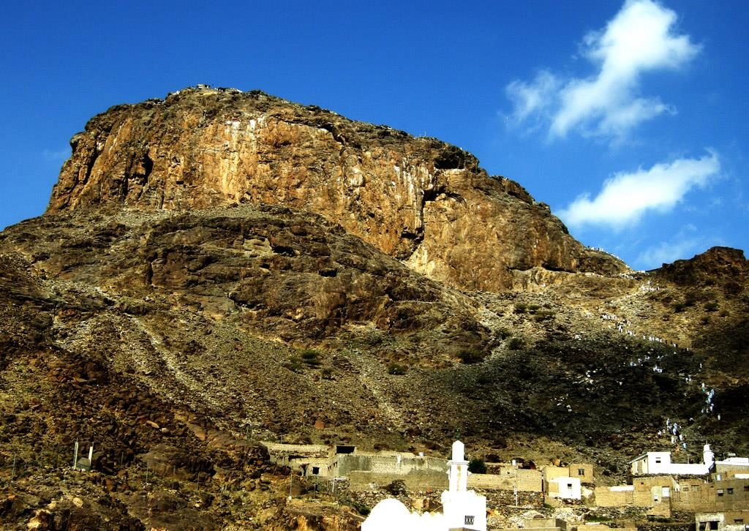
This is the Mountain of Light or Jabal An Nour. It is in Mecca. Angel Gabriel visited Prophet Muhammad here for the first time.
Angel Gabriel, peace be upon him, brought the Qur’an’s first verses on
Laylat-al-Qadr.

Slide 9
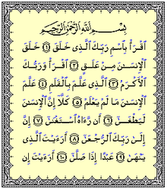
Do you know what the first word was that Angel Gabriel said to the Prophet, peace be upon him?

Slide 10
Iqra
In English iqra means read.
This word makes librarians smile ☺

Slide 11
What else does the Qur’an tell us about Laylat-al-Qadr?

Slide 12
The Qur’an tells us that Laylat-al-Qadr is better than a
1000 months!
Subhan Allah!

Slide 13
Laylat-al-Qadr is a night when Allah rewards the actions of believers as though they are done for 83 years.
Isn’t that amazing!

Slide 14
Do you know how many years are in a 1000 months?
Can you estimate?
1000 ÷ 12 =

Slide 15
1000 ÷ 12 = 83.33
There are 83 years and 4 months!
Alhamdulilah!
That’s a lifetime!

Slide 16
That means if we say alhamdulilah, subhan Allah, Allahu Akbar, one time we will get the reward as though we had said it for 1000 months!
Laylat-al-Qadr is a huge gift. We should do our best to be awake on the night so that we can get closer to Allah!

Slide 17
Verse 4: The angels and the Spirit (Angel Gabriel) descend therein by permission of their Lord for every matter.
The Qur’an also tells us that angels and Angel Gabriel, come to Earth during Laylat-al-Qadr!
Subhan Allah!
Isn’t that so spectacular!
Alhamdulilah!

Slide 18
According to a Hadith, more angels than grains of sand come to Earth for Laylat-al-Qadr. They fill every space! They surround us!

Slide 19
Laylat-al-Qadr commemorates the Qur’an. Angel Gabriel brought the Qur’an so it is fitting that Allah sends Gabriel on this night with all the other angels!

Slide 20
But what does Angel Gabriel and all the other angels do on Laylat-al-Qadr?
Verse 4: The angels and the Spirit descend therein by permission of their Lord for every matter.

Slide 21
But what does Angel Gabriel and all the other angels do on Laylat-al-Qadr?
Verse 4: The angels and the Spirit descend therein by permission of their Lord for every matter.

Slide 22
The angels visit those who are remembering Allah and say salaam, and do any job that Allah asks them to do.

Slide 23
With angels filling the Earth, and people remembering Allah, the Qur’an says there is peace until the dawn.

Slide 24
When is Laylat-al-Qadr?
Laylat-al-Qadr is in one of the last ten days of Ramadan.
It is said to be on one of the odd nights.

Slide 25
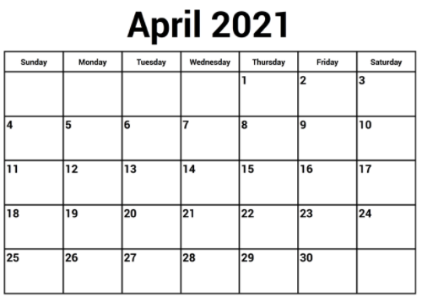
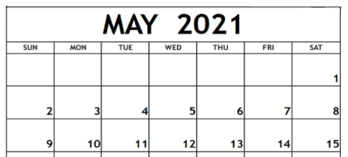
If Ramadan started on March 13, how many days did we fast until today?

Slide 26
What should we do on Laylat-al-Qadr?
A prayer in Laylat-al-Qadr is

Slide 27
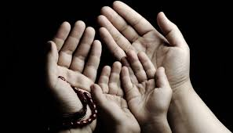
We can make dua. We can pray for many things.
We can pray for:
Ourselves
Our parents
Our families
Our community
Our world

Slide 28
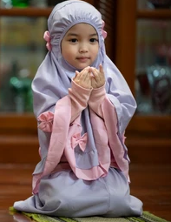
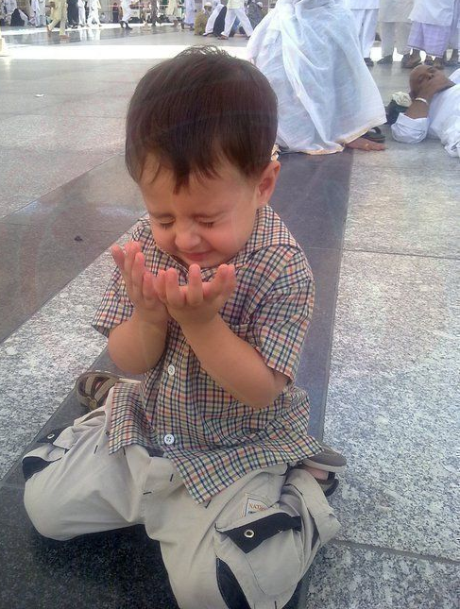
We can ask for forgiveness. We can say sorry.

Slide 29
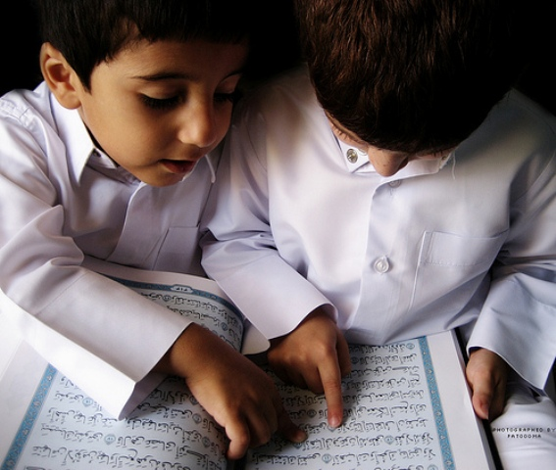
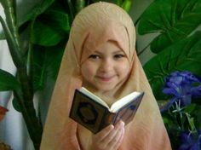
We can read Qur’an.

Slide 30
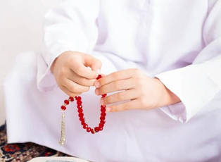
We can do dhikr, remember Allah, by saying these phrases.

Slide 31
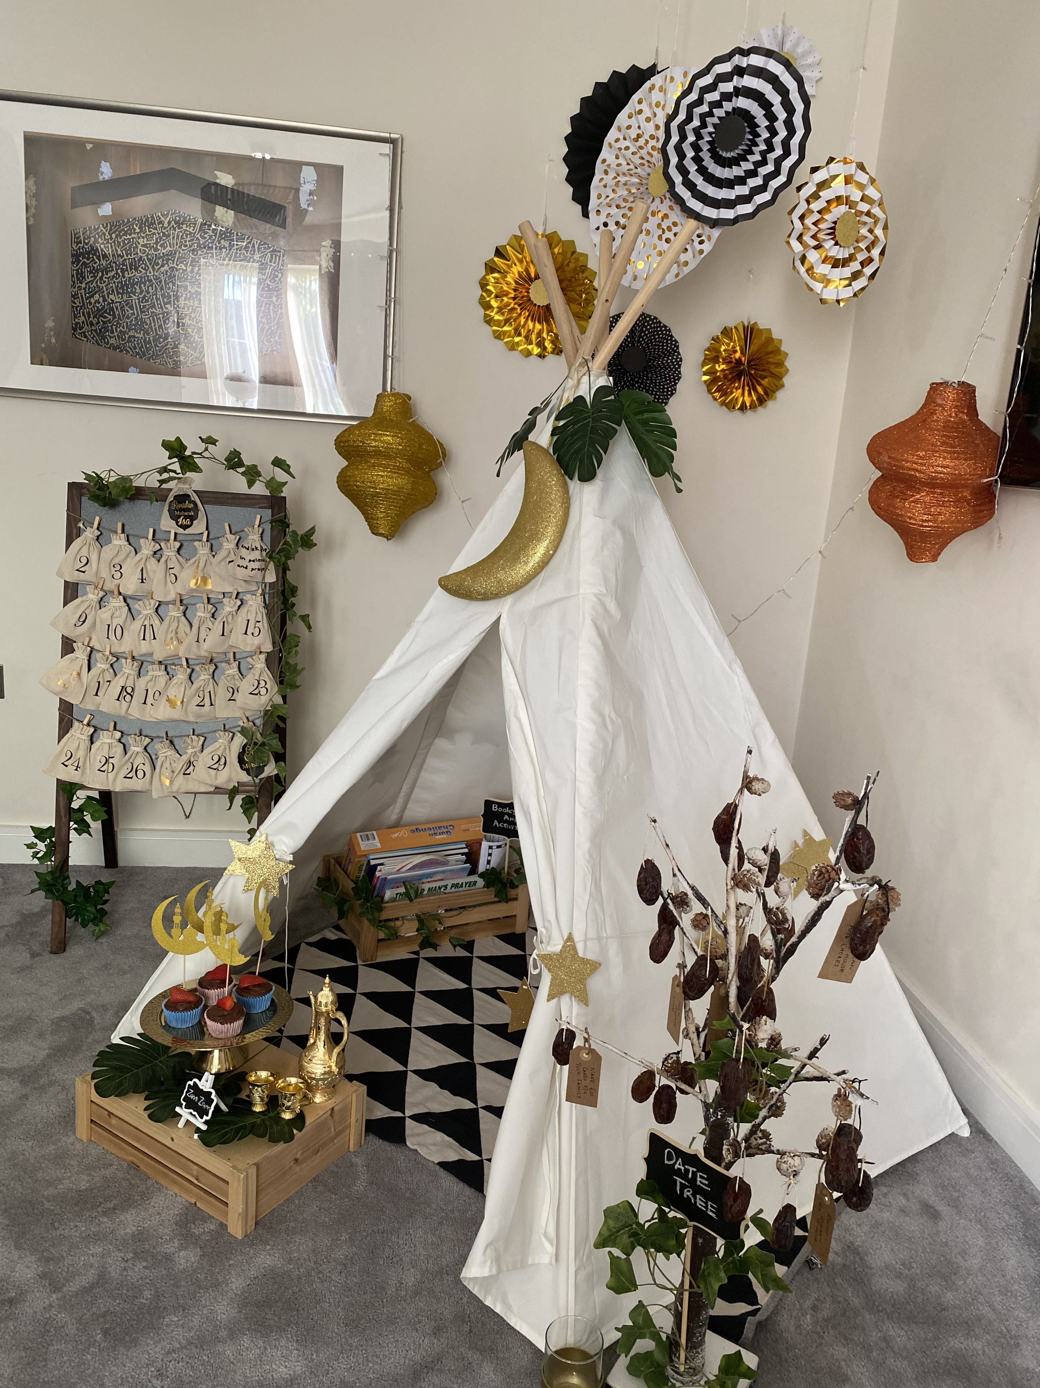
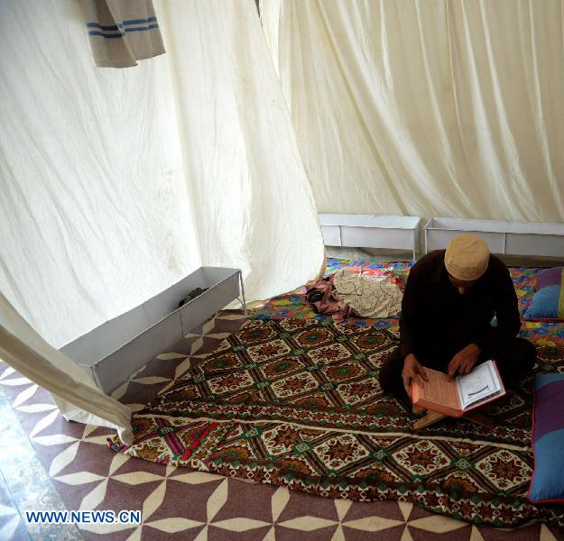
We can do itiqaf. That means we stay by ourselves and spend our time praising Allah.

Slide 32
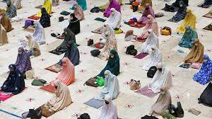
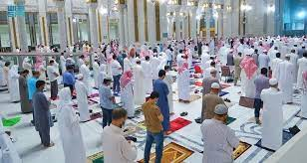
We can do tarawih.

Slide 33
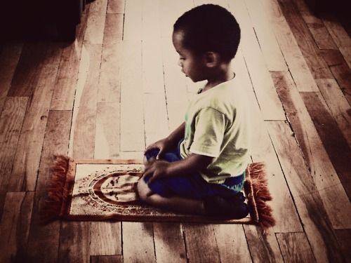
We can do extra salah.

Slide 34
We can help people around us.

Slide 35
We can help the poor by giving charity.

Slide 36
We can

Slide 37
We can say this dua
Allahumma inaka afuwwun tuhibbul afwa fa fu annee.

Slide 38
InshAllah, you find Laylat-al-Qadr. It is God’s greatest gift to us all! InshAllah the first night begins on
……. 12:00 Midnight!
Wishing you all a blessed Laylat-al-Qadr!
Salaam!

