Slide 1
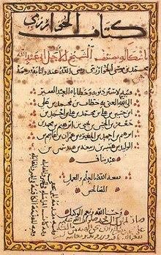
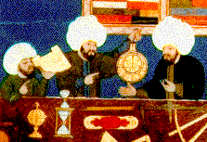
Great Islamic thinkers/inventors
15 OF THE MOST GREATEST THINKERS WHO EVER LIVED.
BY: Abdullah Saeed

Slide 2
Jabir ibn Haiyan --- chemist & pharmacist
The father of Arab chemistry known for his highly influential work on alchemy and metallurgy
His life was from 722 to 804 AD

Slide 3
Muhammad ibn musa al Khwarizmi – mathematician
His works introduced Arabic numerals and the concept of algebra into European mathematics
His life was from 780 to 850
AD

Slide 4
Muhammad ibn musa al Khwarizmi – mathematician (2)
“algebra was derived from the name of his book “al-jabr” and algorithm was derived from his name al Khwarizmi with out algorithms you wouldn't be watching this on your tv; thank you al –Khwarizmi.

Slide 5
Ibn Ishaq al kindi – philosopher & scientist
Arab philosopher and scientist, who is known as the first of the Muslim philosophers
His life was from 801 to 873 AD

Slide 6
Thabit ibn qurra –physician & astronomer & mathematician
A Arab mathematician, physician and astronomer; who was the first reformer of the Ptolemaic system and the founder of statics
His life was from 826 to 901 AD

Slide 7
Al Battani – mathematician & scientist & astronomer
Arab mathematician, scientist and astronomer who greatly improved existing values for the length of the year and of the season
His life was from 858 to 929 AD

Slide 8
Abu-Bakr al razi – alchemist & physician
A Persian alchemist and philosopher, who was one of the greatest physicians in history
His life was from 865 to 925 AD

Slide 9
Abu Nasr al farabi – scientist & philosopher
Arab scientist and philosopher considered as one of the preeminent thinkers of the medieval era
His life was from 872 to 950 AD

Slide 10
Ibn al Haytham – astronomer & mathematician
Arab astronomer and mathematician known for his incredible contributions to the principals of optics and the use of scientific experiments.
His life was from 950 to 1040 AD

Slide 11
Ibn al Haytham – astronomer & mathematician
Arab astronomer and mathematician known for his incredible contributions to the principals of optics and the use of scientific experiments. The word ”camera” is from Arabic.

Slide 12
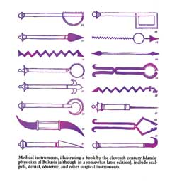
Ibn Sina – doctor & philosopher & scientist
Persian philosopher ,scientist and doctor known for his contributions to artistolian philosophy and medicine. He made most of the modern tools for surgery including the scalpel.
His life was from 980 to 1037 AD

Slide 13
Omar Khayyam – astronomer & poet & mathematician & scientist
Persian astronomer, poet, mathematician and scientist known for his scientific achievements and for his “rubihats”
His life was from 1048 to 1131 AD

Slide 14
Ibn Zuhr – physician & surgeon
Arabic physician and surgeon known for his influential book al-tafsir fil mudawatwal tadbeer
His life was from 1091 to 1161 AD

Slide 15
Ibn rushd –philosopher & scholar
Arab philosopher and scholar who produced a series of summaries and commentaries on most of Aristotle's works and on Plato's republic
His life was from 1126 to 1198 AD

Slide 16
Ibn al baitar – botanist & physician
Botanist and physician who systematically recorded the discovers made by Islamic physicians in the middle ages
His life was from 1197 to 1248 AD

Slide 17
Ibn Battuta – traveler & scholar
Arab traveller and scholar who wrote one of the most famous travel books in history, the rihlah.
His life was from 1304 to 1369 AD

Slide 18
Ibn khaldun – philosopher & historian
He developed one of the earliest non religious philosophies of history. He structured what is now modern historiography sociology and economics
His life was from 1332 to 1406 AD

Slide 19
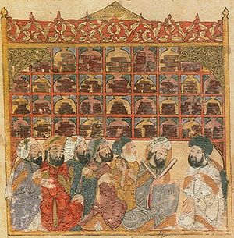
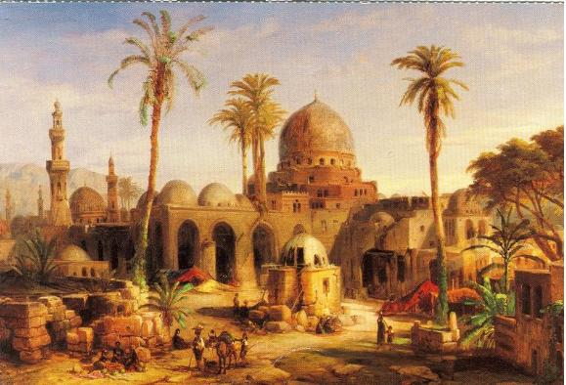
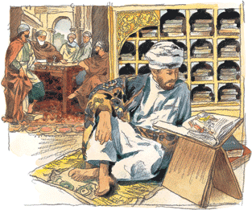
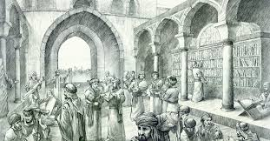
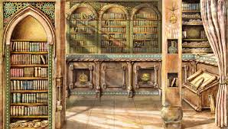
Reflecting
We should feel proud about the intelligent men on this list; that they were on the straight path; may Allah accept all their efforts

Slide 20
THE END!
I HOPE YOU BENEFITED FROM THIS PRESENTATION

