Slide 2
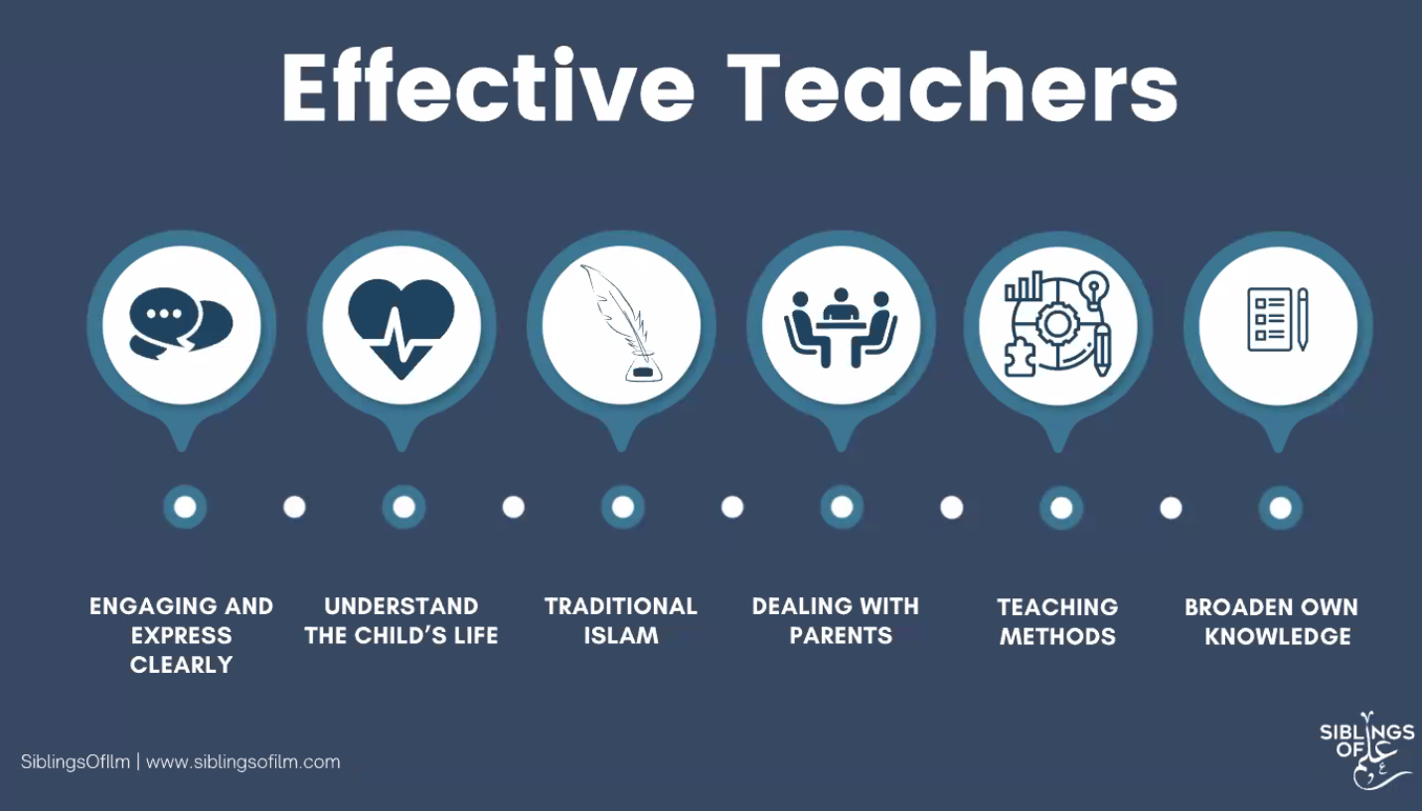
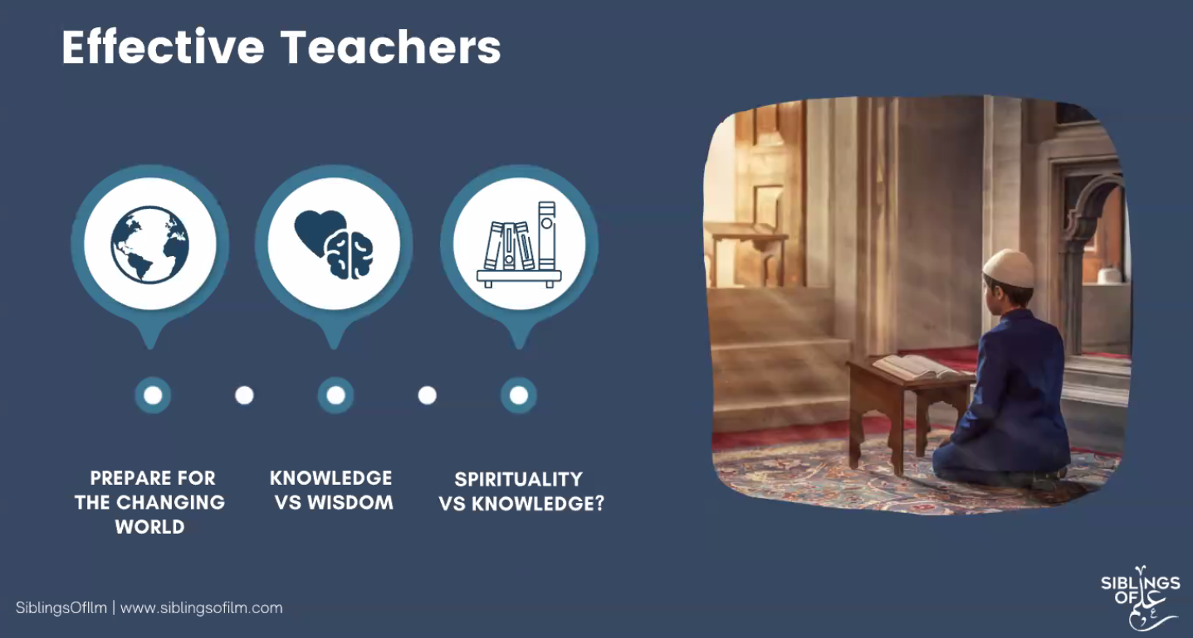
Effective Teachers:
Combine their understanding of Islam with living in the contemporary world.
Implement holistic teaching methods
Accept and appreciate that a child’s upbringing is very different to their own (esp. with children being born into a technological era).
Understand that wisdom is a far broader topic than knowledge.
“For one tonne of knowledge, a person needs ten tonnes of wisdom.”
Know that the Prophet SAW came with wisdom and spirituality (hand in hand), therefore as teachers, we need to teach the wider awareness of Allah and help to build their connection to Him.
The longest war that has been fought is that of Shaytaan vs Mankind and so we need to encourage and guide with wisdom.
Ensure that we are sensitive in the way that we deliver our sessions to our pupils.

Slide 3
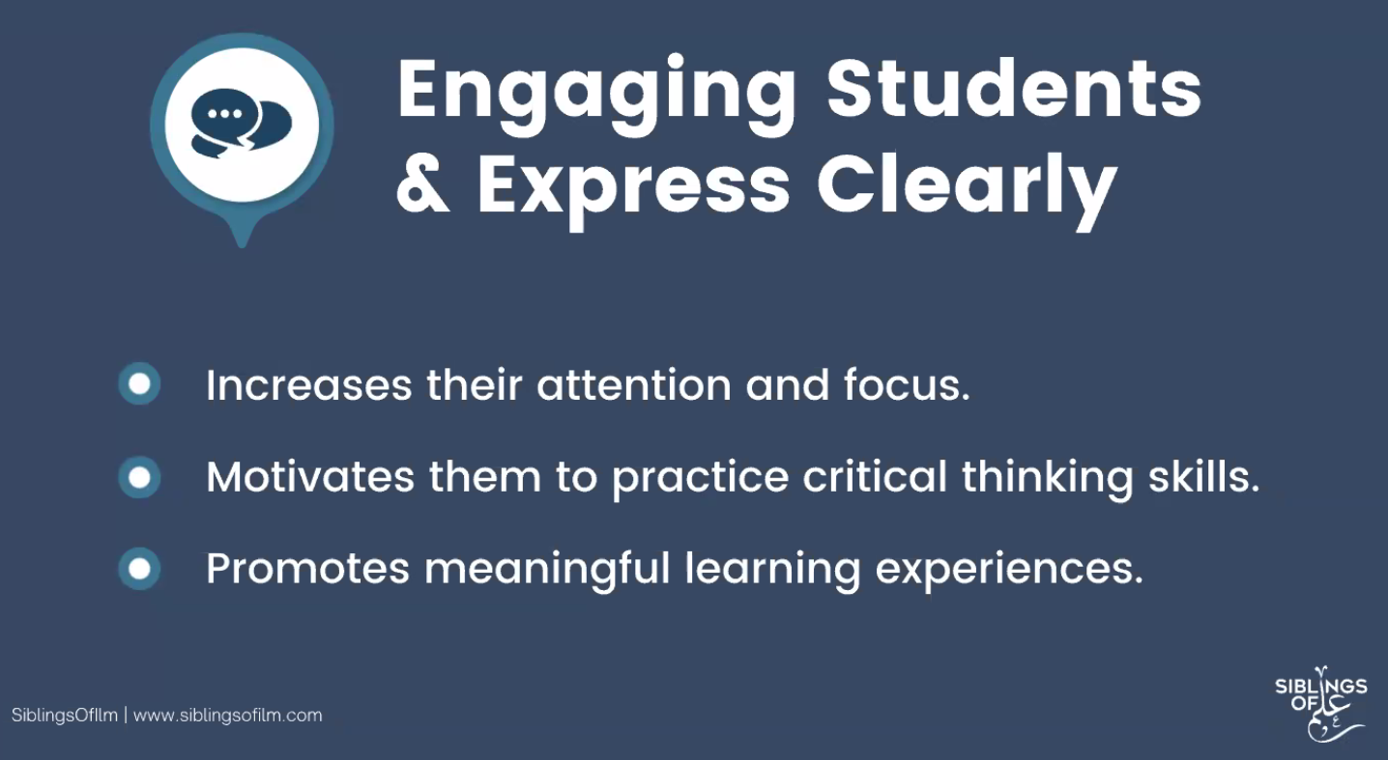
Engaging Students and Clear Expression:
Increases focus and attention –
- What age group are you teaching?
- What levels of ability are present?
Hadith of the Prophet SAW: “Speak to people according to their level.” i.e. according to their level of comprehension and intellect.
Ensuring that our own vocabulary is correct, learning to articulate ourselves properly depending on the age group we are teaching.
Occasionally allow yourself to be informal with them and use language/phrases they would use. It shows that you are attentive to their interests and are willing to get to their level.
Use analogies of things they are interested in to explain Islamic concepts e.g. sports, games.
Engage them in what they engage in.
Motivate students to practice and engage in Critical thinking Skills-
Students now are asking increasingly difficult questions
Cover what is in the syllabus but set aside time to get into their world.
Hadith about the man who asked permission to commit Zina, Nabi SAW responded with compassion and invited him to think critically.
Allow them to ask questions
Never make students feel small for having asked
Remember that the most challenging students in the classroom are the greatest leaders, and so, they are the ones we need to focus on.
Either they can be the leaders of Islam or the leaders of the Streets.
The most outspoken and courageous ones are the ones we need to give the most attention to.
If you allow yourself to be on their level, they will return to you; Keep the doors of communication open.

Slide 4
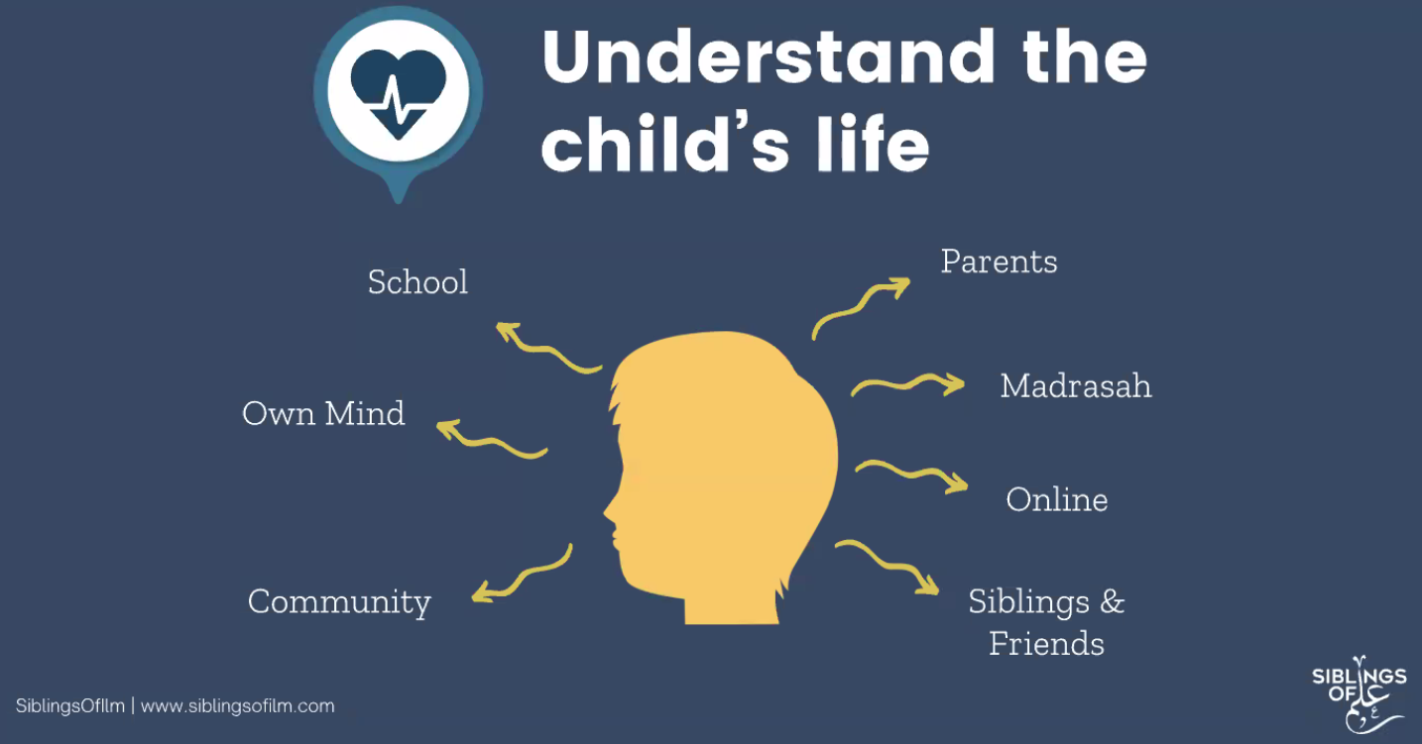
Understand the Child’s Life:
Parents:
What are the parents like? Do they practice Islam? What is their Tarbiyyah like?
Do not see the child’s education as ‘endgame’ by 12. This is the most pivotal age of a child so as much as you can, keep them in the Madrassah setting.
One of the biggest failures is when teachers fail to plan their lessons and instead end up delivering a Bayaan – students know when you are waffling!
Eye contact needs to be with children so phones and gadgets should be put away
Aim to have lessons where they are fully engaged and enjoy what is being taught.
Teach with love
Understand the background of your children e.g if your students are refugees, then they may have just come from a war-torn country..don’t label everything as misbehaviour
Enable students from all diversities and backgrounds to attend the Madrassah
If you are not ready for a challenge – then you won’t get the best out of your children.
Madrassah:
If the rules of the Madrassah/Class are strict, then you will get resentment from the pupils.
If they are too lenient, then the students will have it too easy.
Aim for fairness and balance WITHOUT any favouritism.

Slide 5
Understand the Child’s Life:
Online:
Kids have a life online, whether that’s on social media or their gaming devices.
We need to appreciate that they live in a tech world
When/If you see a child not engaging, befriend them.
The core things we need to teach: Love for the Masjid, Love for their teachers
“Never underestimate your power as a teacher.”
Treat them with dignity and you’ll have an impact for life.
Community
Own mind
Their own minds are a unique experience
A lot of children end up having a resentment for Islam because of the way that culture is forced into their upbringing
Never lie to your students
The litmus test is the next time you meet your students, do they run away or do they greet you?

Slide 6
Traditional Islam:
Don’t make Islam all about do’s and don’ts – because otherwise they will see Islam as the problem
Give reasons for why things aren’t permitted
Children in today’s world are moulded to ask questions
Ensure that you have a reward system in place

Slide 7
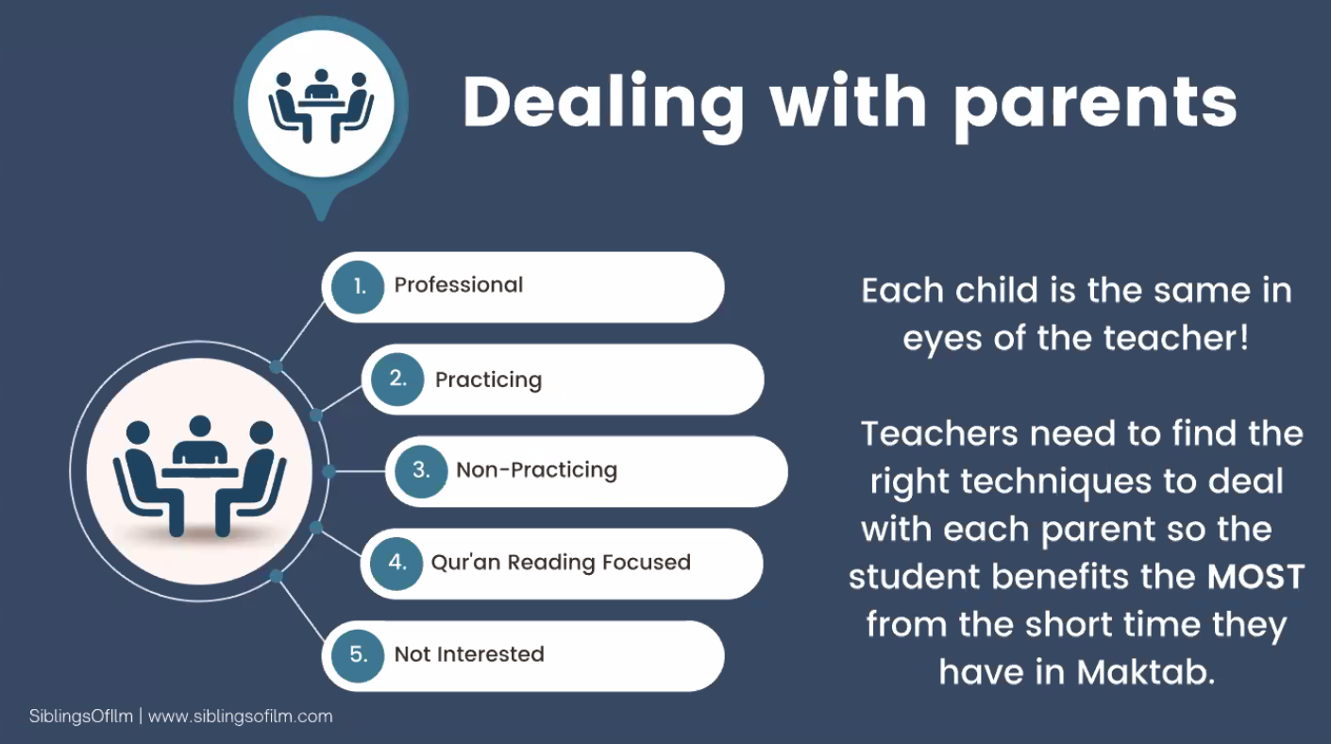
Dealing with parents:
Know that the child who is not paying attention, is the one who needs the most attention
Each child should be equal in the eyes of the teacher.
Think of the teachers you loved during your own studies and the ones you didn’t. Why?
The main reason why people love their teachers, is rarely because of their intellect, but because they have taught with kindness, love, mercy and compassion.
What are your students going to remember YOU for?
Give your pupils a blank piece of paper (or get them to type it out): Ask them to write down feedback of what they make of your teaching style, whether good or bad.
You cannot escape them because it is your mirror.
Parental engagement:
Teachers need to find the right techniques to deal with each of their child’s parents, so that they can benefit the most from the time they have in Madrassah.

Slide 8
Teaching Methods:
Know that when we engage in setting/role, there is our way and the Prophetic way.
If our way is not in accordance to the teachings of Nabi SAW then it will be problematic
Know that if a child has rectified themselves, then we should not bring up the past.

Slide 9
Broaden your own knowledge:
Read beyond the subject matter

Slide 11
Knowledge vs Spirituality:
Hikmah gives you acumen – Broadens you
Understand the context of that which you are teaching
Knowing when and when not – without compromising our Deen
Develop a real human connection with your students so that they can understand fully Sabr, Tawakkul etc.

Slide 12
https://www.youtube.com/user/SafarAcademyOnline
https://resources.safarpublications.org/

