Slide 1
NUSRAT UL ISLAM MASJID & EDUCATION CENTRE
QURBANI
COURSE STARTING
SOON (8:40PM) INSHA-ALLAH
A walk-through of the wisdom and rulings related to Qurbani

Slide 2
NUSRAT UL ISLAM MASJID
& EDUCATION CENTRE
QURBANI
A walk-through of the wisdom and rulings related to Qurbani

Slide 3
“THERE ARE NO DAYS ON WHICH RIGHTEOUS DEEDS ARE MORE BELOVED TO ALLAH THAN THESE TEN DAYS."
(BUKHARI)
QURBANI
A walk-through of the wisdom and rulings related to Qurbani

Slide 4
مَن فاته القيام بعرفة فلْيقُم للهِ بحقه الذي عرَفه
ومن عجز عن المبيت بمزدلفة فليبت عزمُه على طاعة الله وقد قربه وأزلفه
ومن لم يقدر على نحر هديه بمنى فليذبح هواه هنا فقد بلغ المنى
ومن لم يصِل إلى البيت لأنه منه بعيد فليقصد رب البيت فإنه أقرب إلى من دعاه من حبل الوريد
QURBANI
A walk-through of the wisdom and rulings related to Qurbani

Slide 5
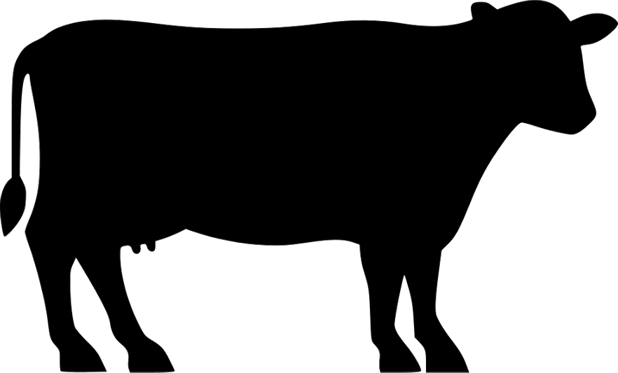
Part 1: A Walk-through Qurbani
The Meaning of Qurbani, Udhiyyah and Nahr
Qurbani in the Qur'an & Sunnah
The Purpose & Wisdom behind Qurbani
Virtues of Qurbani
The Etiquettes of Qurbani

Slide 6
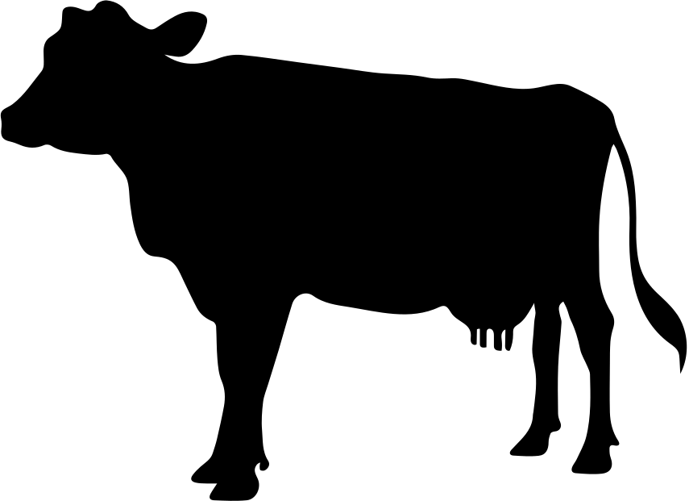
Part 2: The Rulings Pertaining to Qurbani
Upon Whom is Qurbani Compulsory?
What is Nisab?
The Time of Qurbani
Qurbani on Behalf of Others
The Qurbani Animal
FAQ

Slide 7
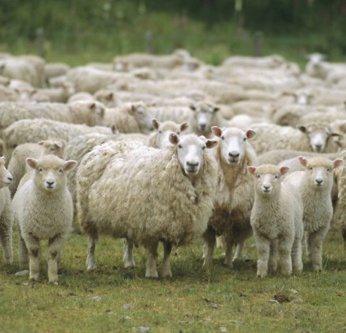
THE MEANING OF QURBANI, UDHIYYAH AND NAHR
The Urdu and Persian word Qurbani (Sacrificial slaughter) is derived from the Arabic word Qurban.
Lexical Definition: An act performed to seek Allah’s pleasure.
Religious Definition: The sacrifice of an animal slaughtered for the sake of Allah.

Slide 8
Qurbani
Quran ~
~ Sunnah
عن مخنف بن سليم قال النبي صلى الله عليه وسلم: على أَهلِ كلِّ بيتٍ أُضحيَةٌ رواه ابن حجر العسقلاني، في فتح الباري
عن أبي هريرة رفعه: من وجد سعة فلم يضح فلا يقربن مصلانا أخرجه ابن ماجه وأحمد
عن البَرَاءِ رَضِيَ اللهُ عنه: قال: قال النبيُّ صلَّى اللهُ عليه وسلَّم: مَن ذبَحَ قبل الصَّلاةِ فإنَّما يذبحُ لنَفْسِه، ومَن ذَبَحَ بعد الصَّلاةِ فقد تَمَّ نسُكُه وأصاب سُنَّةَ المُسْلمينَ
فَصَلِّ لِرَبِّكَ وَانْحَرْ
[الكوثر:2]
قُلْ إِنَّ صَلَاتِي وَنُسُكِي وَمَحْيَايَ وَمَمَاتِي لِلَّهِ رَبِّ الْعَالَمِينَ * لَا شَرِيكَ لَهُ [الأنعام:162-163]
وَلِكُلِّ أُمَّةٍ جَعَلْنَا مَنْسَكًا لِيَذْكُرُوا اسْمَ اللَّهِ عَلَى مَا رَزَقَهُمْ مِنْ بَهِيمَةِ الْأَنْعَامِ فَإِلَهُكُمْ إِلَهٌ وَاحِدٌ فَلَهُ أَسْلِمُوا وَبَشِّرِ الْمُخْبِتِينَ
[الحج:34]

Slide 9
The Purpose & Wisdom behind Qurbani
TO COMMEMORATE THE ULTIMATE SACRIFICE OF PROPHET IBRAHIM (A.S)
DISTANCING ONESELF FROM THE DESIRES OF THIS WORLD
DEMONSTRATION OF TOTAL SUBMISSION TO ALLAH
ENCOURAGES SOCIAL UNITY
DISPLAYING SABR UPON OBEDIENCE
DISPLAYING AND HONOURING THE SYMBOL OF ALLAH

Slide 10
Virtues of Qurbani
عن زيد بن أرقم قال: قال أصحاب رسول الله صلى الله عليه وسلم: يا رسول الله، ما هذه الأضاحي؟ قال: سنة أبيكم إبراهيم عليه الصلاة والسلام، قالوا: فما لنا فيها يا رسول الله؟ قال: بكل شعرة حسنة، قالوا: فالصّوف يا رسول الله؟ قال: بكل شعرة من الصوف حسنة
رواه الإمام أحمد وابن ماجه
عن عائشة رضي الله عنها أن رسول الله صلى الله عليه وسلم قال: ما عمل آدمي من عمل يوم النّحر أحبُّ إلى الله من إهراق الدّم، إنّها لتأتي يوم القيامة بقرونها وأشعارها وأظلافها، وأن الدم ليقع من الله بمكان قبل أن يقع من الأرض، فطيبوا بها نفسا
رواه الترمذي

Slide 11
The Etiquette of Qurbani
To slaughter the Qurbani animal yourself (if you are able to do so)
To witness the Qurbani
To make intention at the time of purchase/slaughter
To ensure that the knife has already been sharpened before bringing the animal to the place of slaughter
Lay the animal down on its left side with the face towards qiblah. The slaughterer can place his foot on the flank of the animal to keep it still
الهم منك واليك - بسم الله الله اكبر
Once the animal is down, the slaughterer will recite the following dua’s:
انّي وجهتُ وجهي للذي فطر السماوات والأرض حنيفا وما انا من المشركين
The animal should be left a while before skinning. When all life has gone out of the animal only then should the skinning process begin
It is not permissible to slaughter one animal in front of another

Slide 12
PART 2
THE RULINGS PERTAINING TO QURBANI
MUFTI DILWAR
QURBANI
A walk-through of the wisdom and rulings related to Qurbani

Slide 13
Part 2: The Rulings Pertaining to Qurbani
Upon Whom is Qurbani Compulsory?
What is Nisab?
The Time of Qurbani
Qurbani on Behalf of Others
The Qurbani Animal
FAQ

Slide 14
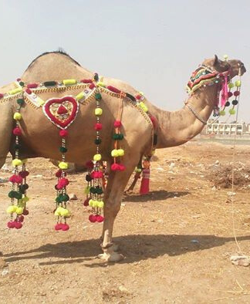
Upon Whom is Qurbani Compulsory?
Qurbani is compulsory upon every:
Muslim
Sane
Mature
Resident
Male or Female
Owns the Nisab during the days of Udhiyah.

Slide 15
WHAT IS NISAB?
The amount stipulated by Shari'ah is:
87.48g of gold; or
612.36g of silver; or
any other form of wealth that is
equivalent to value of above silver.

Slide 16
NISAB: DIFFERENT TO ZAKAT
• Wealth includes anything that is beyond one’s basic need.
- Clothes
- Properties
- Cars
- Household Utensils.
The individual does not need to possess this wealth for an entire year.

Slide 17
WHEN DO I PERFORM QURBANI?
During the days of Eid al-Adha.
12TH DHUL HIJJAH
BEFORE SUNSET
10TH DHUL HIJJAH
AFTER EID PRAYER

Slide 18
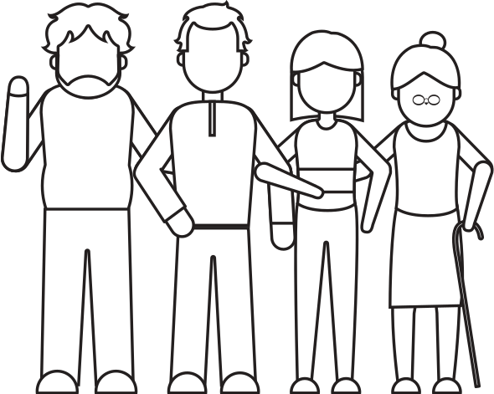
CARRYING OUT ON BEHALF OF FAMILY
Spouse and mature children are responsible for their own Qurbani, if they meet the criteria.
However, husband/father may carry out the Qurbani on their behalf (with their knowledge and approval)

Slide 19
QURBANI ANIMAL
SHEEP, GOAT, RAM
AT LEAST
ONE YEAR OLD
COW, BULL, BUFFALO
AT LEAST
TWO YEARS OLD
CAMEL
AT LEAST
FIVE YEARS OLD
FULFILS ONE PERSON'S OBLIGATION
FULFILS UPTO
SEVEN PEOPLE'S OBLIGATION

Slide 20
THE MEAT
It is Sunnah to divide the meat into
three portions:
oneself
family & friends
poor
• It can be given to Non-Muslims.

Slide 21
FAQ
Giving the value to charity
- It is NOT permissible to give the value in charity.
Qurbani must be carried out.
Making up for previous years
- The value of a Qurbani animal should be given in charity for each year that it was missed..
- A Qurbani animal cannot be slaughtered for each year.

Slide 22
Q & A
ASKMUFTI@COMPASSGUIDANCE.CO.UK
QURBANI
A walk-through of the wisdom and rulings related to Qurbani

