Slide 1
15th Night of Sha'ban
Nusrat ul Islam Masjid & Education Centre

Slide 2
CONTENT
Significance of Sha'ban
Virtues of the 15th Night of Sha'ban
Things to do on this special night
Things not to do on this night
When is this night?
PITT STREET | OLDHAM | OL4 1AL

Slide 3
Significance of Sha'ban
The Prophet (saw) said, ‘Rajab is the month of Allah, Sha’ban is my month and Ramadan is the month of my Ummah’. (As-Suyuti)
This means that we should be making an effort to draw closer to the Prophet (saw) during this month. We can do this by learning more about his Seerah, and increasing our knowledge of topics like the du’as he loved, the foods he ate, and is by following his Sunnah.
Sha'ban: The Month of the Beloved

Slide 4
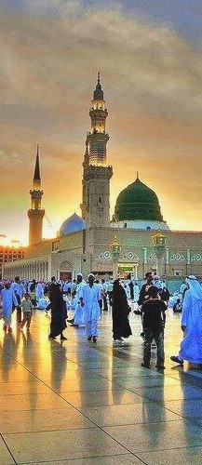
15th Night of Sha'ban
This night occurs between the 14th and 15th day of Sha’ban. In the Hadith this night is mentioned as:
لَيْلَةٌ النِّصْفِ مِنْ شَعْبَان
In our community, it is known as:
شب برائت
Shab means night and Bara'at means freedom.

Slide 5
Virtues of the 15th Night of Sha'ban
“Allah Almighty descends (in a manner He best knows it) in the night occurring in the middle of Sha’ban and forgives a large number of people more than the number of the fibers on the sheep of the tribe, Kalb.”
Ummul-Mu’mineen ‘Aishah, Radi-Allahu anha, is reported to have said, “Once Prophet Muhammad, Sall-Allahu alayhi wa sallam, performed the Salah of the night (Tahajjud) and made a very long Sajdah until I feared that he had passed away. When I saw this, I rose (from my bed) and moved his thumb (to ascertain whether he is alive). The thumb moved, and I returned (to my place). Then I heard him saying in Sajdah: ‘I seek refuge of Your forgiveness from Your punishment, and I seek refuge of Your pleasure from Your annoyance, and I seek Your refuge from Yourself. I cannot praise You as fully as You deserve. You are exactly as You have defined Yourself.’ Thereafter, when he raised his head from Sajdah and finished his salah, he said to me: ‘Aishah, did you think that the Prophet has betrayed you?’ I said, ‘No, O Prophet of Allah, but I was afraid that your soul has been taken away because your Sajdah was very long.’ He asked me, ‘Do you know which night is this?’ I said, ‘Allah and His Messenger know best.’ He said, ‘This is the night of the half of Sha’ban. Allah Almighty looks upon His slaves in this night and forgives those who seek forgiveness and bestows His mercy upon those who pray for mercy but keeps those who have malice (against a Muslim) as they were before, (and does not forgive them unless they relieve themselves from malice).
“Allah Almighty looks upon all those created by Him in the middle Night of Sha’ban and forgives all those created by Him, except the one who associates partners with Him or the one who has malice in his heart”.
MAKE THE MOST OUT OF THIS NIGHT

Slide 6
Things to do on this special night
Ensure you perform all your Salaah that fall on this night
Forgive all those that have wronged you
Engage in Nafl Ibaadath and make a lot of Dhikr
Make sincere Taubah by begging and crying for Allah's forgiveness
Remove all malice and hatred from the heart
Abstain from the usage of social media as it will waste your night
Recite the Qur'an shareef, Surah Mulk, Surah Sajdah and Waqia
Make lots of Duas
REMEMBER - THE NIGHT ONLY COMES ONCE A YEAR

Slide 7
Things to Refrain from
Refrain from innovations, such as cooking sweet dishes, lighting up your house thinking the souls will come and lighting up the graveyard.
Non of these acts are from the teachings of our Beloved Nabi sallallahu alaihi wasallam

Slide 8
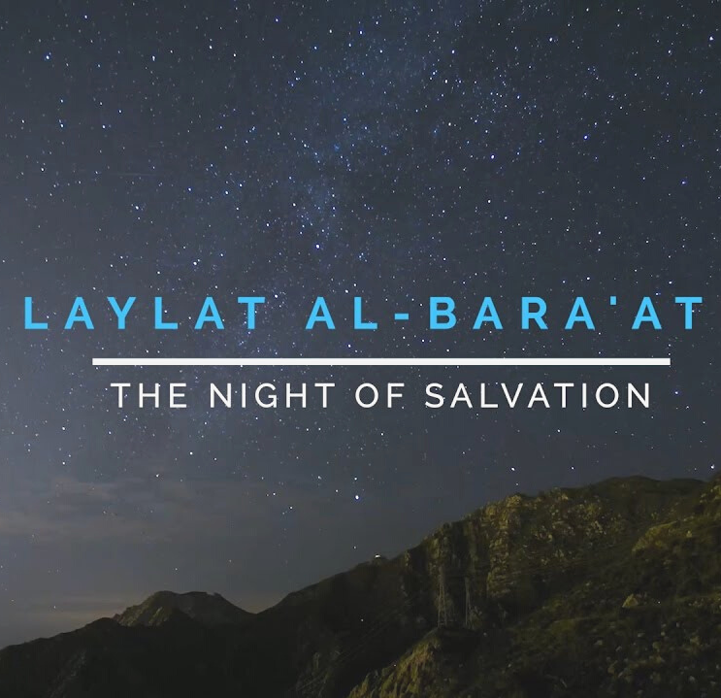
Fasting on the 15th of Sha'ban
There is no harm in fasting on the 15th day of Sha'ban, however we should bear in mind that specically fasting on this day is not a sunnah of our Beloved.

Slide 9
When is this night?
This Wednesday is the 14th of Sha'ban
The Islamic calendar doesnt change after mid-night, rather it changes after Maghrib
Therefore this special night will fall on Wednesday after Maghrib Salah
DON'T FORGET TO KEEP US IN YOUR DUAS

