Slide 1
Shaitan
Our Enemy
Amal Haque/Momin Kids/Happy Land

Slide 2
Who is Shaitan?
Shaitan is not our friend
He tells us to do bad things, like telling lies or disrespecting our parents.
If we do these bad things we will not go to Jannah (Paradise)
Amal Haque/Momin Kids/Happy Land

Slide 3
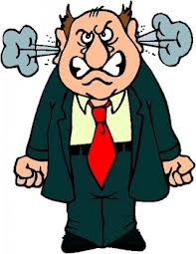
He whispers in our mind.
We cannot see him but he can see us.
Sometimes he will make our friends tell us to do bad things!
Amal Haque/Momin Kids/Happy Land

Slide 4
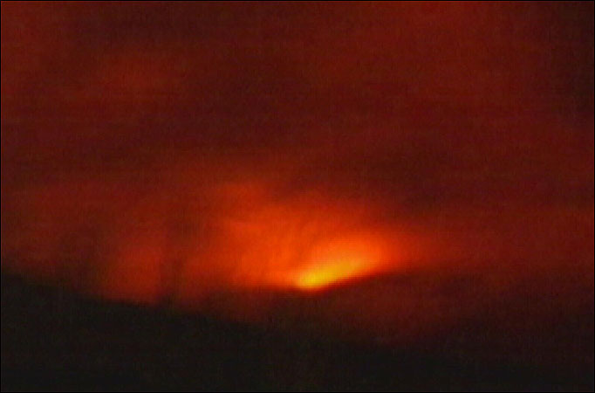
We should ignore these thoughts and Allah will be happy with us. We should always try and do good things.
All the bad things we do it is because of Shaitan
Amal Haque/Momin Kids/Happy Land

Slide 5
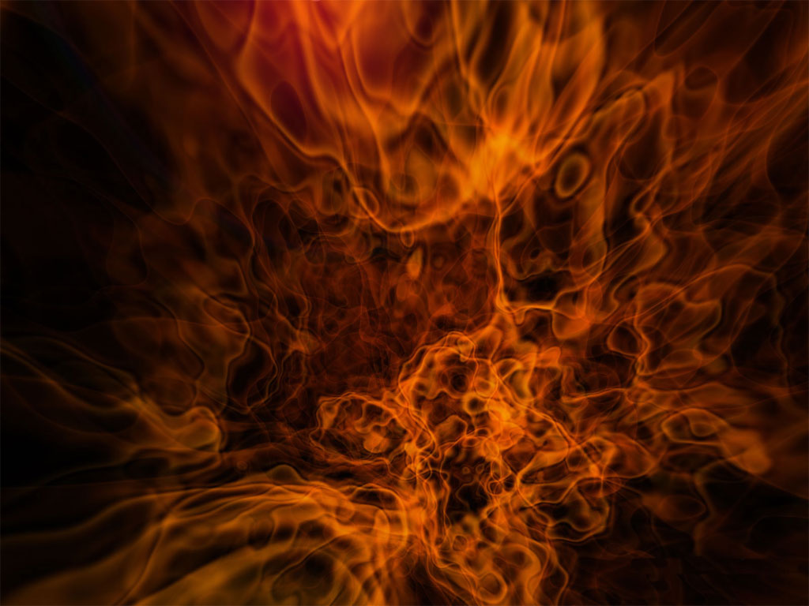
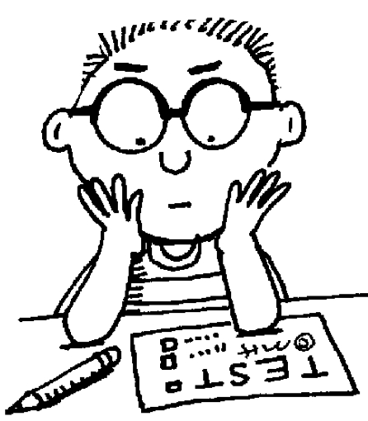
Allah has made angles out of light and Shaitan out of fire!
Allah (SWT) has made shaitan to test us to see if we our good Muslims.
Amal Haque/Momin Kids/Happy Land

Slide 6
When any bad idea comes in our mind we should say:
A udhu billahi minash shaitanir rajim
Amal Haque/Momin Kids/Happy Land

