Slide 1
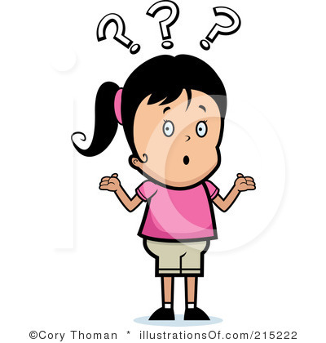
Who is Allah?
Notes:
Now tell me who is allah?

Slide 2
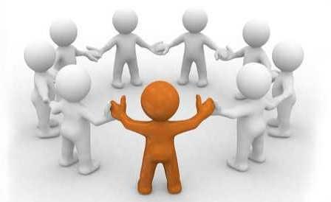
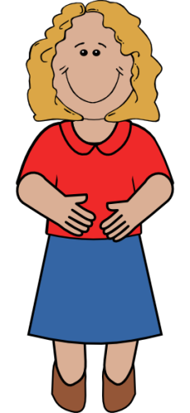
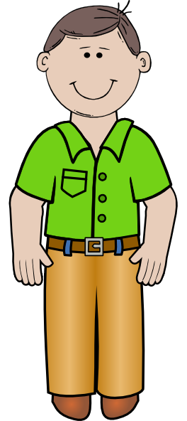
No Partners
No helpers
He doesn’t need anyone
No Mum or Dad
No children or wife
Not a girl or a boy
Notes:
We say He because in Arabic there is no other word to describe Allah, but that doesn’t mean Allah is a man. Allah is nothing like us, He is special, and no body is like Allah. He knows everything! And He sees everything, he is know what we are doing right now, and he also knows what we are thinking all the time.

Slide 3
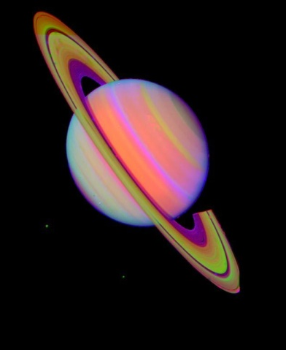
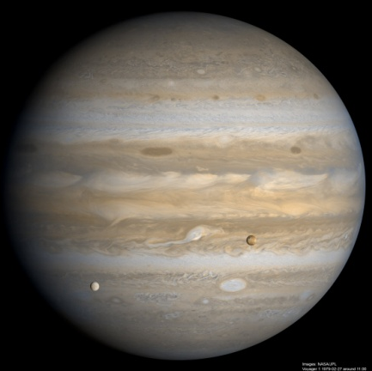
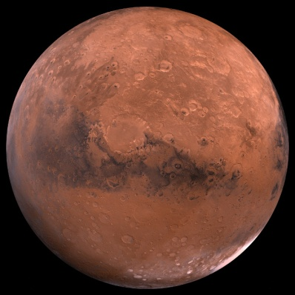
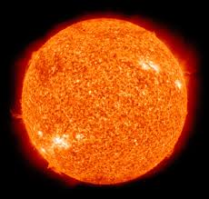
Notes:
Allah Has created everything! The earth and the planets.

Slide 4
HE IS OUR GOD
Notes:
He is our God because He has created us and everything else. He has given us sooooo much.

Slide 5
Allah Sub-hana-wata-aala
Notes:
We say this after we say Allah’s name because He is the most great and he deserves our praise.

