Slide 1
What is the Quran?

Slide 2
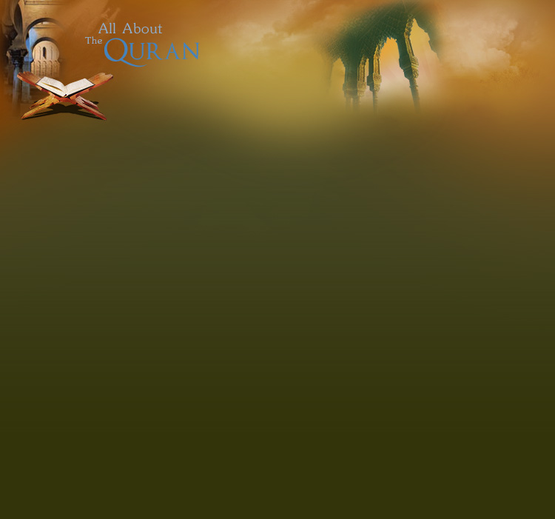
The Quran is a book of Allah (SWT)
Allah (SWT) sent the book to Muhammad
(Sallallah hu alayhi wasalam)
So Muhammad (sw) could teach it to us ☺
Notes:
Tell the children that we MUST say sallahualayhiwasalam after hearing the prophets name!

Slide 3
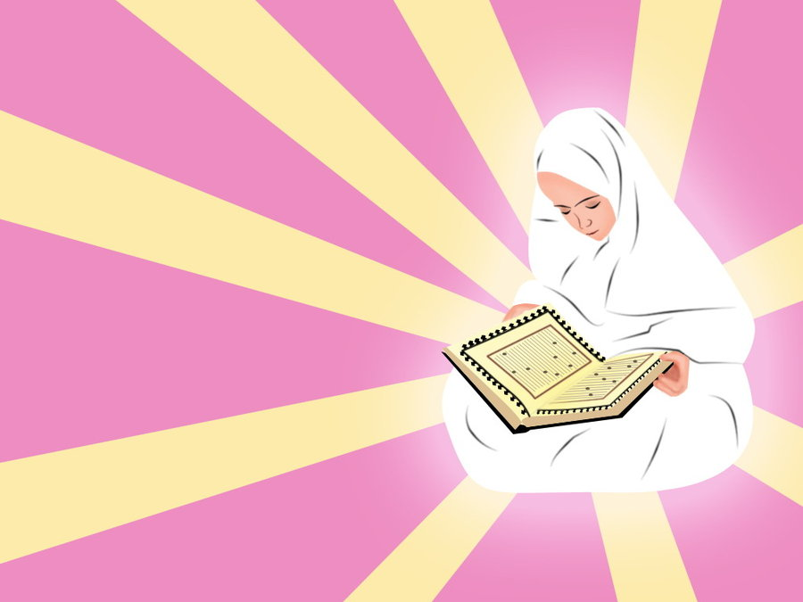
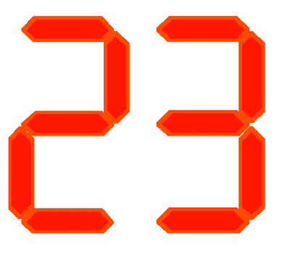
Angle Jibraeel brought the Quran to Muhammad (sallallah hu alayhi wasalam)
Jibraeel bought it to Mumammad (sw) part by part.
It took 23 years to complete the Quran
Notes:
Tell the children that Allah (swt) sent his angle to send the Quran to Muhammad. Role play this with them.
Tell 2 children to stand, give one of them a message eg ‘we should be good to our mums and dads’, tell that child to tell the second child the EXACT message (inform them that the angle wouldn’t get the message wrong because they are perfect ie, don’t make mistakes), then tell the child to tell the message to the class.

Slide 4
The Quran we read today is the same as is came to Mumammah (sw) years and years ago.
Not a single word has changed!
Notes:
Tell them how books change, like how many goldilock books there are. But the Quran with Allah’s will does not change EVER.

Slide 5
The Quran teaches us how to be a good Muslim and how go to Jannah (Paradise)
Notes:
Refer to the five pillars. The quran says we must do these things to be a Muslim and go Jannah. The quran also says we must tell the truth ☺

