Slide 1
NUSRAT UL ISLAM MASJID & EDUCATION CENTRE
The Significance of Ramadhan
THE MOST UNIQUE RAMADHAN IN YOUR LIFE

Slide 2
GIVE ME ONE REASON WHY
IS SPECIAL?
RAMADHAN

Slide 3
BEFORE WE DISCUSS YOUR REASONS
LETS PLAY THIS GAME
S N
T F
G A I
O U
R H
S O
D H
Q S
A A A
PUT YOUR HAND UP, IF YOU KNOW THE ANSWER

Slide 4
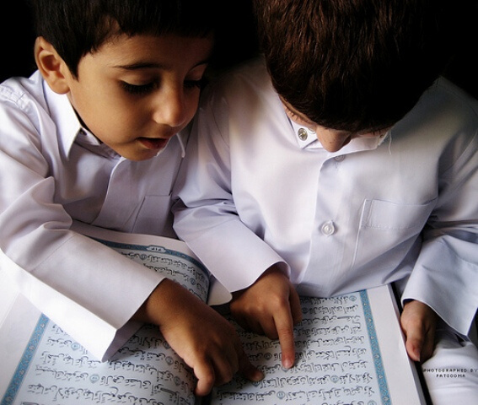
RAMADHAN IS SPECIAL BECAUSE..
IT IS THE MONTH OF THE QUR'AN

Slide 5
2. RAMADHAN IS SPECIAL BECAUSE..
IT IS THE MONTH WHEN WE PERFORM TARAWEEH

Slide 6
TARAWEEH IN MAKKAH
LED BY SHEIKH BALEELA

Slide 7
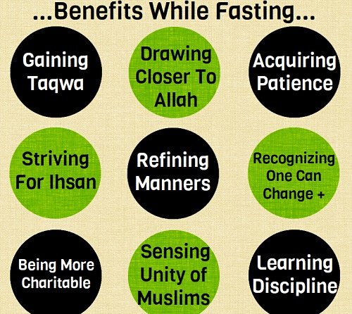
3. RAMADHAN IS SPECIAL BECAUSE..
IT IS THE MONTH IN WHICH WE FAST

Slide 8
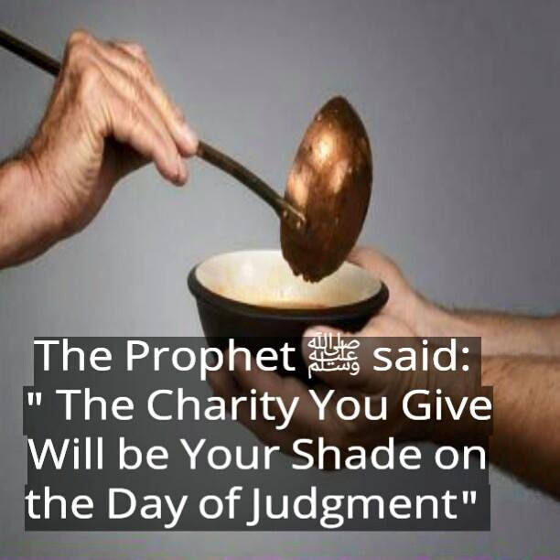
4. RAMADHAN IS SPECIAL BECAUSE..
IT IS THE MONTH IN WHICH WE LOOK AFTER THE POOR

Slide 9
LISTEN TO THIS NASHEED

Slide 10
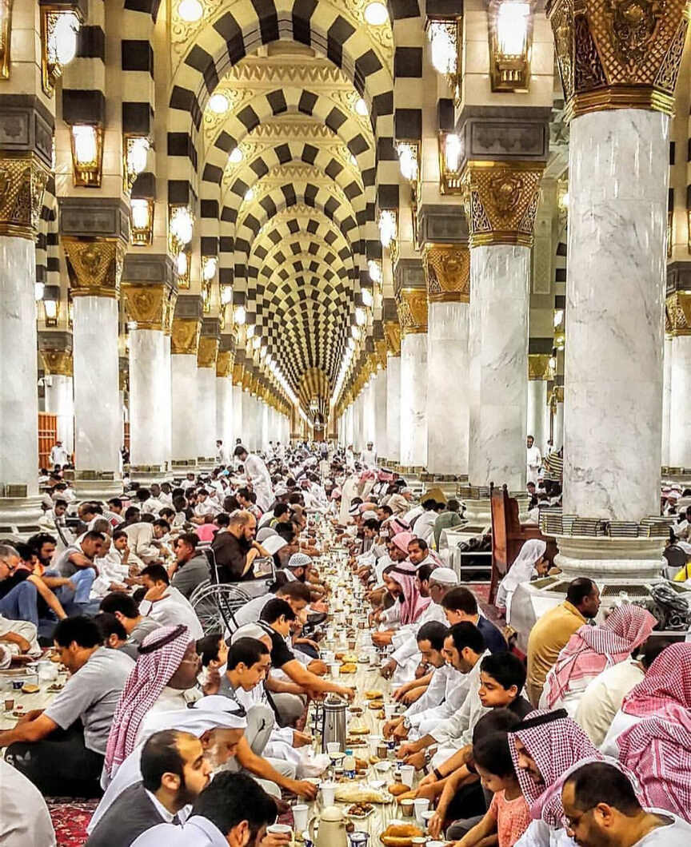
5. RAMADHAN IS SPECIAL BECAUSE..
IT IS THE MONTH IN WHICH WE HAVE IFTAR AND SUHOOR

Slide 11
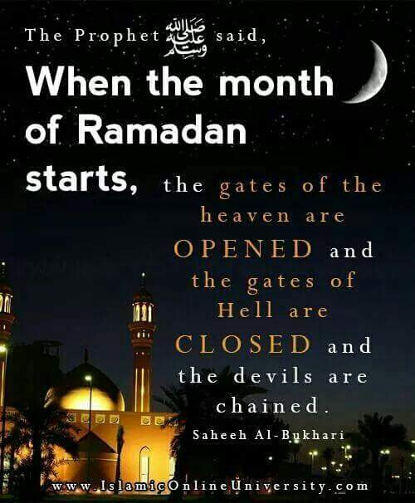
6. RAMADHAN IS SPECIAL BECAUSE..
IT IS THE MONTH IN WHICH THE DOORS OF JANNAH ARE OPEN AND ALLAH FORGIVES LIKE NO OTHER MONTH

Slide 12
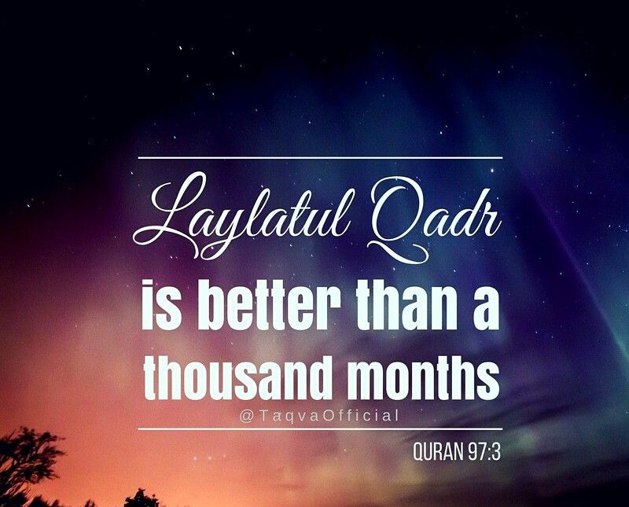
7. RAMADHAN IS SPECIAL BECAUSE..
IT IS THE MONTH IN WHICH WE HAVE A VERY SPECIAL NIGHT

Slide 13
LETS LISTEN TO OUR WEEKLY ADHKAAR
DUROOD SHAREEF & DHIKR
JOIN IN PLEASE

