Slide 1
TEEN ESSENTIALS
HIGHLY ESSENTIAL TOPICS FOR SECONDARY STUDENTS

Slide 2
SOCIAL MEDIA
What will we cover in this session?
Life Before & After Social Media
Pros & Cons
Do's & Don'ts
Nusrat ul Islam Masjid & Education Centre

Slide 3
LIFE BEFORE SOCIAL MEDIA
People visited family and friends regularly
People would spend time playing outside
Life Wasn’t Such a Competition
Only few things were Photographed
People used to send letters not emails
Mobile phones were mostly used to talk and send messages
IMAGINE IF THERE WAS NO SOCIAL MEDIA

Slide 4
HISTORY OF SOCIAL MEDIA
A Chronological History of Social Media
1971
2004
2005
2010
2011
First Email was sent
Facebook was Born
YouTube Joins the Party and Twitter a Year Later
Instagram and Pinterest are Born
Snapchat breaks the bone
HOW OLD WERE YOU WHEN FACEBOOK WAS BORN?

Slide 5
LIFE AFTER SOCIAL MEDIA
IN THE CHAT BOX, TYPE IN ONE THING YOU NOTICE IN THIS VIDEO

Slide 6
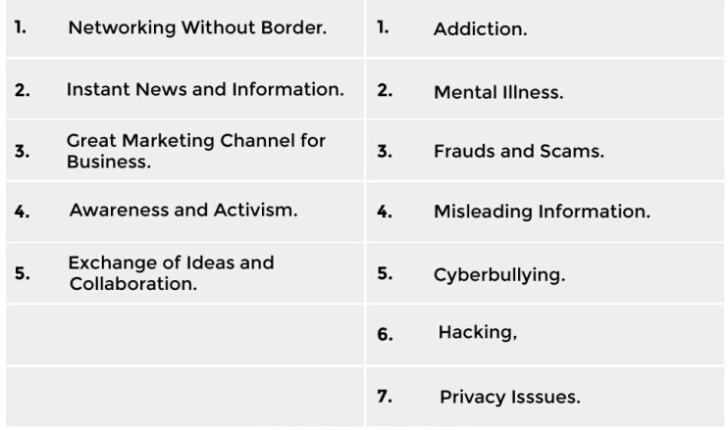
PROS & CONS OF SOCIAL MEDIA
PROS CONS

Slide 7
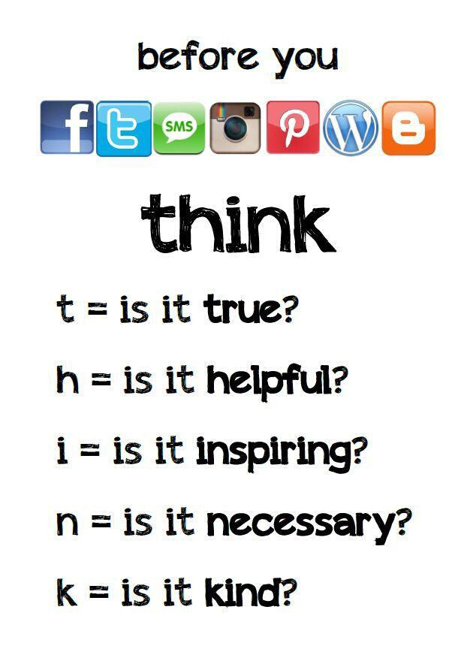
Do's & Don'ts of Social Media

Slide 8
WOW
LISTEN TO THIS!
SPEECH BY MOHAMMAD HOBLOS

Slide 9
10 Ways For Teens to Use Social Media

