Slide 1
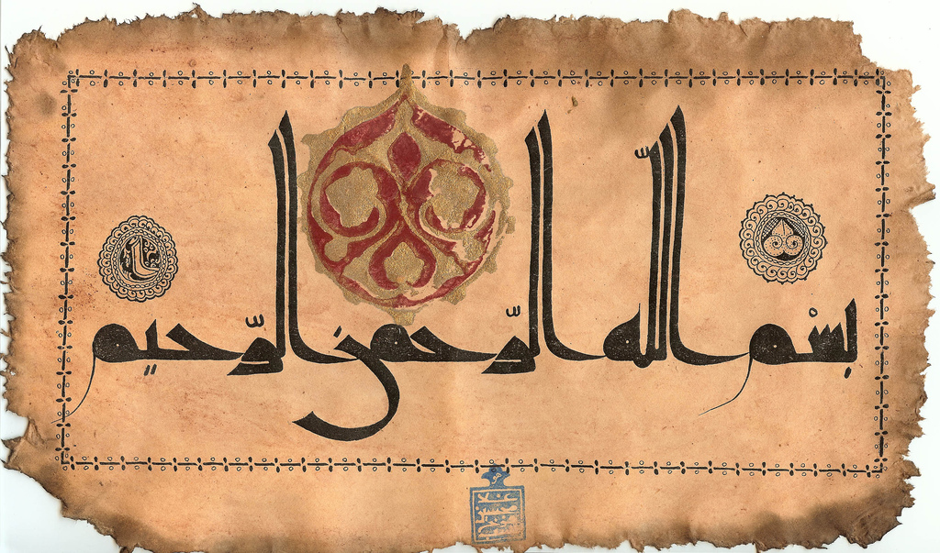

Slide 2
Journey Towards Light…
Enlightenment of the Hearts!
Notes:
Quran is Allah’s Noor
… Lets Enlighten our lives with it!

Slide 3
Quran- Allah’s light, A clear book!
O People of the Scripture, there has come to you Our Messenger making clear to you much of what you used to conceal of the Scripture and overlooking much. There has come to you from Allah a light and a clear Book.
Notes:
A Book of Guidance….The first introduction to the book…an answer to our prayer…Ihdinassirata

Slide 4
By which Allah guides those who pursue His pleasure to the ways of peace and brings them out from darknesses into the light, by His permission, and guides them to a straight path.
5:16

Slide 5
Allah’s Chosen Ones!
عَنْ أَنَسِ بْنِ مَالِكٍ قَالَ قَالَ رَسُولُ اللَّهِ صَلَّى اللَّهُ عَلَيْهِ وَسَلَّمَ إِنَّ لِلَّهِ أَهْلِينَ مِنْ النَّاسِ قَالُوا يَا رَسُولَ اللَّهِ مَنْ هُمْ قَالَ هُمْ أَهْلُ الْقُرْآنِ أَهْلُ اللَّهِ وَخَاصَّتُهُ
From Anas ibn Malik who said that Allah's Messenger (sas) said: Verily Allah has his family members among people. They said: And who are they, O Messenger of Allah? He (sas) said: They are the people of the Qur'an the people of Allah and his select ones.
ran
Notes:
Every thing in the Universe prays for the one who seeks out knowledge!

Slide 6
What does the Quran Talk about?
Notes:
Quran is Allah’s Noor
… Lets Enlighten our lives with it!

Slide 7
We have certainly sent down to you a Book in which is your mention. Then will you not reason?
(Al-Anbiya 21:10)

Slide 8
Those who know vs. those who do not!
Say, "Are those who know equal to those who do not know?" Only they will remember [who are] people of understanding.
Notes:
Qul Hal Yastaillazeena Yaalamoona wa la yaalamoon…
Those of knowledge have the highest levels…
Allah ko pehchannay walay aur na pehchannay walay barabar nai
Jo jitna Allah ko Janay ga uske utnay darjaat buland hotay hain….

Slide 9
The Book of Quran Does not Throw its Gems at Everyone!

Slide 10
Amongst People of the Book are The Illiterate !
And among them are unlettered ones who do not know the Scripture except in wishful thinking, but they are only assuming.
Notes:
Among the people of the Book there are Illiterate…in terms of Understanding!
All they understand is what fits their worldly interests!
Selective understanding!
Ibn Taimia:
Ibn Abbas Al Qatada.
Do not understand the meaning of the book…
Learn it,

Slide 11
Quran – A Book for Intellectuals?
IS IT FOR US?

Slide 12
38:29
[This is] a blessed Book which We have revealed to you, [O Muhammad], that they might reflect upon its verses and that those of understanding would be reminded.
Notes:
Mubarak kitab
So poeople may ponder over its ayat
Because its Allahs words, its Grandearur is above any other book of this world…
Its entirely based on Allahs will..and commands..
Not only to read, to recite..but to

Slide 13
Quran Addresses the Intellect
وَمَا يَذَّكَّرُ إِلاَّ أُوْلُواْ الأَلْبَابِ
"But none will grasp the message except the men of intellect." (Quran 2:269)

Slide 14
Wisdom and Applied Understanding
He gives wisdom to whom He wills, and whoever has been given wisdom has certainly been given much good. And none will remember except those of understanding.
Notes:
Secondly, one's intellect has to be applied in the understanding of this Book. This is something that the Quran itself has commanded us to do at many occasions. For instance, in Al-Baqarah, Quran talks about spending in the way of Allah and how Satan allures man into spending elsewhere for this worldly life. And then in the middle of this discussion, Allah says,وَمَا يَذَّكَّرُ إِلاَّ أُوْلُواْ الأَلْبَابِ”
But none will grasp the message except the men of intellect." (Quran 2:269)
And the discussion then continues on.
Clearly, it needs to be appreciated that the Quran really does reason with arguments and if one’s mind is not applied in the study of this Book, then the benefit will be very limited.

Slide 15
What Allah Wants from us?
Notes:
How can we know our responsibilities if we don’t know>?
How can you take what Allah Wants?
How would the final Evaluation be cleared? Student cannot do well in exam without knowing what a teacher wants
Home work for life…Open Book Exam!
Would we be excused?
Alam Najal lahu ainain, wa lisananwa shafataein, …
Allah has shown us the path….if we do not try for it…how do we except to reap fruit?

Slide 16
Reasoning!
Indeed, the worst of living creatures in the sight of Allah are the deaf and dumb who do not use reason.
8:22
Notes:
We do not want to be amongst the hearing deaf, the seeing blinds and the talking dumbs!
In general, the Quran has used reasoning and has cited arguments in support of its claims whenever it has urged man to accept a belief. It warns those who do not apply the faculty of their reasoning and become slaves to emotions like hate and prejudice.3 For example, consider the following where those who do not use their intellect in the study of the Book are addressed as deaf and dumb.إِنَّ شَرَّ الدَّوَابَّ عِندَ اللّهِ الصُّمُّ الْبُكْمُ الَّذِينَ لاَ يَعْقِلُونَSurely the worst of animals in Allah's sight are the deaf, the dumb who do not use their brains.(Quran 8:22)

Slide 17
Active Engagement!
And do not be like those who say, "We have heard," while they do not hear.
8:22
Notes:
We do not want to be amongst the hearing deaf, the seeing blinds and the talking dumbs!
In general, the Quran has used reasoning and has cited arguments in support of its claims whenever it has urged man to accept a belief. It warns those who do not apply the faculty of their reasoning and become slaves to emotions like hate and prejudice.3 For example, consider the following where those who do not use their intellect in the study of the Book are addressed as deaf and dumb.إِنَّ شَرَّ الدَّوَابَّ عِندَ اللّهِ الصُّمُّ الْبُكْمُ الَّذِينَ لاَ يَعْقِلُونَSurely the worst of animals in Allah's sight are the deaf, the dumb who do not use their brains.(Quran 8:22)

Slide 18
Then do they not reflect upon the Qur'an, or are there locks upon [their] hearts?
Notes:
47:24 afala yatabbarul quran…
Di par tala ho to no entry…
Dil main insaan keeps one beloved….you are in my heart….
Dunya ki kitni hi batain hum sochtay hain…kitni worries…
So many thoughts , so many worries…
When in our thoughts, ideas, we are thinking about Allahs words,,
And relate it to our Personal Lives…Its not a book of pilososphy, it gives guidance about every angle and aspect of life.
Opens those things to us, which are hidden, its like a mirror, shows us…
Zalikal kitabu la raiba fih….no doubt, no
- Quran ka challenge…

Slide 19
Presence of Heart
Indeed in that is a reminder for whoever has a heart or who listens while he is present [in mind].
25:30
Notes:
Presence of Heart….
For one who has present heart, attentive , Concentration, takes interest
If we do not wishe to create relation Prophet will sifarish against us!
25:30

Slide 20
Are we One of them?
The Illiterate?
The Living Dead?
The Seeing Blind…
The Hearing Deaf…
The Speaking Dumb…
Notes:
A processor with no software, no application…a dumb machine….an animal…

Slide 21
Consequences of Turning Away from Quran

Slide 22
Do Not Wish to be testified against on the Day of Judgment !
And the Messenger has said, "O my Lord, indeed my people have taken this Qur'an as [a thing] abandoned."

Slide 23
Thus, [O Muhammad], We relate to you from the news of what has preceded. And We have certainly given you from Us the Qur'an.
Whoever turns away from it - then indeed, he will bear on the Day of Resurrection a burden, [Abiding] eternally therein, and evil it is for them on the Day of Resurrection as a load -

Slide 24
And whoever turns away from My remembrance - indeed, he will have a depressed life, and We will gather him on the Day of Resurrection blind."
Notes:
Zindagi tang ker dun ga

Slide 25
He will say, "My Lord, why have you raised me blind while I was [once] seeing?"
[ Allah ] will say, "Thus did Our signs come to you, and you forgot them; and thus will you this Day be forgotten."
Notes:
Bhula daina….
Kin cheezon ko hum bhool jatay hain…
Jis ko hum Importance nai daitay
Allah sai dua hai ke Allah humain iss Quran ka Haq Ada kernay ki Taufeeq ata farmaye!

Slide 26
And thus do We recompense he who transgressed and did not believe in the signs of his Lord. And the punishment of the Hereafter is more severe and more enduring.
Notes:
Ae Allah iss kitab sai behtereen faida
Ae Allah humaray dilon main iss kitab ki roshni
Ae Allah jo kuch Hum nai parha qabul
Allah humain apni rehmat sai dhanp lai
Apni muhabbat ata ker
Guna maaf
Dukh door
Duunya o Akhrat
Apni rehmat
Dunia o akhrat ki kamiati
Walaidain ki rehmat
Rehmat ki faryad!

Slide 27
Living the Book of Allah!
Not possible without Love for the Book!
Attachment with the Book!
Interaction with the Quran!
Notes:
Interaction with the book is very important….
Talking to Sllah…Listening to Allah…

Slide 28
Living with Quran
Every moment…every breath…every Day!
Notes:
STUDYING THE BOOK OF ALLAH
STAYING ALIVE…
BEING A MUSLIM ...IQBAL

Slide 29
Engaging with the quran
Active Engagement/Total Inner Participation
Physical Involvement (Body)
Feeling the Presence of Allah
Hearing from Allah
Allah’s Direct Address
Feeling every word for Myself
Dialogue/Conversation with Allah
Trusting and Expecting Allah’s Rewards
Humility and Surrender
Spiritual Involvement (Soul)
Emotional Involvement (Heart)
Self Purification
Intellectual Involvement (Mind)
Comprehension
Supplication and Dua
Tarteel
Purity
Seeking Allah’s Help and Protection
Response of the Eyes (Tears)
Response of the Tongue
Preparation for Inner Participation
Deep thinking and Reflection
Trust and Dependence
Obedience and Change
Purity of Intention and Purpose

Slide 30
Pure hearts will never find satisfaction enough from the book of Allah!

