Slide 1
The Isra and the Mi’raj
Of the Prophet of Allah,
may Allah bless him and grant him peace

Slide 2
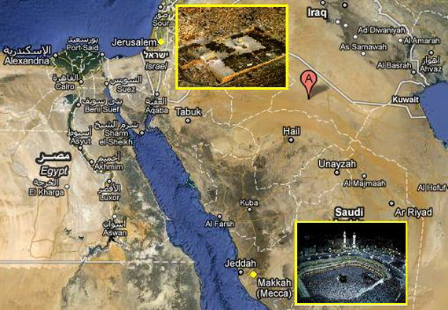
Lesson 1 Learning Intentions
Understand the meaning of the words of Isra and Mi’raj.
Know the main events of the Isra.
Understand that Allah has blessed certain lands.

Slide 3
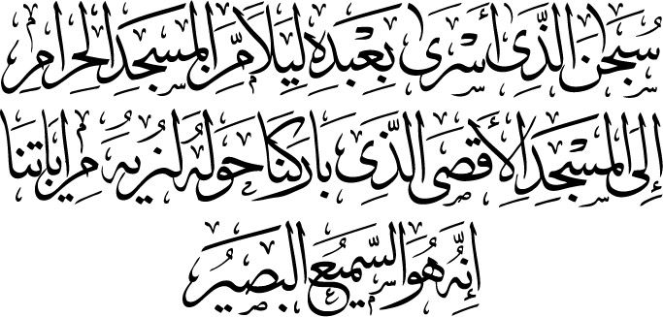
Glory to the One who took His servant by night from the Sacred Mosque to the Furthest Mosque; the surrounding area of which We have blessed, so that we may show him Our signs.
He is all-Hearing all-Seeing
Quran – Surah Isra, Verse 1.

Slide 4
What was the Isra and the Mi’raj?
Isra means ‘Journey by Night.’
Allah took the Prophet from the Haram in Makkah and brought him to Bayt al-Maqdis in Jerusalem all in one special night.
Mi’raj means ascension.
Allah then took the Prophet up to the Heavens where he saw many miraculous and wonderful things.

Slide 5
What major events took place?
The Prophet led all the other Prophets in prayer at Bayt al-Maqdis in Jerusalem.
The Prophet met with all the other Prophets in each of the 7 heavens.
The Prophet witnessed Paradise and the punishments of the Fire.
The Prophet crossed beyond the highest Heaven that no one angel or prophet has ever gone.
The Prophet spoke to Allah.
The Prophet received the gift of prayer – 5 times every day.

Slide 6
The Journey Begins
One night the Prophet was resting in front of the Kabah in the area known as the Hatim when 2 angels appeared. One of them was Jibril and the other was Mikail. They had a very special task tonight. For this night they had been ordered to take the Prophet on a journey to Jerusalem and then to the Heavens beyond that would end with a meeting with Allah.
Notes:
The Hatim is the semi circular enclosure in front of the Ka’bah. It has been related that whoever prays there, it is as though he has prayed in the Ka’bah.

Slide 7
The Buraq
The Prophet was the special guest of Allah tonight, and so Jibril had been sent with a heavenly steed; not a normal horse, camel, donkey or mule but the Buraq.
The Buraq was a creature that was white in colour, larger than a donkey but smaller than a mule. It had a beautiful face and was bridled, but the most amazing thing about it was its speed, it could travel as far as it eye could see in one step!

Slide 8
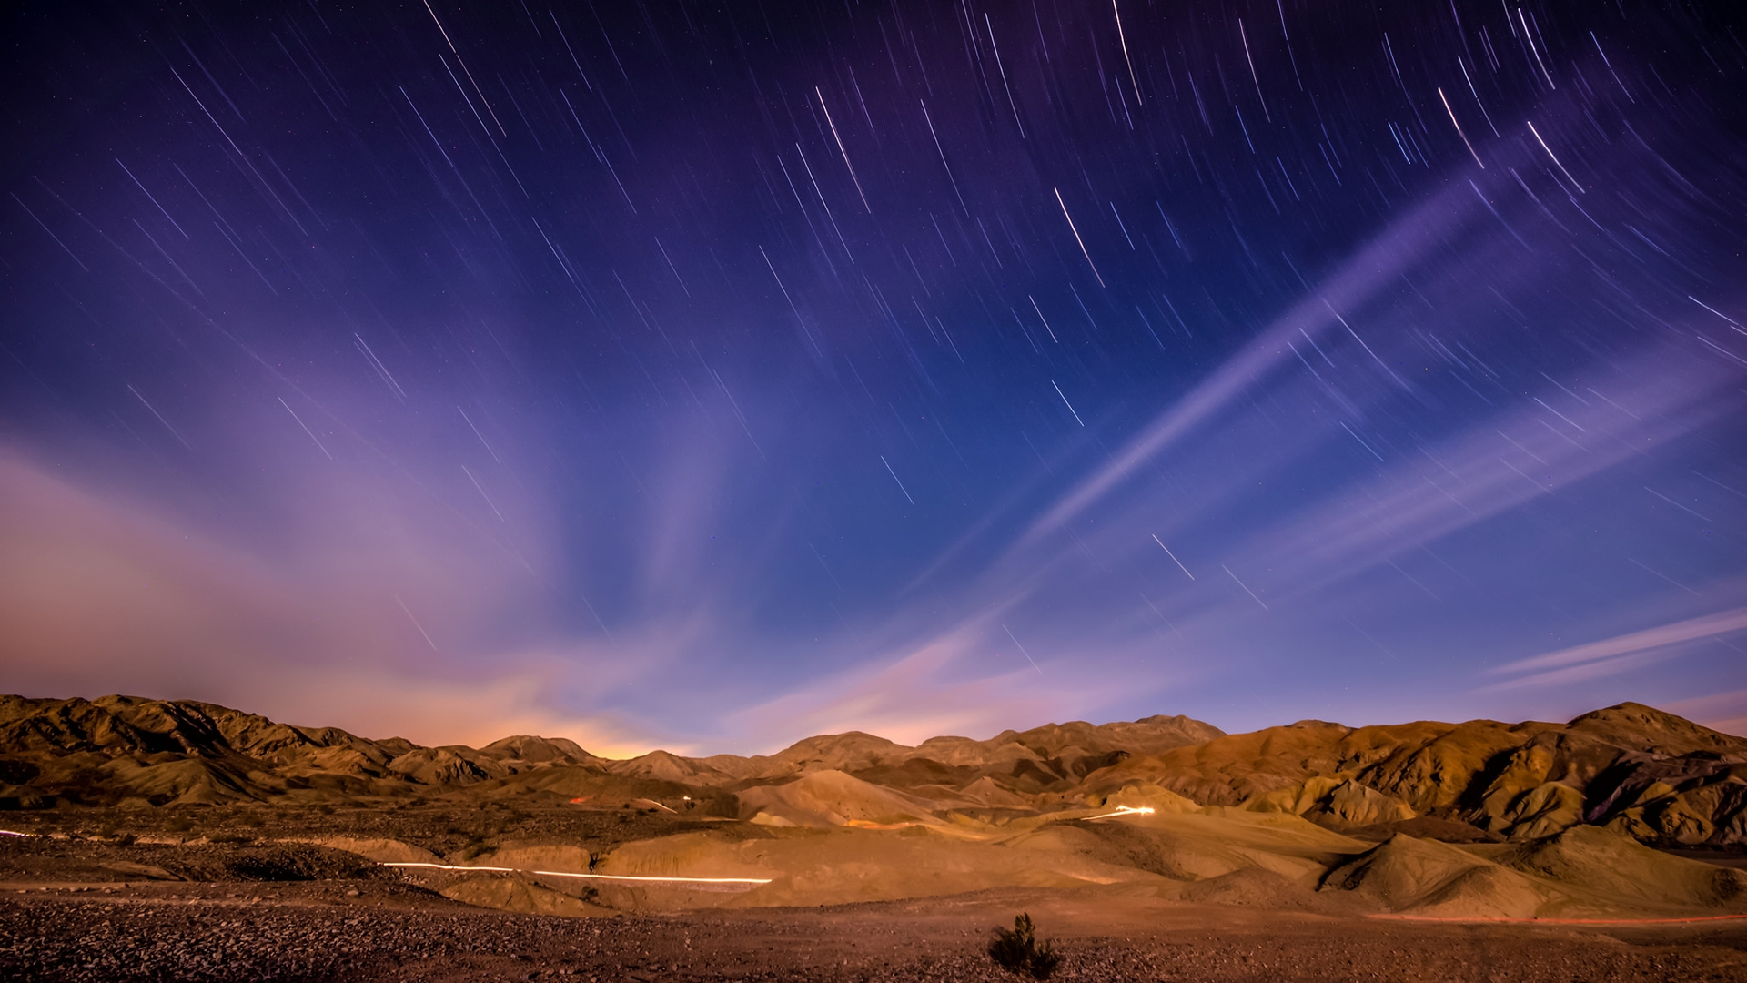
The Prophet mounted the Buraq, with the Angel Jibril on the right of the Prophet and Mika’il on the other side of the Prophet, they set off.
The Buraq’s speed was staggering; with one step he could travel as far as his eye could see. Soon they reached a land filled with date palms.
Do you know what land this was?

Slide 9
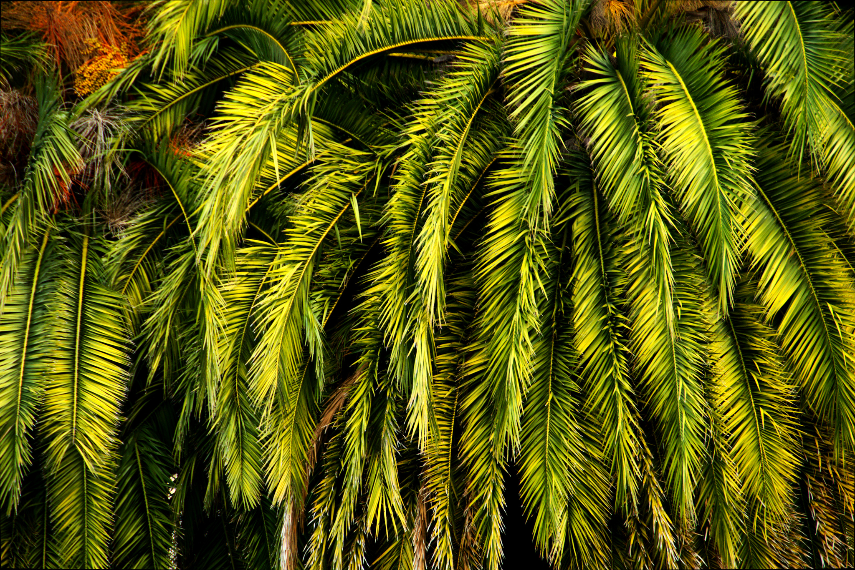
Madinah
Jibril said to the Prophet, ‘Alight, and pray here.’ The Prophet dismounted and prayed 2 rak’ah.’
Jibril said, ‘Do you know where you prayed?’
The Prophet replied, ‘No,’
Jibril said ‘You prayed in Tayba (Madinah), and the migration will take place here.’

Slide 10
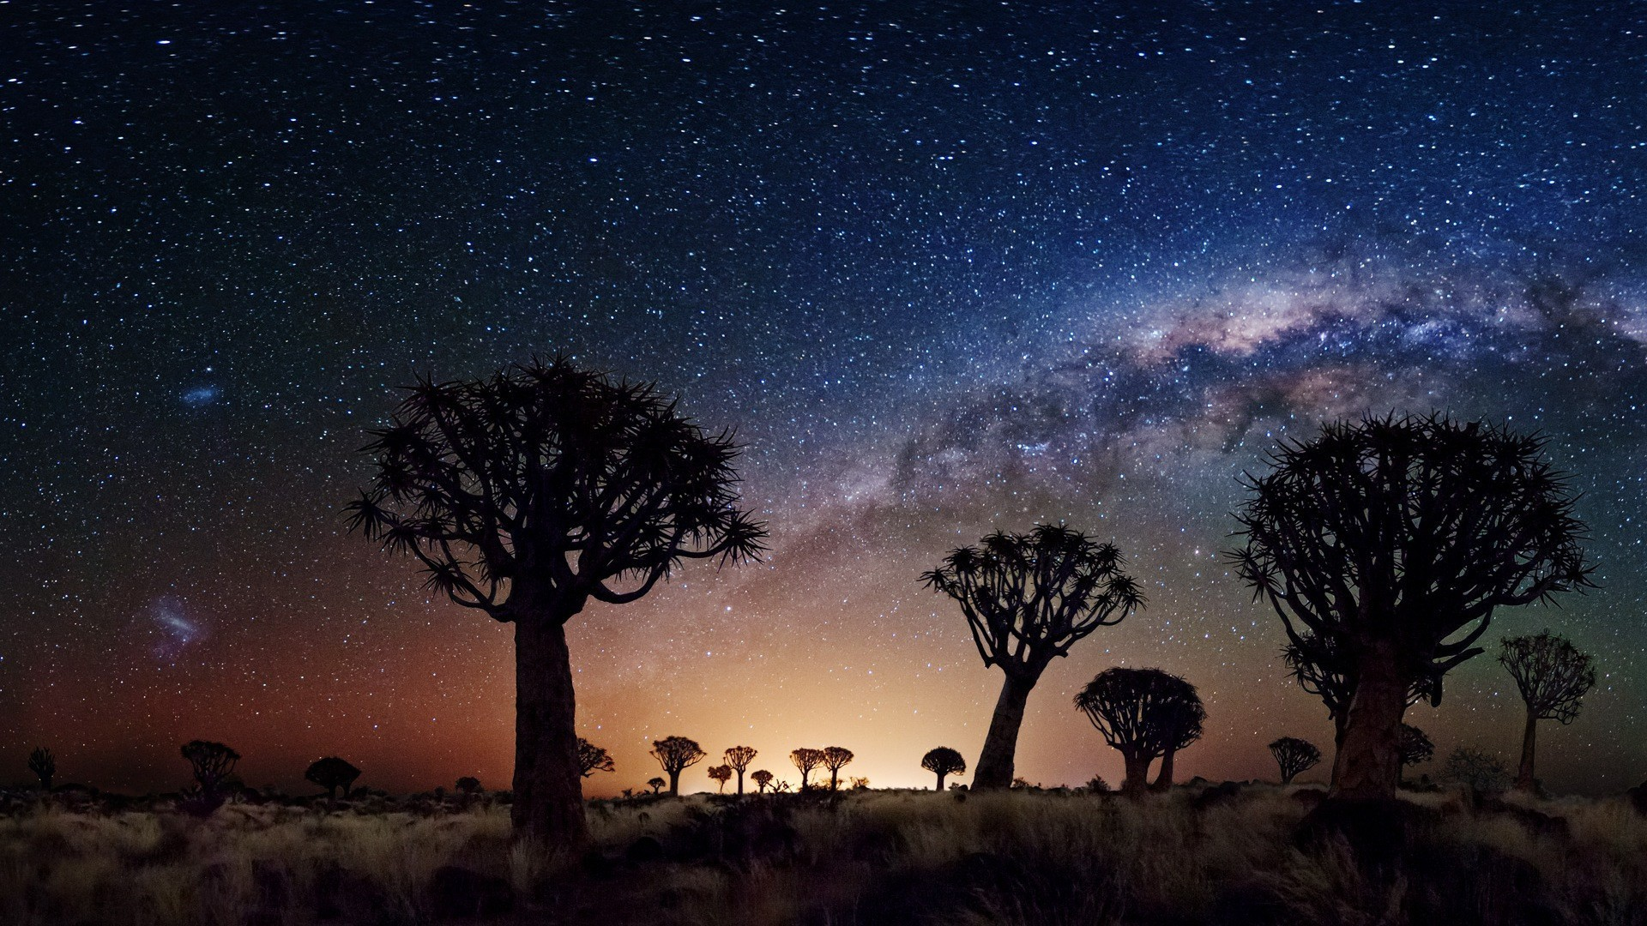
Madyan
The Buraq continued his lightening flight, placing his hooves wherever his gaze could reach. They reached another land. Jibril then said again: ‘Alight and pray here.’ The Prophet did so, prayed 2 rak’ah and remounted.
Jibril asked, ‘Do you know where you prayed?’ The Prophet replied, ‘No,’
Jibril said, ‘You prayed in Madyan at the tree of Musa.’
What was special about this tree?
Notes:
Madyan was the place that the Prophet Musa stopped at, after leaving the land of Egypt. He sat beneath the tree, and supplicated to Allah, ‘O Lord I am the most in need of any good that you send down.’ He helped the daughters of the Prophet Shu’ayb giving their flock water to drink and was invited by the Prophet Shu’ayb to stay with him for ten years.

Slide 11
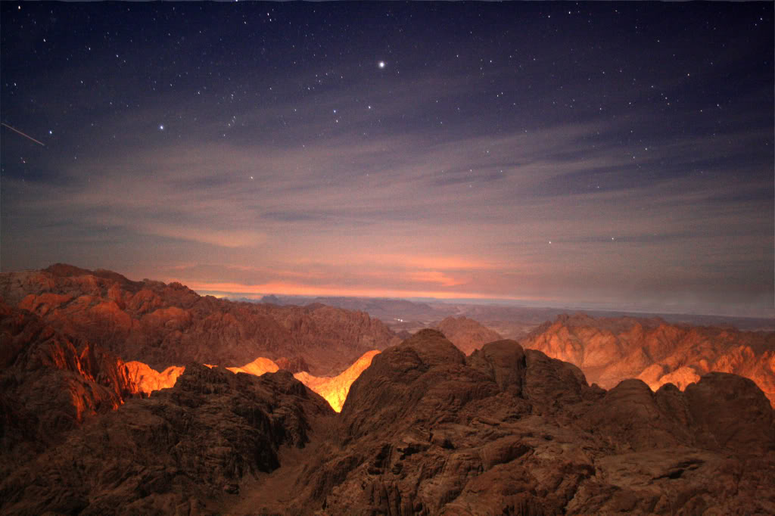
Mount Sinai
The Buraq continued travelling, then Jibril said again, ‘Alight and pray here.’ The Prophet did so and remounted, then Jibril said, ‘Do you know where you prayed?’ The Prophet said, ‘No,’ Jibril said, ‘You prayed at the mountain of Sinai where Allah spoke to Musa.’
Can you imagine how blessed that spot must be?
In which Surah does Allah mention Mount Sinai?
Notes:
Allah mentions Mount Sinai in many surahs. One which the pupils will know is Sura Teen. ‘Wa Teen waz Zaytun. Wa tura Sinin, wa hadha al-baladil amin.’

Slide 12
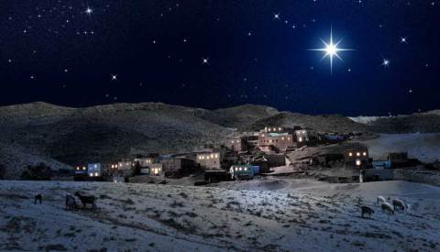
Bayt Lahm
Then the Prophet reached a land where the palaces of Sham became visible to him. Jibril said ‘Alight and pray here.’
The Prophet did so and remounted, then Jibril said, ‘Do you know where you prayed?’
The Prophet replied, ‘No.’
Jibril answered, ‘You prayed in Bayt Lahm (Bethleham), where Isa ibn Maryam was born.’

Slide 13
Imam of the Prophets
They continued travelling until they reached Jerusalem; Masjid al-Aqsa. The Prophet dismounted the Buraq and tied it at the gate of the mosque.
Entering the ancient mosque the Prophet prayed 2 rakah.
Soon, a huge throng of luminous people entered the masjid, they had such beautiful faces and walked graciously. Who were they? The Prophet recognised them all, as the previous prophets; some were standing in prayer, some bowing, while others in Sajdah.
Then the sound of the Azan echoed around the Mosque. All the prophets stood in lines waiting for the one who would lead them.
The Prophet wondered as to who would lead the prayer when Jibril gently took the hand of the Prophet and brought him forward .
The Prophet of Allah, Sayyidina Muhammad led them in prayer. Imam al-Ambiya wa al-Mursaleen.

Slide 14
What a Prayer!
Can you imagine what that must have looked like?
Imagine if you were in that Jama’ah. Standing on your right is the Prophet Ibrahim, on your left is the Prophet Musa. All around you are prophets after prophets.
What must have that prayer been like?
And in front of them all is the greatest of all Messengers; the beloved of Allah—Sayyidina Muhammad, sallahu alayhi wa sallam.

Slide 15
Lesson 2 Learning Intentions
Understand the importance of Masjid al-Aqsa.
Know where it is located and the difference between masjid al-Aqsa and Qubbat ul-Sakhra.

Slide 16
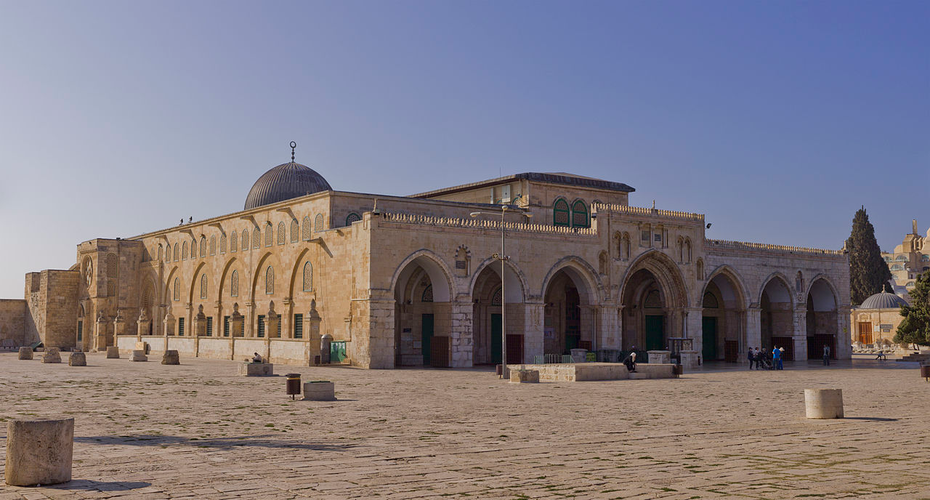
Masjid al-Aqsa is where the Prophet led all the other Prophets in prayer. This is the 3rd most holiest Masjid in the World.
To pray one prayer here is the reward of 500 prayers anywhere else.

Slide 17
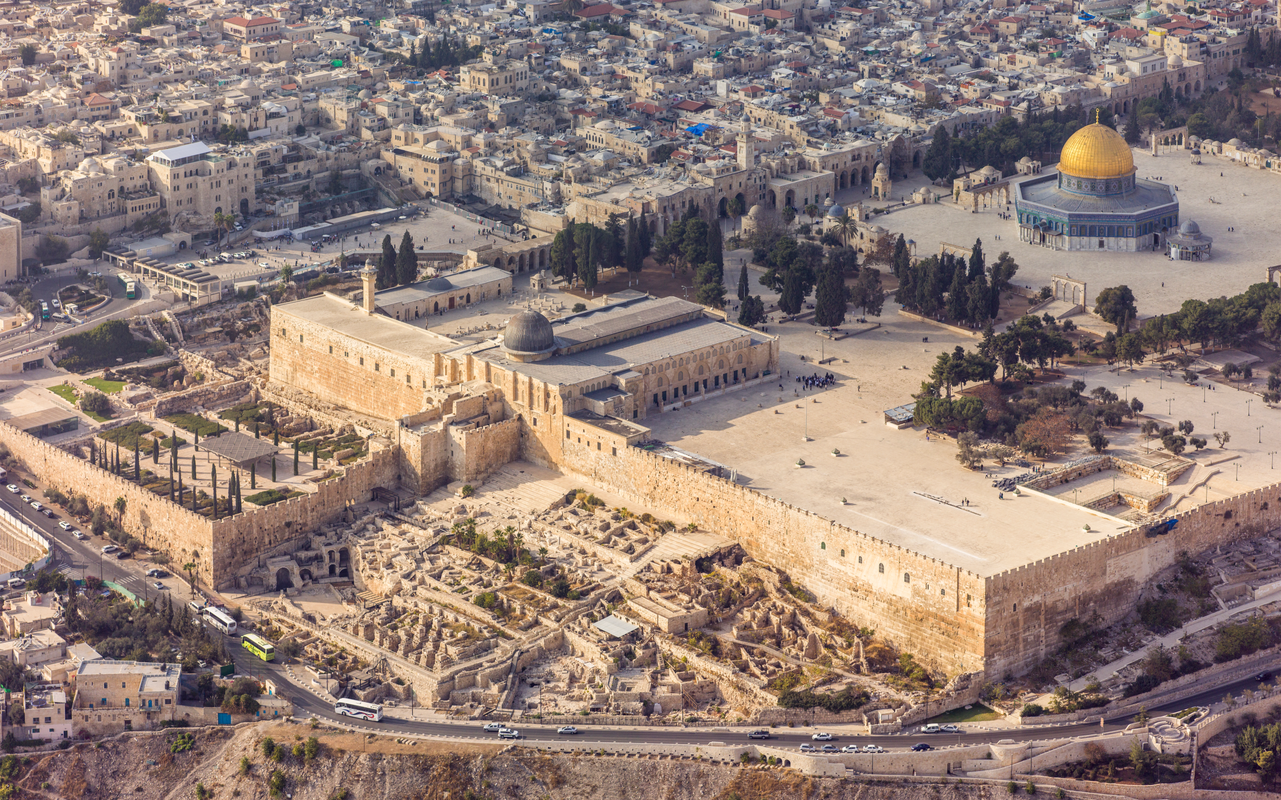
Facts about Masjid al-Aqsa
Allah has called this area blessed in the Quran in Surah al-Isra.
Masjid al-Aqsa was the first Qiblah of the Muslims.
It was the 2nd masjid to be built on the Earth. The first was the Haram of Makkah.
The Prophet led all the other prophets in prayer here.

Slide 18
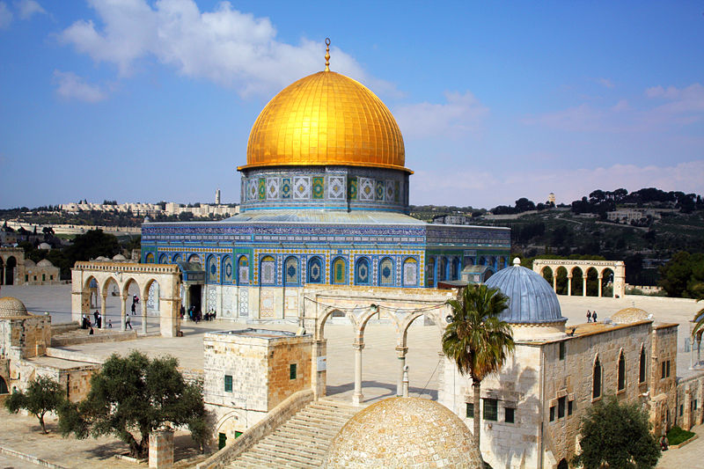
Dome of the Rock Qubbat us-Sakhra
This is where the Prophet ascended to the heavens
It is in Jerusalem. Opposite Masjid al-Aqsa
It is said to contain the rock from where the Prophet stood and ascended to the heavens.

Slide 19
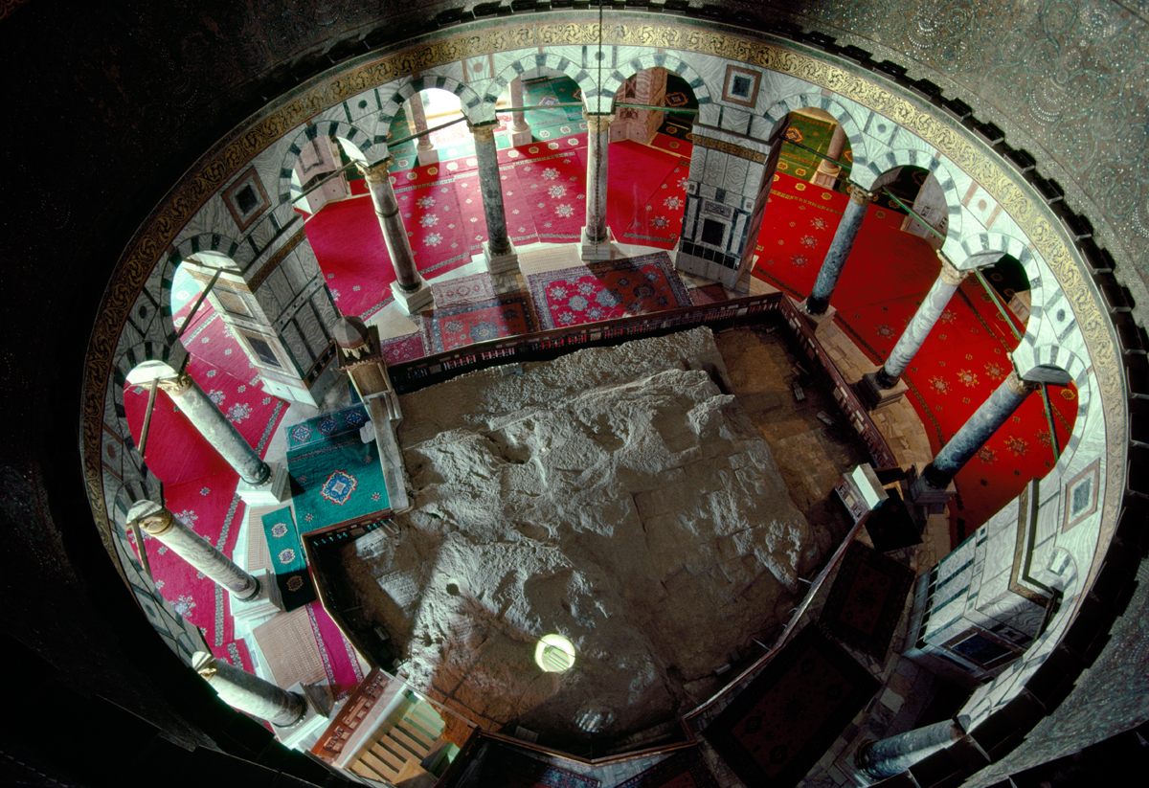
Inside the Dome of the Rock Mosque where the Prophet made his Mi’raj from.

Slide 20
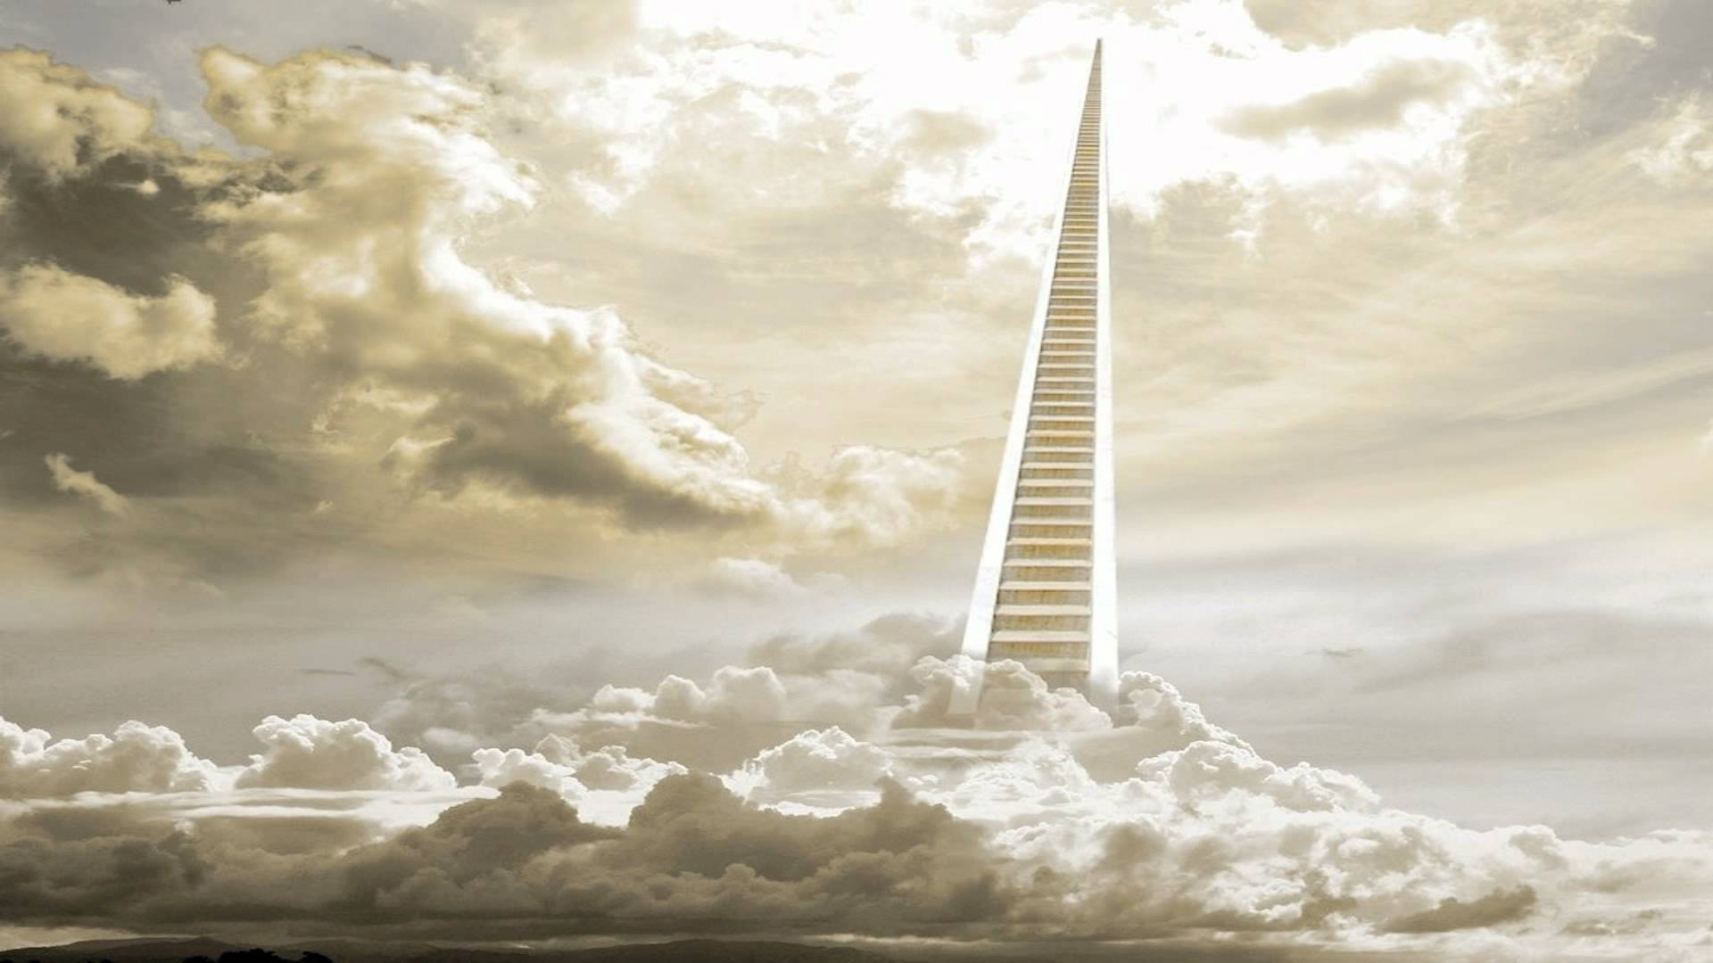
The Mi’raj
After the prayer was over, the Prophet left the Masjid. Jibril presented 3 drinks to the Prophet. One was water the other was milk and the other was alcohol. The Prophet chose to drink the milk. Jibril replied, ‘You have chosen the natural way.’
The Prophet was then brought stairs to the heavens. The stairs had steps made of silver and gold and came down from the Highest Paradise, Jannat al-Firdaws. It was incrusted with pearls and was surrounded with angels on its right and left.

Slide 21
Lesson 3 Learning Intentions
Know the main events of the Mi’raj
Reflect on how Allah loves the Prophet.
Understand the importance of Salah.

Slide 22
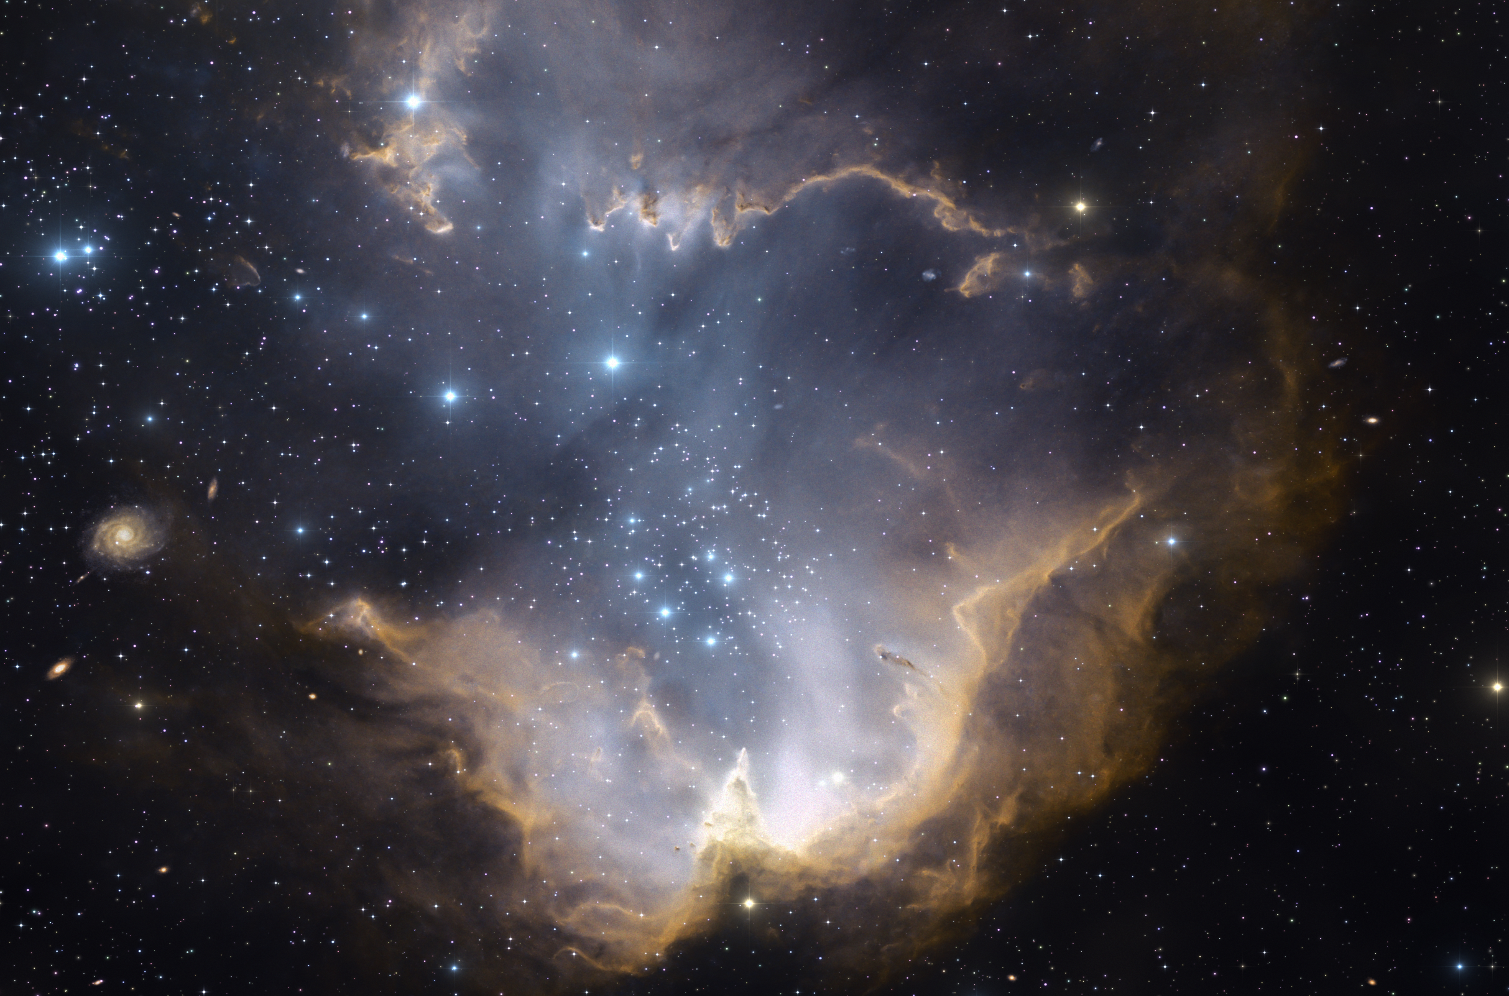
The Prophet began his ascent with Jibril until they reached one of the gates of the nearest heaven called Bab al-Hafaza.
There an angel stood guard named Ismail. In front of him stood 70,000 angels, each angel commanding an army of 70,000 more!

Slide 23
The First Heaven
Jibril asked for the gate to be opened. Someone said:
‘Who is this?’
‘Jibril’
‘Who is with you?’
‘Muhammad’
Has he been sent for?’
‘Yes’
‘Welcome to him, from his family. May Allah grant him long life! A brother and deputy, and what an excellent brother and deputy! What an excellent visit this is!’

Slide 24
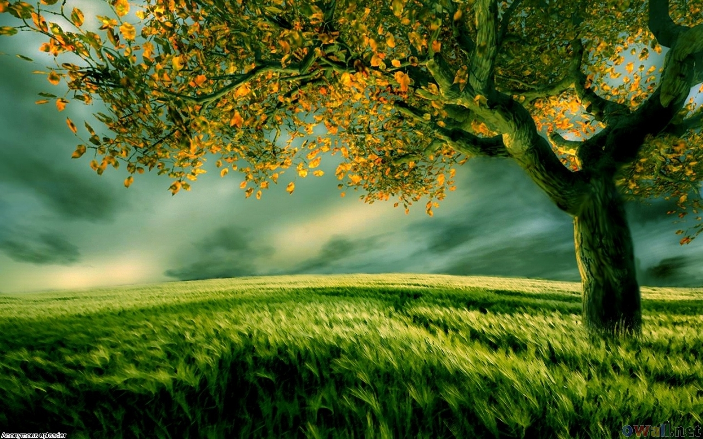
Adam
The gate was opened. When they came in they saw Adam, the father of humanity.
The Prophet saw on Adam’s right a great dark cloud and a gate with a fragrant smell and on his left a great dark cloud and a gate with a foul putrid smell.
When Adam looked to his right he would smile and be happy, and whenever he looked to his left he would be sad and weep.
The Prophet greeted him and Adam returned the greeting and said, ‘Welcome to the righteous son and the righteous Prophet!’

Slide 25
Jibril said, ‘This is your father Adam and the dark clouds are the souls of his children. Those on the right are the people of Paradise and those on the left are the people of the Fire. Whenever he looks to the his left he is sad and weeps.
The door to his right is the gate of Paradise. Whenever he sees those of his offspring enter it he smiles happily.
The door to his left is the gate of Hell-Fire. Whenever he sees those of his offspring enter it he weeps sadly.’

Slide 26
The Second Heaven
Then they ascended to the second heaven. Jibril asked for the gate to be opened. Someone said:
‘Who is this?’
‘Jibril’
‘Who is with you?’
‘Muhammad’
Has he been sent for?’
‘Yes’
‘Welcome to him, from his family. May Allah grant him long life! A brother and deputy, and what an excellent brother and deputy! What an excellent visit this is!’

Slide 27
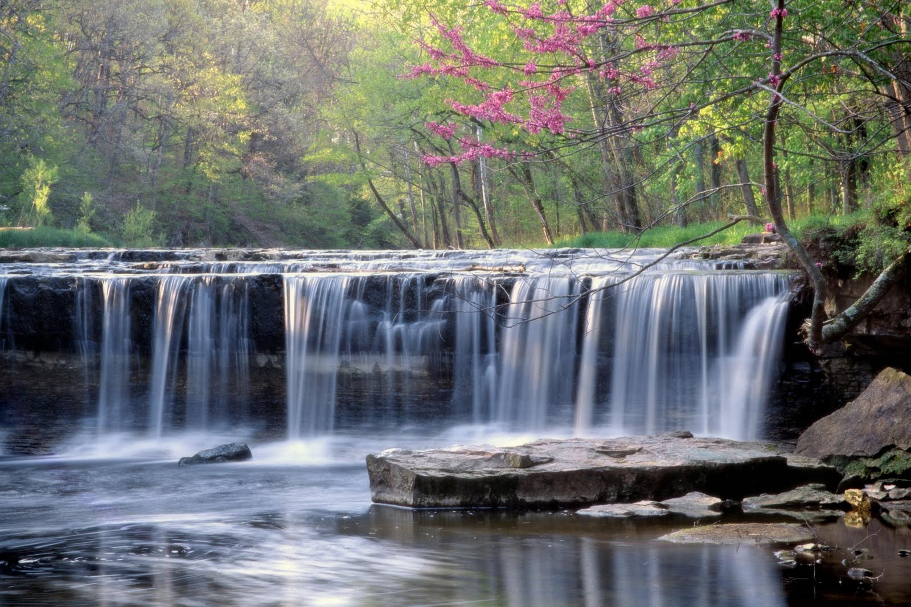
Isa and Yahya
The gate was opened. When they came in they saw Isa ibn Maryam and Yahya ibn Zakariyya. Each had with him a large company of his people. Isa was curly haired of medium build, with somewhat of a fair complexion, with hair let down as if he were coming out of the bath.
The Prophet greeted them and they returned his greeting. Then they said, ‘Welcome to the righteous brother and the righteous Prophet!’ Then they made dua for him.

Slide 28
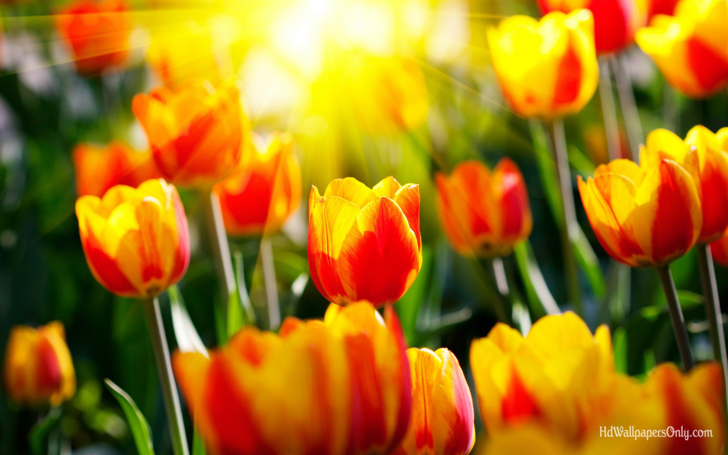
Yusuf
In the third heaven the Prophet saw the Prophet Yusuf and with him stood a large company of people. They greeted him and he returned his greeting and said: ‘Welcome to the righteous brother and the righteous Prophet!’ then he made dua for goodness for him.
Yusuf had been granted the gift of beauty. In one hadith it is mentioned that he had been give half of all of the beauty of the world.

Slide 29
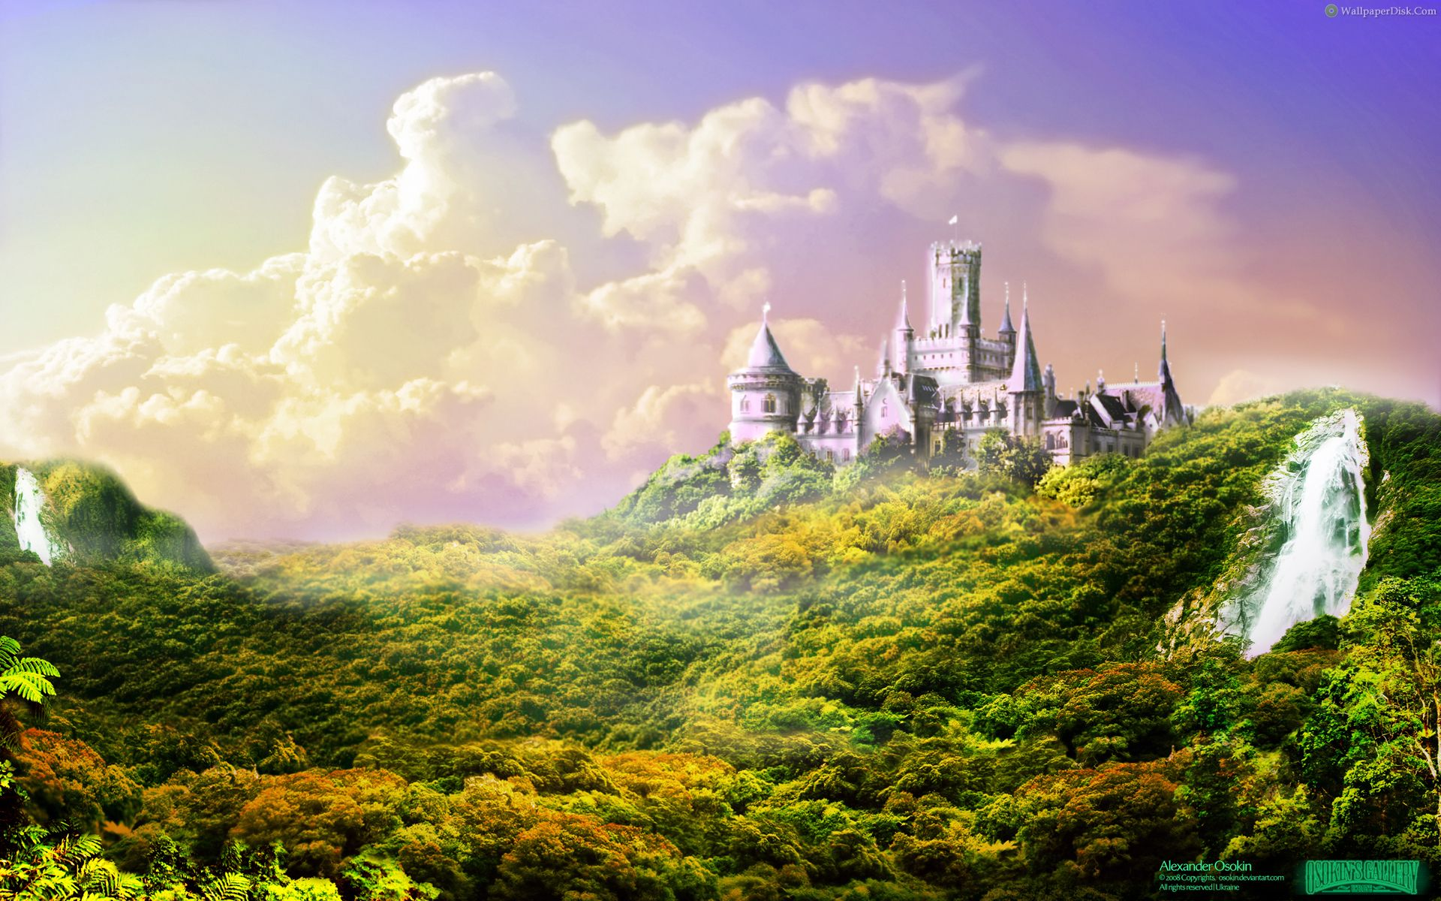
The Fourth and Fifth Heavens
Similarly the Prophet visited the fourth heaven where he met Idris, and then the fifth heaven where he met Harun.
Half of the Prophet Harun’s beard was white and the other half was black and it almost reached his navel due to its length.
Surrounding him were a group of the Children of Israel listening to him as he was telling a story.
Jibril said to the Prophet, ‘This is the man beloved among his people, Harun ibn Imran.’

Slide 30
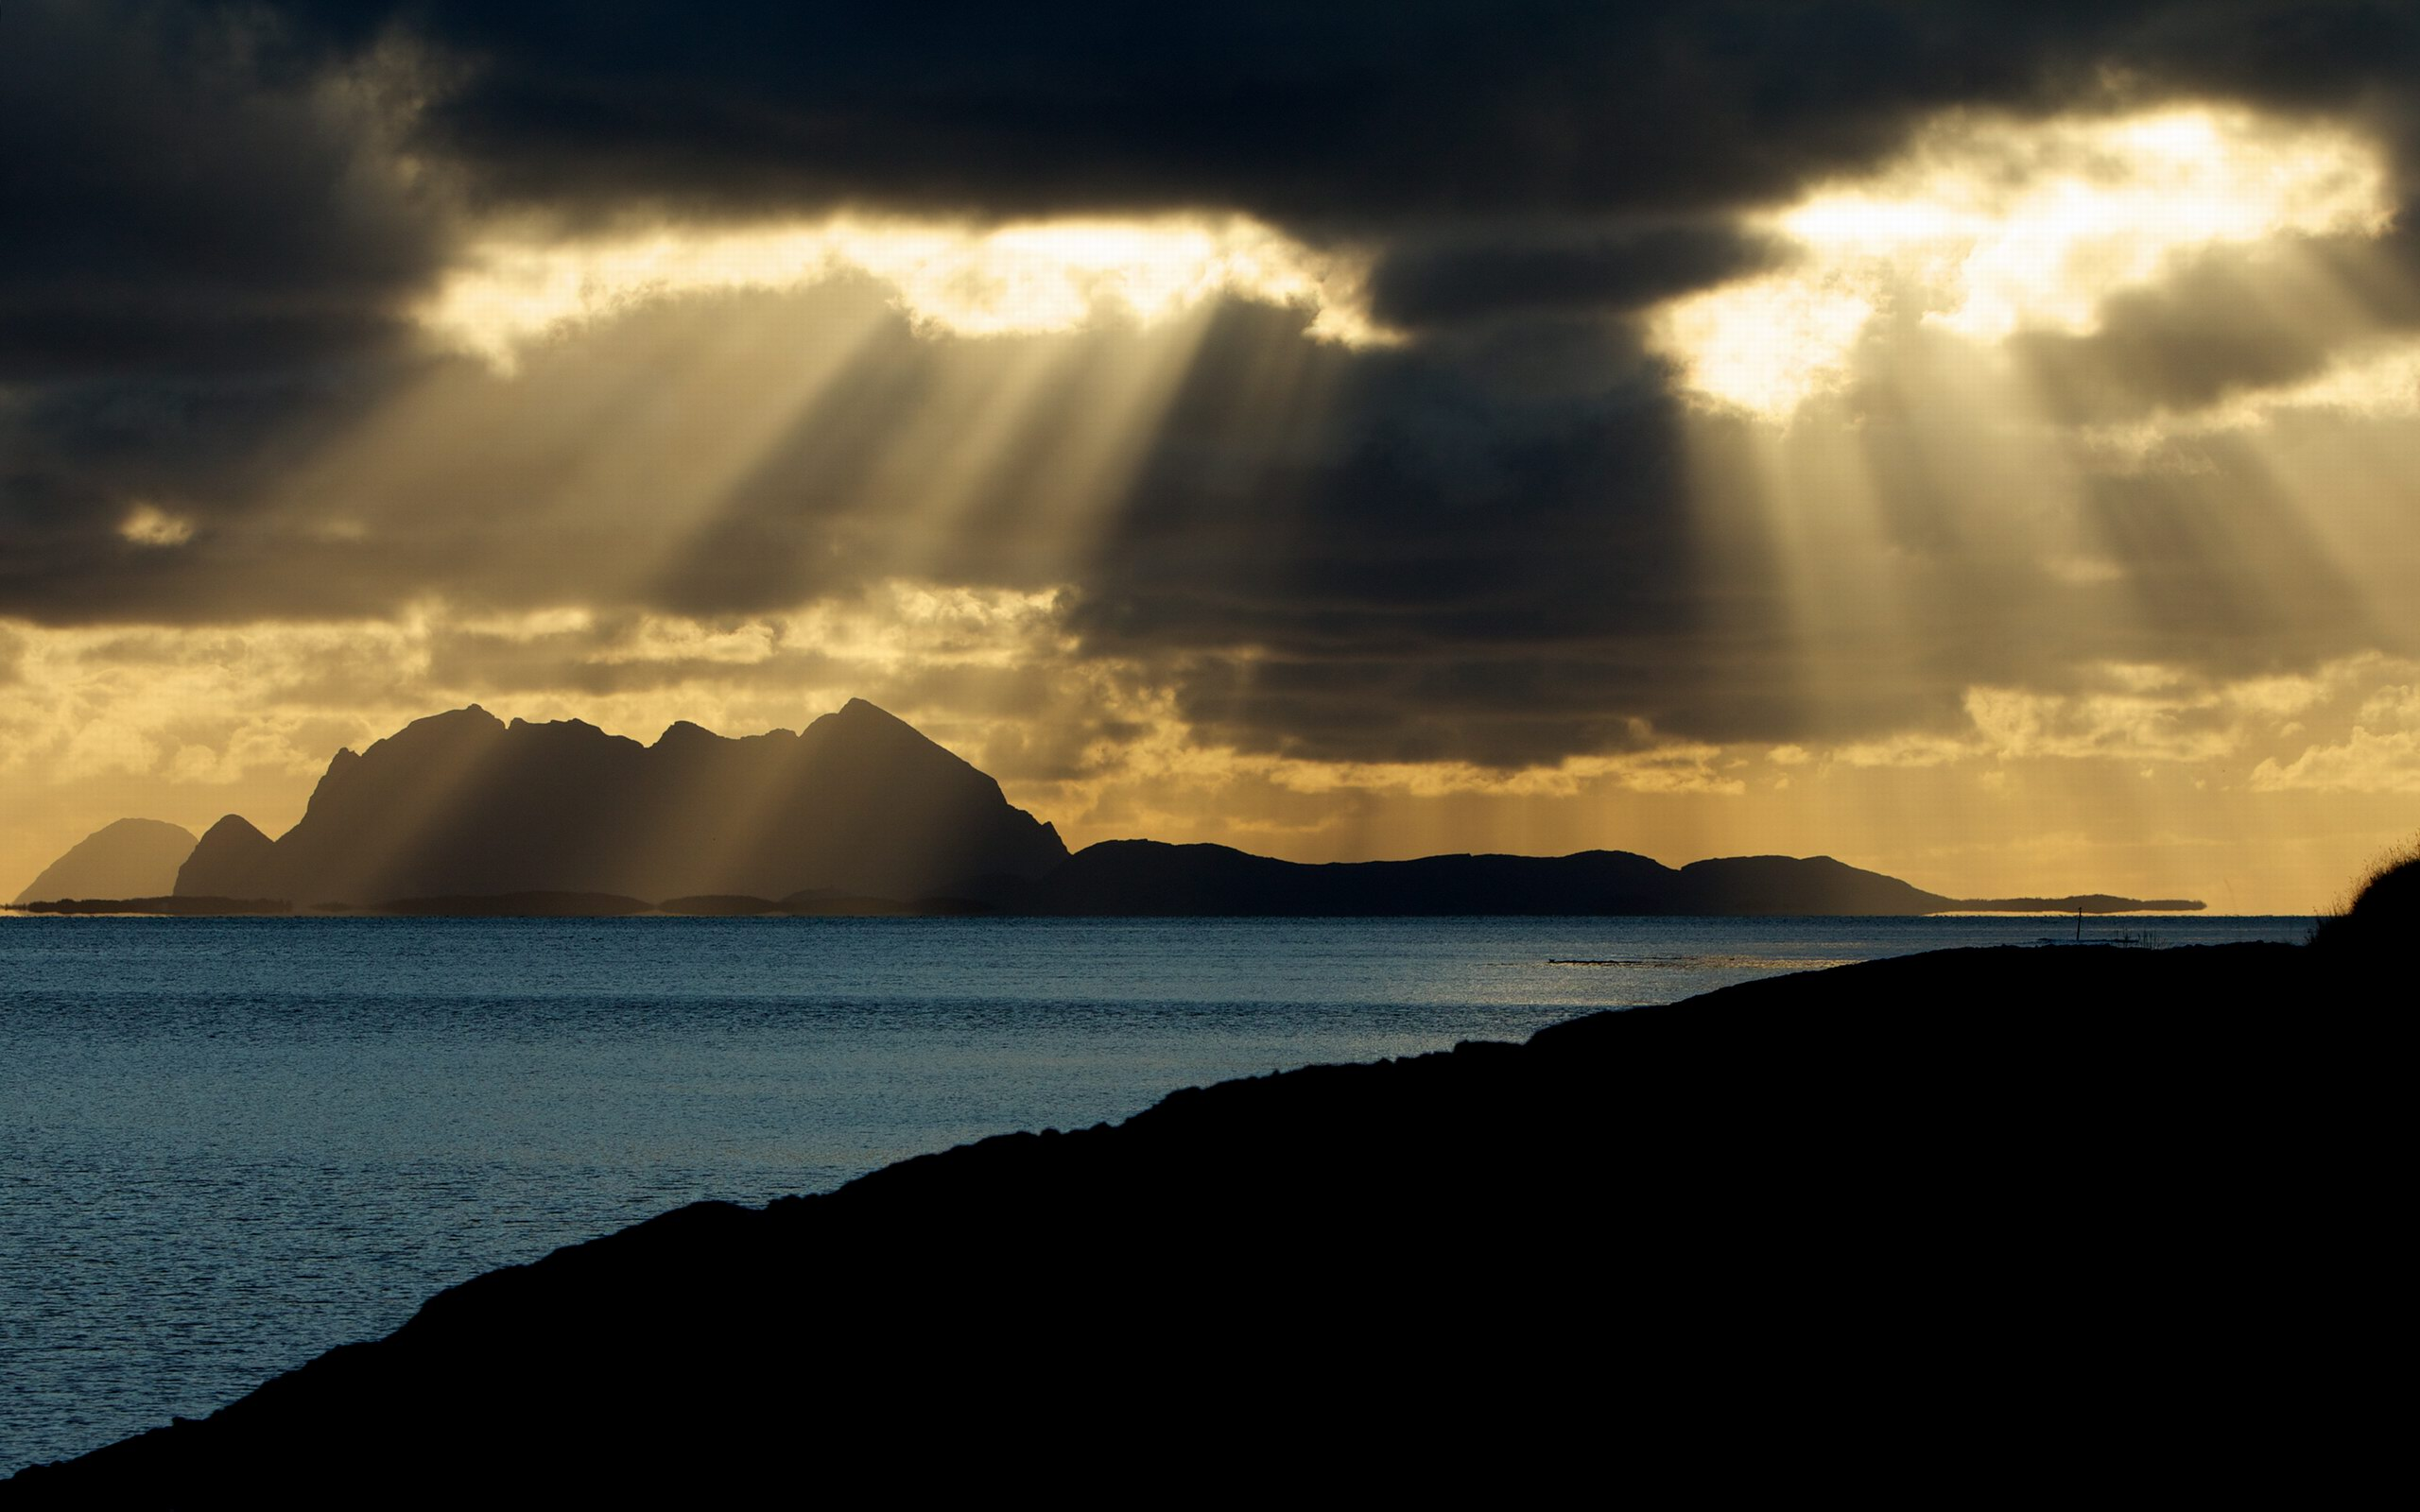
The Sixth Heaven
When the Prophet reached the sixth heaven he passed by Prophets who had with them less then 10 followers, while others had large company and others had not even one follower.
Then he saw a huge dark cloud that was covering the heavens. He asked, ‘Who are these people?’ It was said, ‘This is Musa and his people. Now raise your head and look.’
The Prophet looked and he saw another huge mass that was covering the heavens from every direction he looked. He was told: ‘This is your Ummah, and besides these are 70,000 of them who will enter Paradise without any account.’

Slide 31
Further into the 6th Heaven
As they went in the Prophet saw Musa ibn Imran, a tall man with a brown complexion, he looked similar to the people of the Shanu’a tribe; the people of Yemen.

Slide 32
The Seventh Heaven
When they reached the 7th heaven the Prophet saw Ibrahim the Friend of Allah, sitting a the gate of Paradise on a throne of gold and black which was leaning against the Bayt al-Ma’mur (the Ka’bah of the 7th heaven). With him were a company of people.
The Prophet greeted him and he returned his greeting and said, ‘Welcome to the righteous son and the righteous Prophet!’

Slide 33
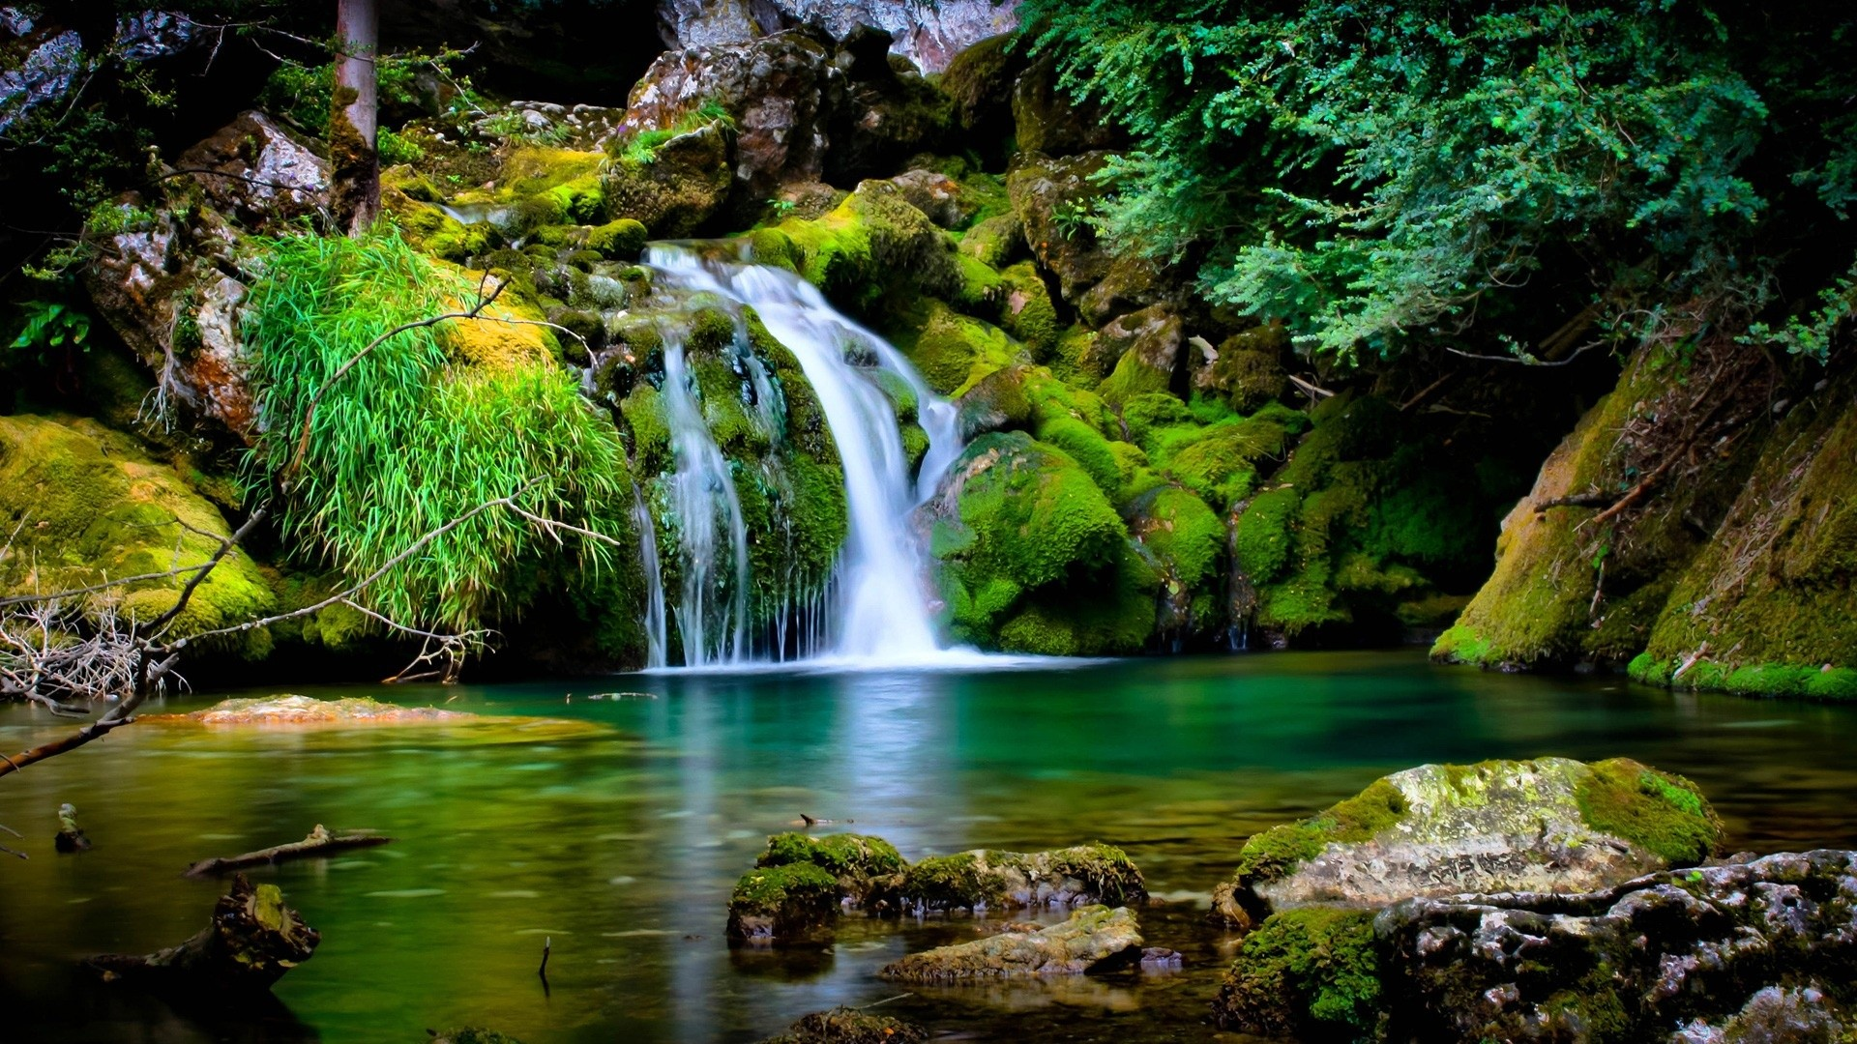
The Advice of the Prophet Ibrahim
The Prophet Ibrahim said, ‘Give my Salam to your Ummah, and tell them that Paradise has excellent soil and sweet water, and that its plants are grown from:
Subhanallah! Allah is perfect
Wa al-hamdulillah Praise is for Allah
Wa la ilaha illa Allah There is no god but Allah
Wallahu Akbar Allah is greater

Slide 34
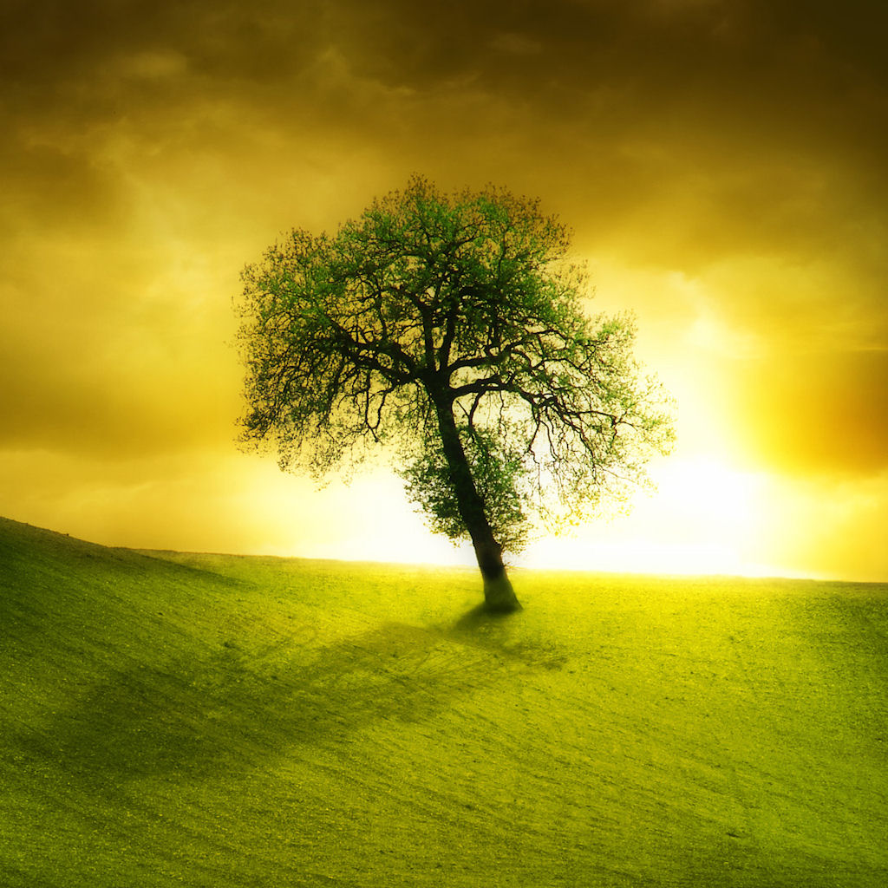
The Lote Tree
Then the Prophet was raised up to the Lote Tree, (Sidrat ul-Muntaha).
It is a tree from the base of which rivers spring whose water is never old, and rivers of milk whose taste does not change, and rivers of wine which brings only pleasure. It is so huge that a person can travel under its shade for 70 years and still not reach the other side of it. The leaves are magnificent and huge and on each leaf there was an angel who covered it with colours that cannot be described.

Slide 35
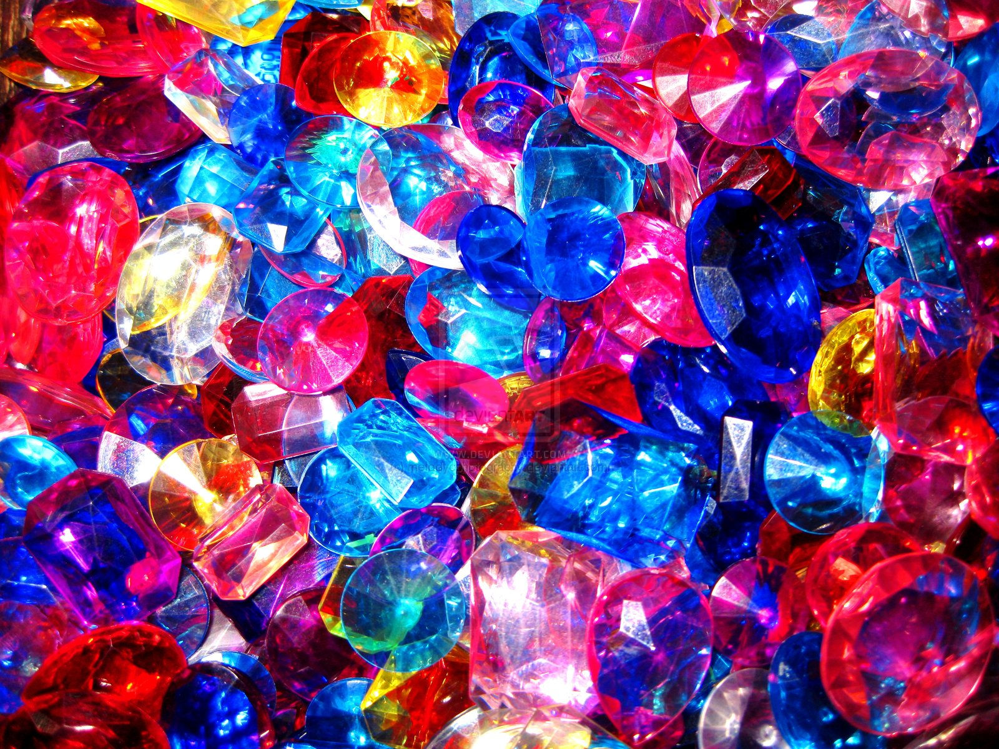
Rivers from the Tree
There were rivers that flowed from the tree; the Prophet said, ‘I saw it flowing forcefully, roaring and at the speed of arrows. Near were it were structures made out of pearl, sapphire and chrysolite on top of which nested green birds more delicate than any you have ever seen. On its banks were cups of gold and silver. The river ran over pebbles made of sapphire and emerald. Its water was whiter than milk.
The Prophet took one of the cups and scooped some water and drank. It was sweeter than honey and more fragrant than musk. Jibril said to him: ‘This is the river which Allah has given you as a special gift, (Kawthar). And the other river is the River of Mercy.’
The river of mercy is a river outside of Paradise which when you dip into, all of your sins are fogiven.

Slide 36
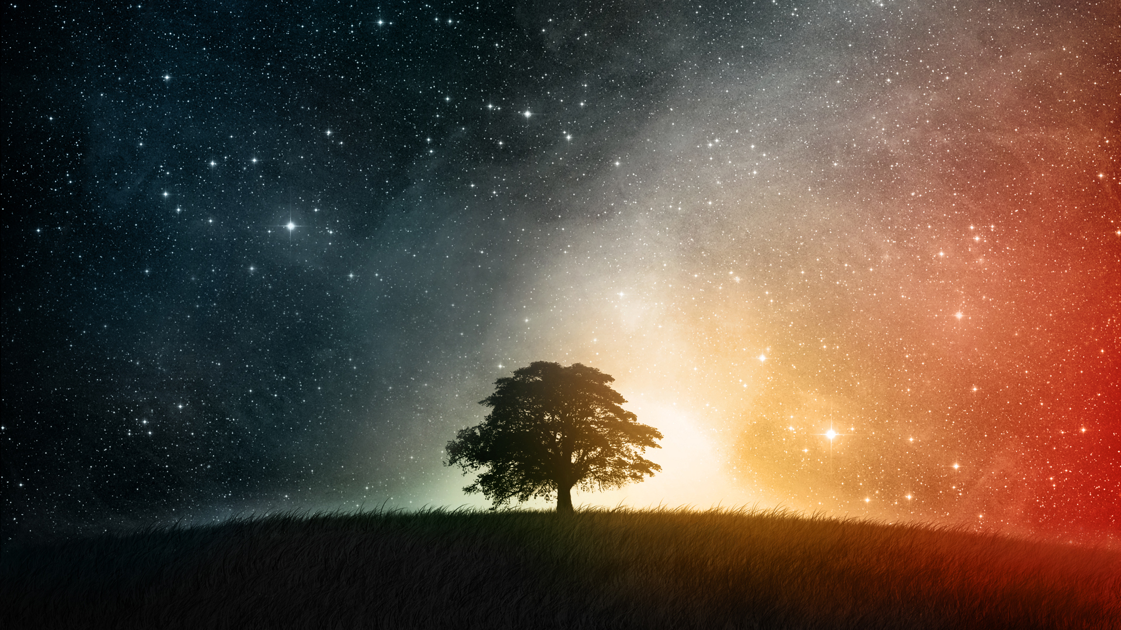
Jibril
At Sidrat ul-Muntaha, the Prophet saw Jibril in his full angelic appearance. He had six hundred wings. Every single wing could cover the horizon.
Then the Prophet was taken to al-Kawthar and entered Paradise.

Slide 37
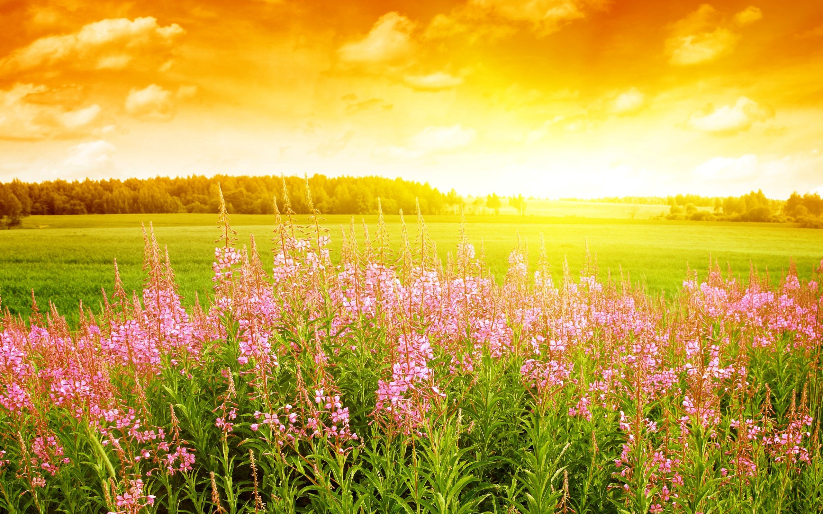
Paradise
Lo and behold! Paradise contains what no eye has seen, no ear has heard, and no mind has imagined.
The Prophet continued to travel where he saw the palaces, the rivers, and the rewards of the people of Paradise.

Slide 38
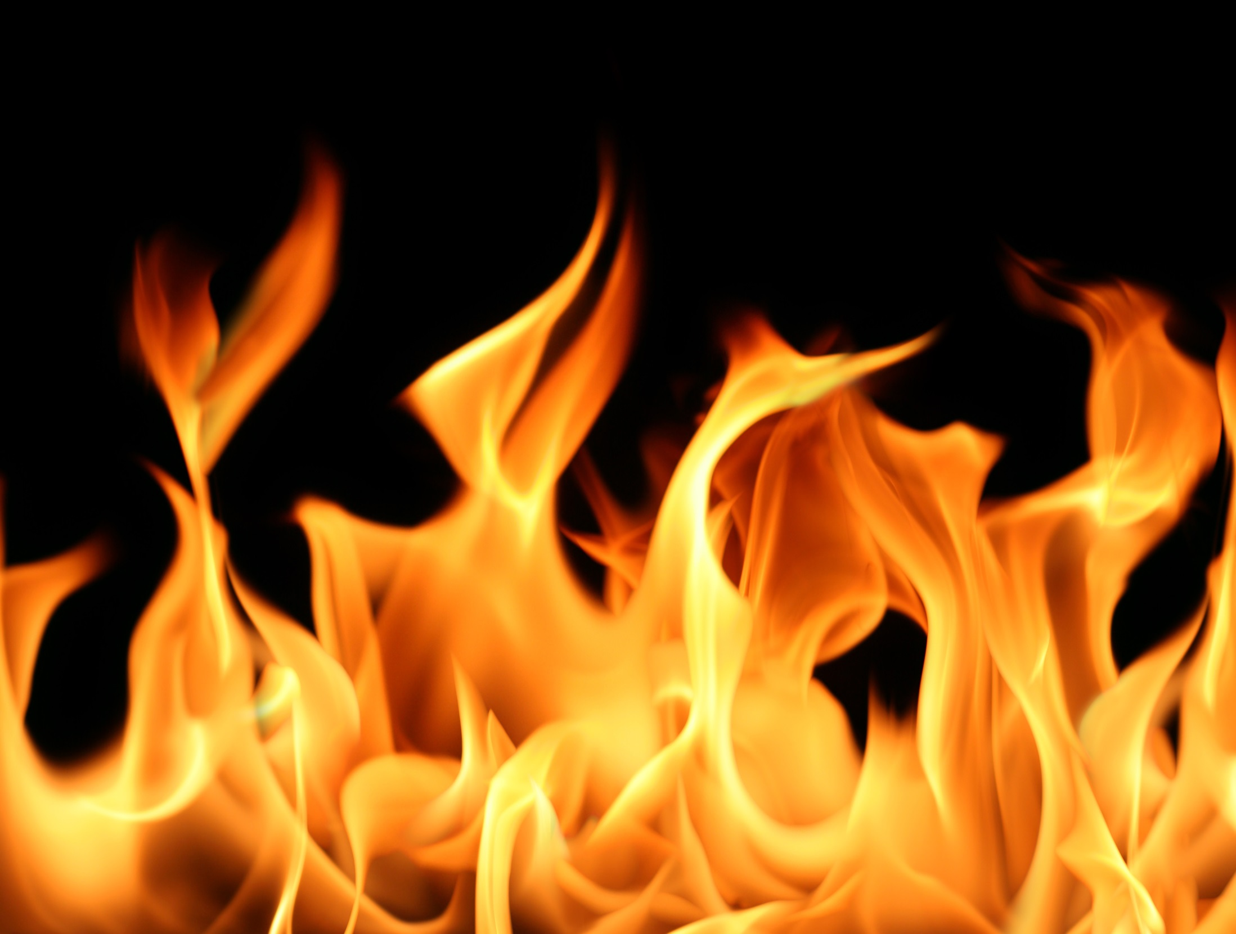
The Fire
The Prophet also saw the Fire and the punishments therein. He saw Malik, the Guardian of the Fire, who was a grim figure whose face showed anger.
The Prophet said to Jibril that everyone who met him smiled and welcomed him warmly except for Malik.
Jibril replied, 'Malik has not smiled since the time the Fire was created, but if was to smile he would have smiled at you.'

Slide 39
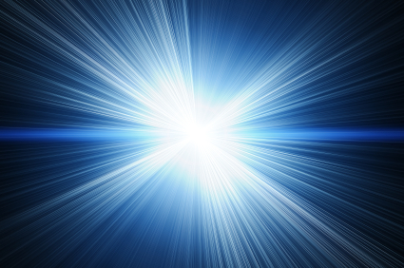
The Meeting with Allah
The Prophet was then raised even further to a point where Allah spoke to him. No one has ever been given such a position by Allah. Allah honoured and blessed the Prophet in a way no one else had been blessed. Allah the Exalted then gave a gift to the Prophet for his whole Ummah. A special gift…

Slide 40
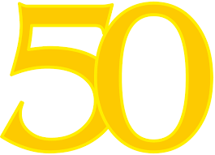
The Prayer
The prayer is the greatest gift of the Mi’raj; in our prayer we worship Allah and we draw close to Him. There is no religion that has a prayer like ours.
Fifty prayers were made fard upon the Prophet!

Slide 41
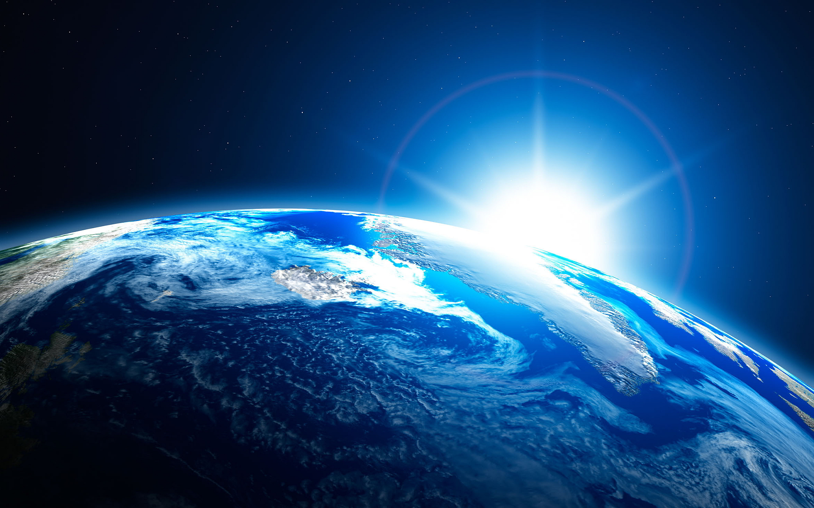
Return to the World
On the Prophet’s return journey, he passed by the Prophet Musa who asked, ‘What did your Lord make fard upon you and your people?’
The Prophet replied, ‘Fifty prayers, every day and night on me and my people.’
Musa said, ‘Return to your Lord and ask Him to lighten your burden and that of your people, for your people will not be able to do it. I tested the Children of Israel with something easier than this but they were too weak and abandoned it.

Slide 42
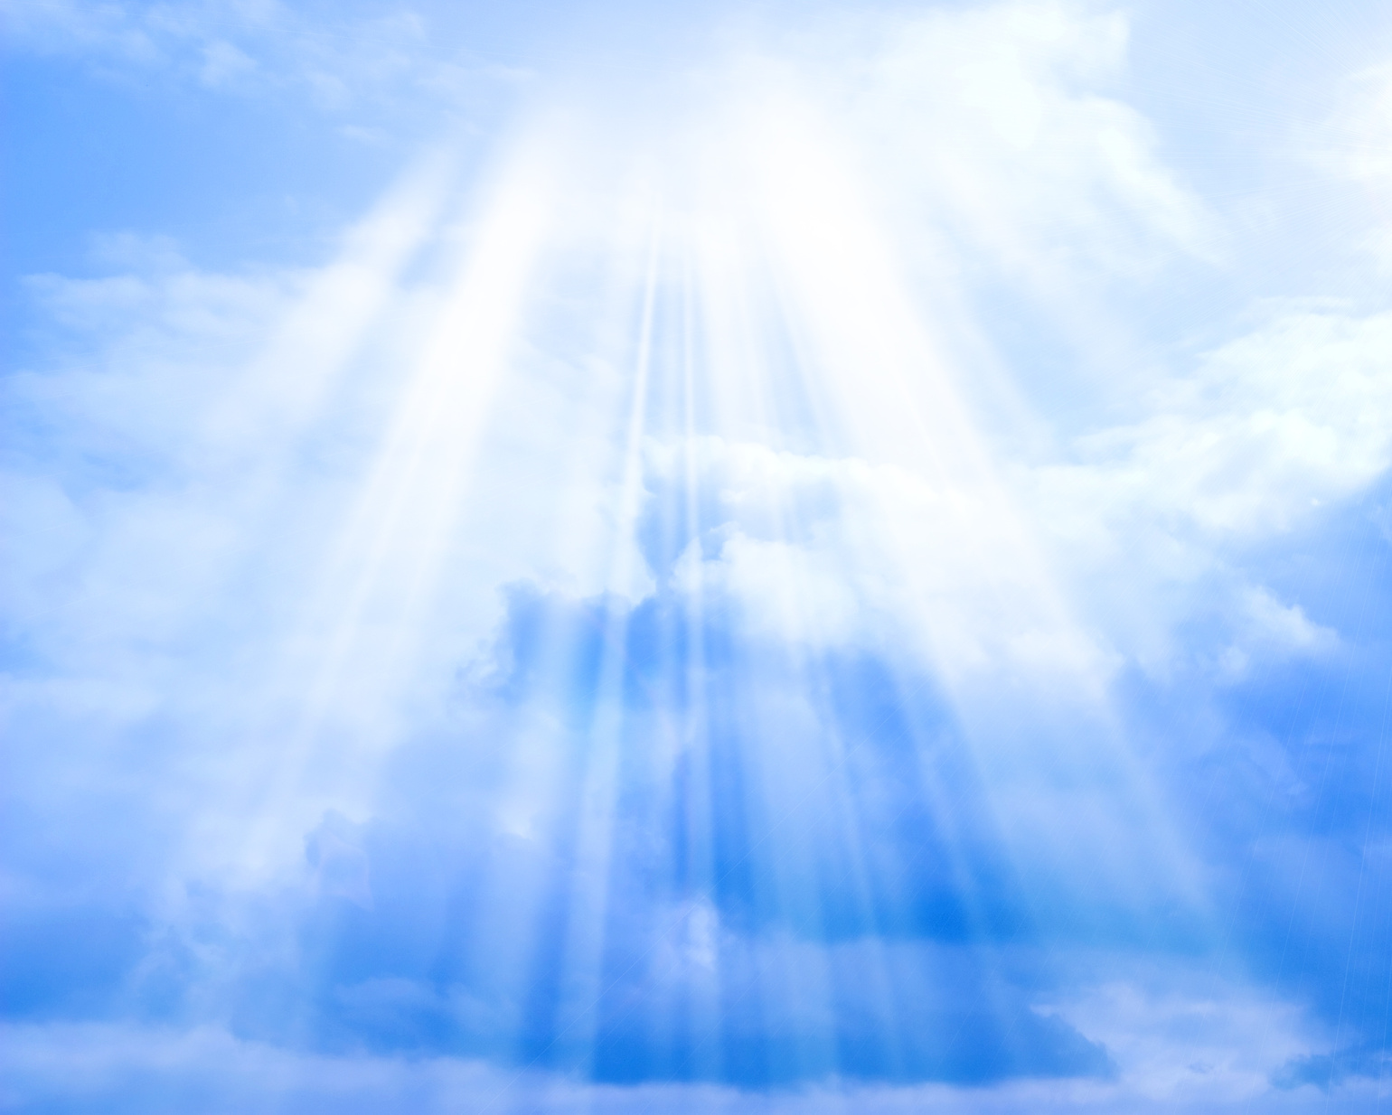
So the Prophet returned to Allah and asked ‘My Lord, make lighter the burden of my people for they are the weakest of all people.’
Allah replied, ‘I have removed five prayers.’
The Prophet then returned back to Musa, and Musa again said, ‘Go back to your Lord and ask him to make it less, for in truth your people will not be able to do it.’
The Prophet kept returning back to Allah, and Allah reduced it by five prayers until Allah said:

Slide 43
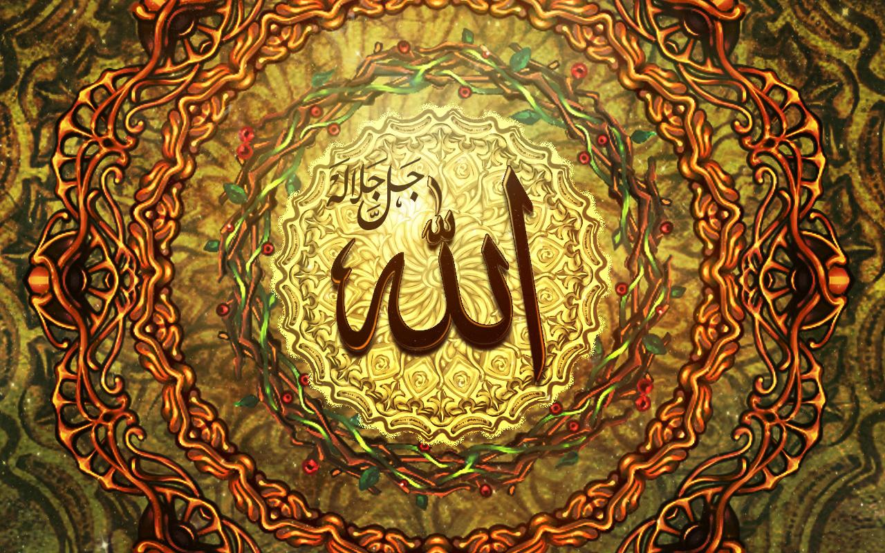
‘Let them be 5 prayers every day and night and let every prayer count as 10. That makes 50 prayers. This word of Mine shall not be changed nor shall My Book be overwritten.
Let whoever is about to perform a good deed even if he does not do it, receive the reward of doing it, while if he does it, he shall receive it multiplied by 10.
Let whoever is about to commit a bad deed, and he does not do it, no sin will be written against him, and if he does it then only one sin will be written against him.’

Slide 44
Jibril then accompanied the Prophet to Jerusalem. The Prophet mounted the Buraq and returned to Makkah.
Back in Makkah the Prophet sat by the Kabah.
The Prophet had the greatest experience that no one else had been honoured with, he had travelled to Jerusalem, and was raised to the heavens, passing each of the 7 heavens up to the Sidrat ul-Muntaha and had spoken with Allah. All in one miraculous night.

