Slide 1
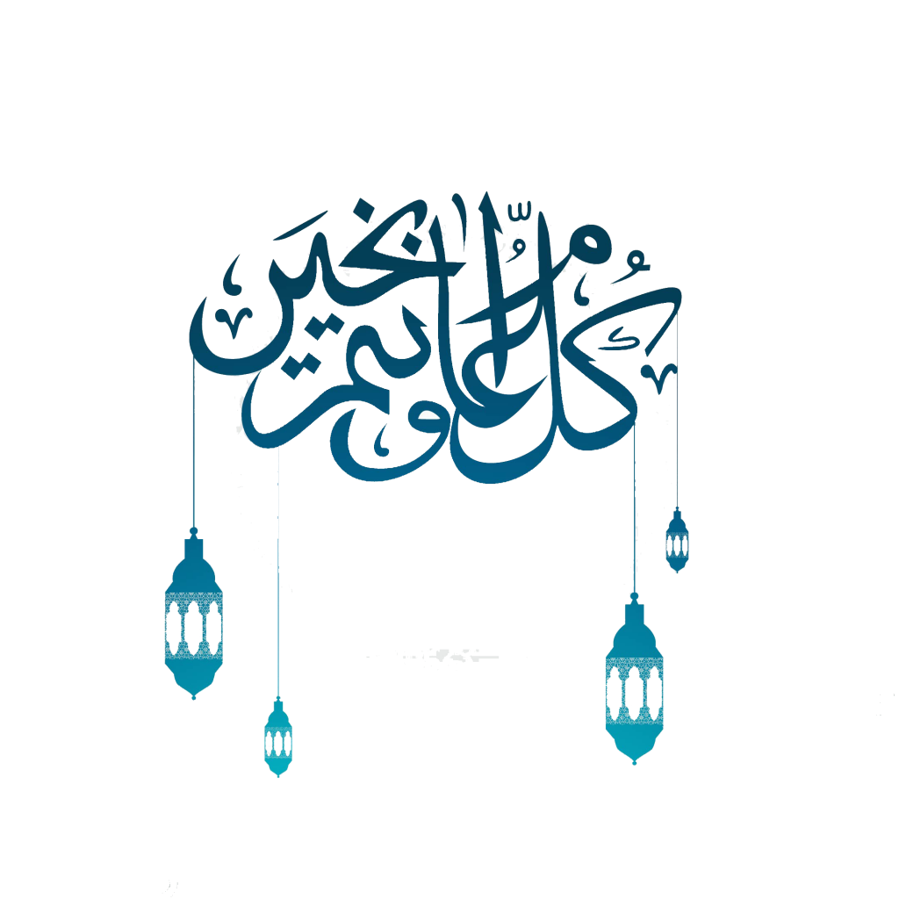
Eid Ul Adha

Slide 2
“Allah’s Messenger ﷺ used to offer the prayer of Eid Ul Adha and Eid Ul Fitr and then deliver the Khutbah after the prayer.”
Sahih Al Bukhari, The Two Eids, Hadith 77

Slide 3
The Two Eids
Muslims have two major days of celebration.
Eid Ul Fitr
Eid Ul Fitr is celebrated after the month of Ramadan (1st Shawwal)
Eid Ul Adha
Eid Ul Adha is celebrated on the 10th Day of Dhul Hijjah
Muslims have been given a special salah on these days to express their happiness and gratitude to Allah for giving them a day of celebration.

Slide 4
Eid Ul Adha
Celebrated during the Days of Hajj, Muslims emulate the efforts of Ibrahim (AS). How his submission (the act of sacrifice) to the command of Allah, was loved by Allah. Mankind will continue this act until the end of time.

Slide 5
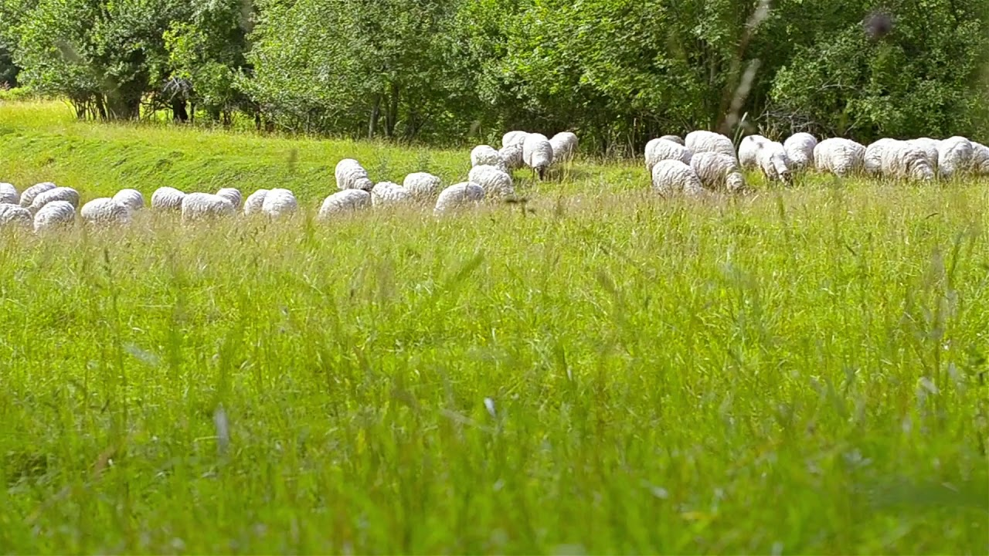
"It is not their meat nor their blood that reaches Allah; it is your piety that reaches Him" (Qur'an 22:37)

Slide 6
Remembering Ibrahim A. S
Eid Ul Adha remembers the prophet Ibrahim’s (AS) willingness to sacrifice his son when ordered to by Allah.
Allah appeared to Ibrahim (AS) in a dream and asked him to sacrifice his son Isma'il as an act of obedience. The Devil tempted Ibrahim by saying he should disobey Allah and spare his son.
As Ibrahim was about to kill his son, Allah stopped him and gave him a lamb to sacrifice in his place.
Lesson
This shows Ibrahim's obedience to Allah. It is important for Muslims to remember that Allah does not want the animal or its meat; Allah wants Muslims to show that they are devoted to him.

Slide 7
Remembering Ibrahim A. S
Eid Participation
By taking part in this Eid, Muslims show that they too are prepared to sacrifice their lives for Allah.
Eid is celebrated in the following way:
A sheep or goat may be sacrificed as a reminder of Ibrahim's obedience to Allah. The meat is shared out among family, friends and the poor, each getting a third share.
Importance of Eid
Eid ul-Adha is important to Muslims today as it reminds them of Ibrahim's obedience, prompting them in turn to consider their own obedience to Allah. Muslims may ask for forgiveness for times when they have not been fully devoted to Allah.

Slide 8
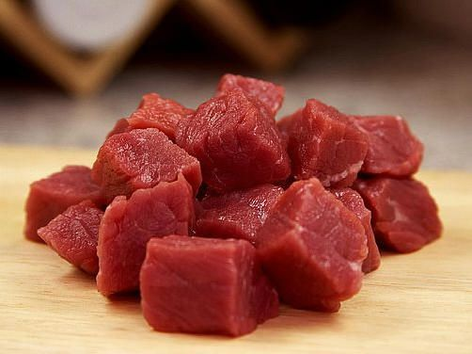
Udhiyyah
Each adult member of the household who has wealth equal to the Nisab of Zakah would have to make their separate Qurbani.
A parent does not have to make Qurbani for their small children who are not baligh (the age of maturity).

Slide 9
Udhiyyah
Qurbani animals have shares. Sheep and goats have one share each, camels and cattle each have seven shares. So for a single person, Qurbani is fulfilled with a sheep or a goat. Up to seven people can share in the purchase of a cow or a camel, and the sacrifice will be made for the seven.
1 small animal (Sheep or Goat) = 1 Qurbani 1 large animal (Cattle) = 7 Qurbanis You can make as many Qurbanis as you want – for example two or three shares in a cow - and on behalf of as many individuals as you like, including those who have passed away.

Slide 10
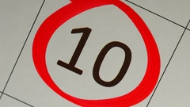
Best time to perform Udhiyyah
Qurbani can be performed from the 10th day of the month of Dhul-Hijjah until the sun sets on the 12th of Dhul-Hijjah.
The best time is to perform the act of Qurbani is immediately after the completion of the Eid-ul-Adha prayers.

Slide 11
Takbir Tashriq
Takbir Tashriq is to be recited by all males and females once after every salah from the Fajr of the 9th of Dhul Hijjah to the Asr of 13th Dhul Hijjah. Males will recite it in a moderately loud voice whilst women will recite it in a soft voice.
Translation
Allah is most great. Allah is most great. There is no
God besides Allah and Allah is most Great. Allah is
most Great and Verily all praises are for Allah.

Slide 12
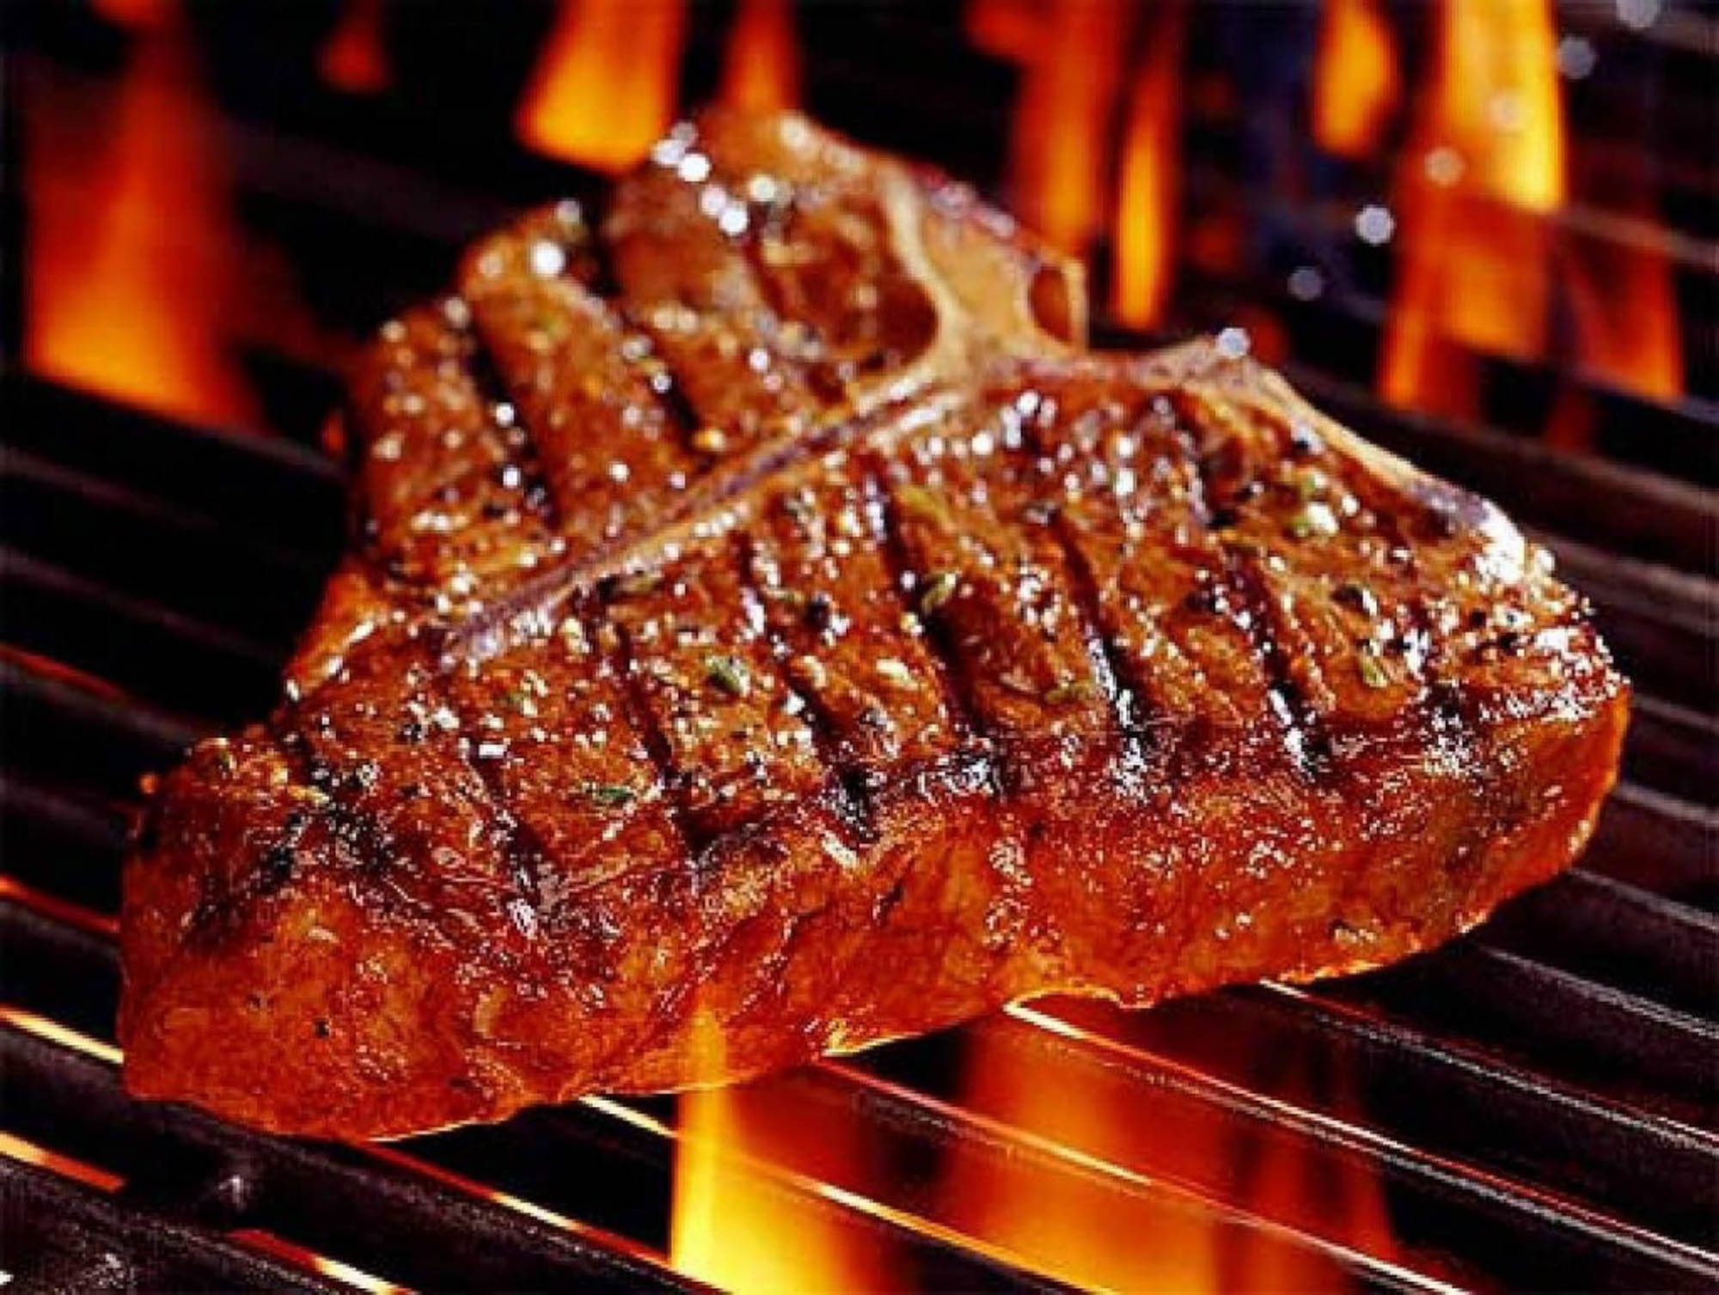
Sunan of Eid
Wake up early
Express Happiness
Use a Miswak
Perform Ghusl
Dress in your best clothes
Apply ‘Itr
Arrive early for Salah
Walk to the place of Salah
It is sunnah to eat qurbani meat after Eid Ul Adha Salah

Slide 13
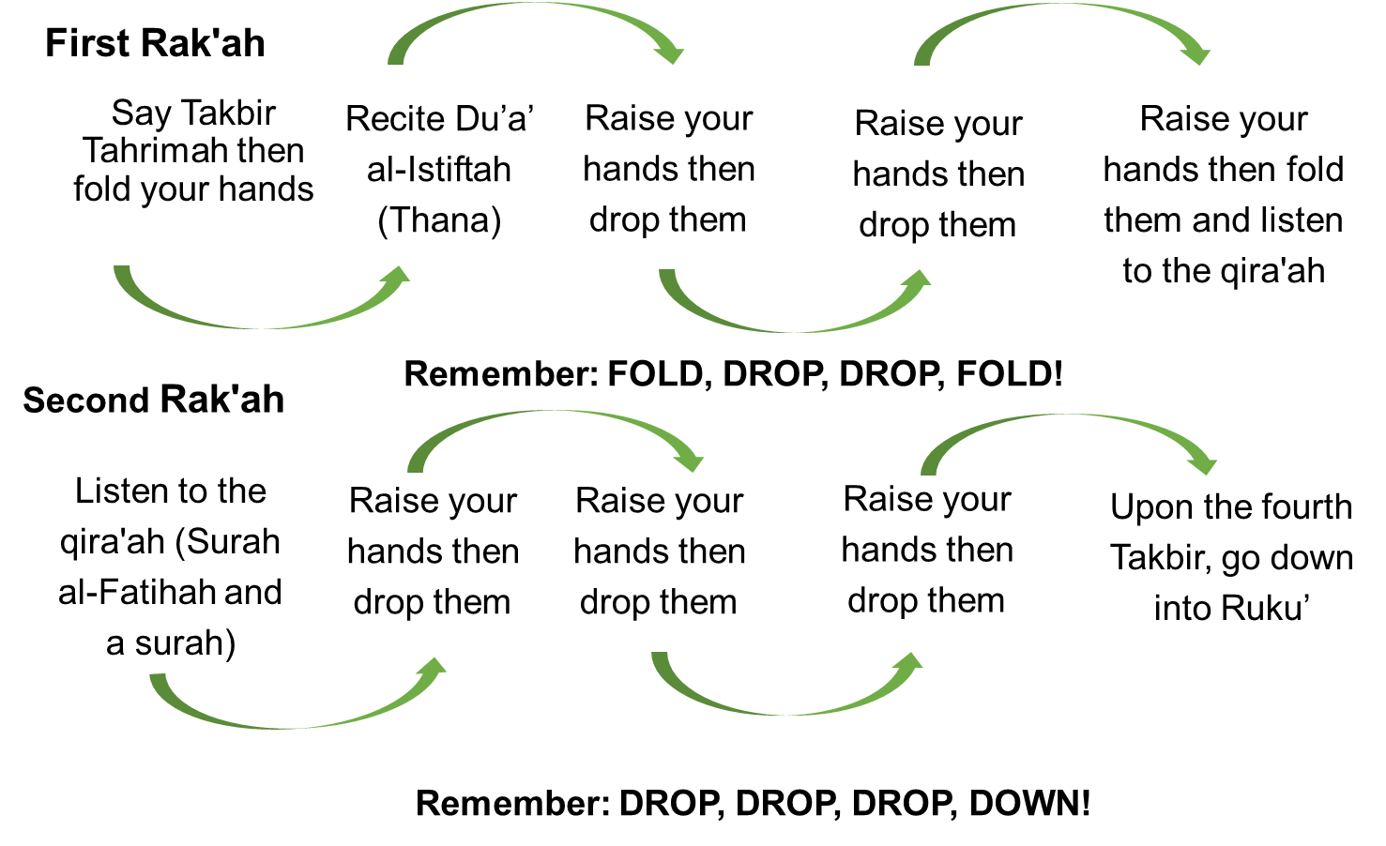
Method of
Eid Salah

Slide 14
What to Avoid during Eid Ul Adha
Eid is a time of celebration, to show gratitude to Allah. We must ensure we celebrate in obedience to Him.
The days of Eid are also a time when it is impermissible (Haram) for a person to observe Sawm for any reason.

Slide 15
JazakAllahu Khayra!
Any questions?
You can contact us @ an-nasihah.com/contact

