Slide 1
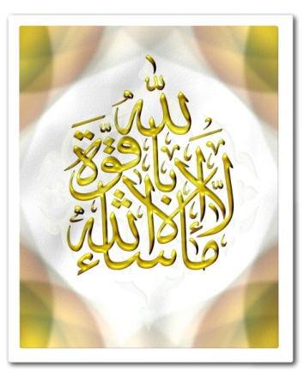
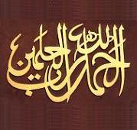
THIS CERTIFIES THAT
has successfully completed10-15 Juzz of The Qur’an, and is therefore awarded this
CERTIFICATE
(3 of 6)
May Allah accept your hard work and grant you Tawfeeq to progress further.
Islamic Studies
Islamic Studies Teacher Headteacher

