Slide 1
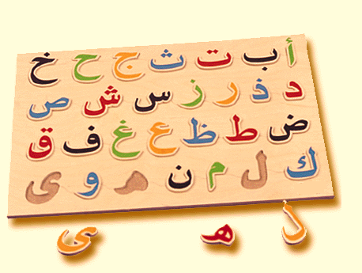
Arabic alphabet II
Learn the Different Forms of Each Letter

Slide 2
Unit outline
Lesson 1: The forms of alif
Lesson 2: The forms of baa, taa, & thaa
Lesson 3: The forms of jeem, haa, and Khaa
Lesson 4: The forms of daal and dhaal
Lesson 5: The forms of raa and zaa
Lesson 6: The forms of seen and sheen
Lesson 7: The forms of saad & daad
Lesson 8: The forms of taw & thaw
Lesson 9: The forms of ein and ghein
Lesson 10: The forms of faa & qaaf
Lesson 11: The forms of kaaf & Laam
Lesson 12: The forms of Meem and noon
Lesson 13: The forms of haa, waw, and yaa

Slide 3
There are 29 letters in the Arabic alphabet
ا ب ت ث ج ح خ د ذ ر ز س ش ص ض ط ظ ع غ ف ق ك ل م ن ه ي ء

Slide 4
Each letter has three forms based upon where it occurs in a word
A letter can be at the beginning of a word---beginning form
A letter can inside the word---medial form
A letter can be at the end of the word—end form

Slide 5
To read arabic, you must learn the three forms of each letter

Slide 6
Lesson 1: The forms of alif (ا)
End of a word | Medial position of a word | Beginning of a word
Alif has only two distinct forms because the ending and middle forms look the same.
Tell how the forms are different and how they are the same.
Why does the beginning and middle forms alif form not have a connector after it?

Slide 7
Forms of alif in action
End of a word | Medial position of a word | Beginning of a word
ﺁسيا | بَاب | أرْنَب

Slide 8
Next steps:
Practice writing each form of alif: Worksheet 1
Use flashcards to review the forms of alif.
Using a mus-haf or book of ahadith, Identify the forms of alif in words.

Slide 9
Lesson 2: The forms of ب ت ث
The forms of baa, taa, and thaa are similar so we will learn them altogether…
End of a word | Medial position of a word | Beginning of a word
Tell how the forms are different and how they are the same.

Slide 10
Forms of ب ت ثin action
End of a word | Medial position of a word | Beginning of a word | Letter
باب | ابواب | باب | ب
تَخت | تَكْتَكَ | تاج | ت
ليث | اثنين | ثلْجَ | ث

Slide 11
Next steps:
Practice writing each form of each letter: Worksheet 2 3 4
Use flashcards to review all forms learned so far.
Identify the forms in words and in the Quraan/ahadith

Slide 12
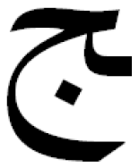
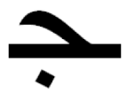
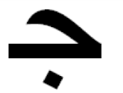
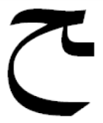
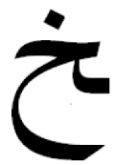
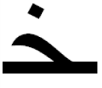
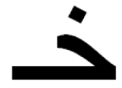
Lesson 3: The forms of ج ح خ
The forms of baa, taa, and thaa are similar so we will learn them altogether…
End of a word | Medial position of a word | Beginning of a word
Tell how the forms are different and how they are the same.

Slide 13
Forms of ج ح خ in action
End of a word | Medial position of a word | Beginning of a word | Letter
ثَلْج | تجر | جَبَل | ج
بلح | بحر | حَبْل | ح
الخ | بخيل | خَبَر | خ

Slide 14
Next steps:
Practice writing each form of each letter. Worksheet 5 6 7
Use flashcards to review all forms learned so far.
Identify the forms in words and in the Quraan/ahadith

Slide 15
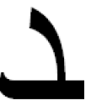
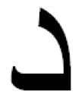
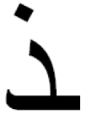
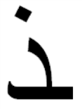
Lesson 4: The forms of د ذ
The forms of baa, taa, and thaa are similar so we will learn them altogether…
End of a word | Medial position of a word | Beginning of a word
Tell how the forms are different and how they are the same.

Slide 16
Forms of د ذ in action
End of a word | Medial position of a word | Beginning of a word | Letter
عقد | مَدخل | دَخَلَ | د
أخذ | تذكير | ذِكْر | ذ

Slide 17
Next steps:
Practice writing each form of each letter: Worksheets 8 9
Use flashcards to review all forms learned so far.
Identify the forms in words and in the Quraan/ahadith

Slide 18
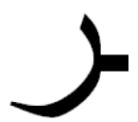
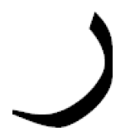
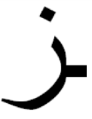
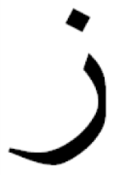
Lesson 5: The forms of ر ز
The forms of baa, taa, and thaa are similar so we will learn them altogether…
End of a word | Medial position of a word | Beginning of a word
Tell how the forms are different and how they are the same.

Slide 19
Forms of ر زin action
End of a word | Medial position of a word | Beginning of a word | Letter
أجر | عرش | رجل | ر
عز | عزيز | زيت | ز

Slide 20
Next steps:
Practice writing each form of each letter. Worksheets: 10 11
Use flashcards to review all forms learned so far.
Identify the forms in words and in the Quraan/ahadith

Slide 21
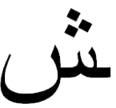
Lesson 6: The forms of س ش
The forms of baa, taa, and thaa are similar so we will learn them altogether…
End of a word | Medial position of a word | Beginning of a word
Tell how the forms are different and how they are the same.

Slide 22
Forms of س شin action
End of a word | Medial position of a word | Beginning of a word | Letter
شمس | جسم | سمع | س
ناقش | كبشان | شمس | ش

Slide 23
Next steps:
Practice writing each form of each letter: Worksheets 12 13
Use flashcards to review all forms learned so far.
Identify the forms in words and in the Quraan/ahadith

Slide 24
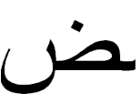
Lesson 7: The forms of ص ض
The forms of baa, taa, and thaa are similar so we will learn them altogether…
End of a word | Medial position of a word | Beginning of a word
Tell how the forms are different and how they are the same.

Slide 25
Forms of ص and ضin action
End of a word | Medial position of a word | Beginning of a word | Letter
مصَّ | قصير | صبون | ص
مريض | فضَّل | ضَحك | ض

Slide 26
Next steps:
Practice writing each form of each letter: Worksheets 14 15
Use flashcards to review the forms.
Identify the forms in words in the Quraan and ahadith.

Slide 27
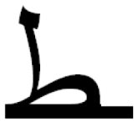
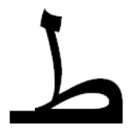
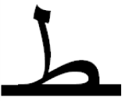
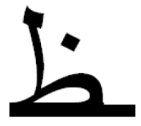
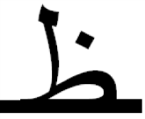
Lesson 8: The forms of ط ظ
The forms of baa, taa, and thaa are similar so we will learn them altogether…
End of a word | Medial position of a word | Beginning of a word
Tell how the forms are different and how they are the same.

Slide 28
Forms of ط ظ in action
End of a word | Medial position of a word | Beginning of a word | Letter
كشط | عطر | طَريق | ط
بظَّ | عظيم | ظُهْر | ظ

Slide 29
Next steps:
Practice writing each form of each letter: Worksheets 16 17
Use flashcards to review all forms learned so far.
Identify the forms in words and in the Quraan/ahadith

Slide 30
Lesson 9: The forms of ع غ
The forms of baa, taa, and thaa are similar so we will learn them altogether…
End of a word | Medial position of a word | Beginning of a word
Tell how the forms are different and how they are the same.

Slide 31
Forms of ع غ in action
End of a word | Medial position of a word | Beginning of a word | Letter
أطبع | معروض | عَرَفَ | ع
أدبغ | يغزل | غَيْر | غ

Slide 32
Next steps:
Practice writing each form of each letter: Worksheets: 18 19
Use flashcards to review the forms.
Identify the forms in words.

Slide 33
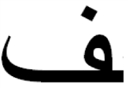
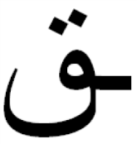
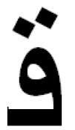
Lesson 10: The forms of ف ق
The forms of baa, taa, and thaa are similar so we will learn them altogether…
End of a word | Medial position of a word | Beginning of a word
Tell how the forms are different and how they are the same.

Slide 34
Forms of ف ق in action
End of a word | Medial position of a word | Beginning of a word | Letter
سَيْف | سِفْر | فَجْر | ف
شَقَّ | سَقَطَ | قَمَر | ق

Slide 35
Next steps:
Practice writing each form of each letter: Worksheets 20 21
Use flashcards to review all forms learned so far.
Identify the forms in words and in the Quraan/ahadith

Slide 36
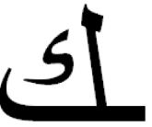
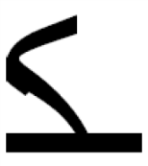
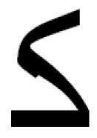
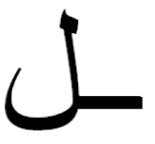
Lesson 11: The forms of ك ل
The forms of baa, taa, and thaa are similar so we will learn them altogether…
End of a word | Medial position of a word | Beginning of a word
Tell how the forms are different and how they are the same.

Slide 37
Forms of ك ل in action
End of a word | Medial position of a word | Beginning of a word | Letter
ضَحِكَ | أكْل | كِتاب | ك
حَبْل | سُلَّم | لَيْل | ل

Slide 38
Next steps:
Practice writing each form of each letter: Worksheet 22 23
Use flashcards to review all forms learned so far.
Identify the forms in words and in the Quraan/ahadith

Slide 39
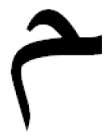
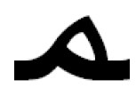
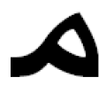
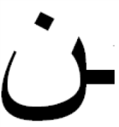
Lesson 12: The forms of م ن
The forms of baa, taa, and thaa are similar so we will learn them altogether…
End of a word | Medial position of a word | Beginning of a word
Tell how the forms are different and how they are the same.

Slide 40
Forms of م نin action
End of a word | Medial position of a word | Beginning of a word | Letter
أنْتُم | شَمْس | مَكْتَب | م
سَكَنَ | تَنْزيل | نار | ن

Slide 41
Next steps:
Practice writing each form of each letter: Worksheets 24 25
Use flashcards to review all forms learned so far.
Identify the forms in words and in the Quraan/ahadith

Slide 42
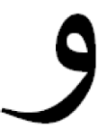
Lesson 13: The forms of ه و ي
The forms of baa, taa, and thaa are similar so we will learn them altogether…
End of a word | Medial position of a word | Beginning of a word
Tell how the forms are different and how they are the same.

Slide 43
Forms of ه و يin action
End of a word | Medial position of a word | Beginning of a word | Letter
الَيْهِ | شَهْر | هِجْرَة | ه
جَوّ | ثَوْب | وَرْدَة | و
حيّ | أيَّام | يَوْم | ي

Slide 44
Next steps:
Practice writing each form of each letter: Worksheet 26 27 28
Use flashcards to review all forms learned so far.
Identify the forms in words and in the Quraan/ahadith

Slide 45
Final ending when a letter follows a “selfish” letter
We have learned the various forms of each letter. However, there is one more thing that should be mentioned.
When a letter is in the medial or final position and it follows one of the letters that doesn’t connect to the letter after it (ا د ذ ر ز و), the medial or final form is the isolated (standalone form) without a lead connector
Examples:
اذا | خدر | تاج

Slide 46
Hamzah
Hamzah itself doesn’t change its form, but it can “ride” on a number of letters in their different forms according to where it occurs in a word.
ﺊ ﺆ ﺅ ﺈ ﺄ ﺃ ﺇ
Hamzah can also just “ride” on connectors or appear by itself:
ءﺌ ﺋ

