Slide 1
Animals in the Quran
Banan
Mahmaljy Obeid

Slide 2
How many animals are mentioned
How Often Are Animals Mentioned
In The Quran?

Slide 3
How many Ayat mention animals?

Slide 4
How many Suwar are named after animals?

Slide 5
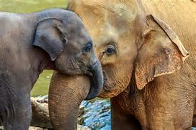
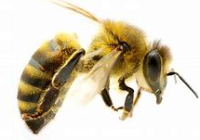
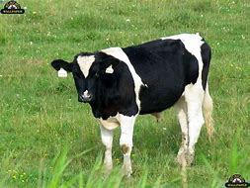
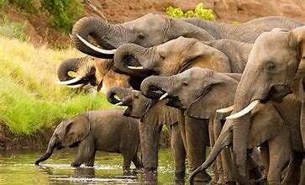
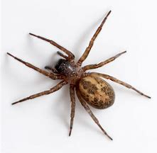
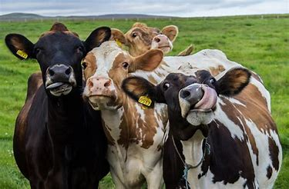
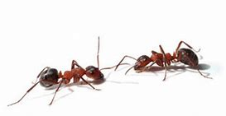
35 Animals/insects are mentioned
200 AYAT mention animals
6 Suwar NAMED AFTER animals:
1. Al- Baqarah: The Cow
2. Al- Naml: The Ant
3. Al-Anaam: The Cattle
4. Al-Nahl: The Bee
5. Al-Ankabut: The Spider
6. Al-Feel: The Elephant
(Search for these Suwar in the Quran)

Slide 6
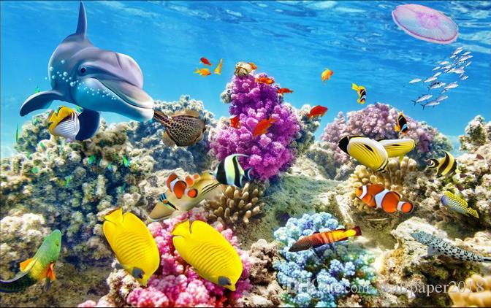
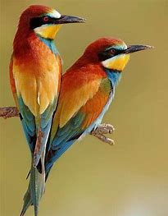
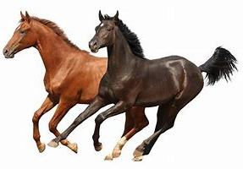
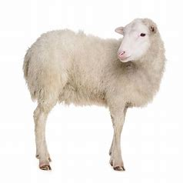
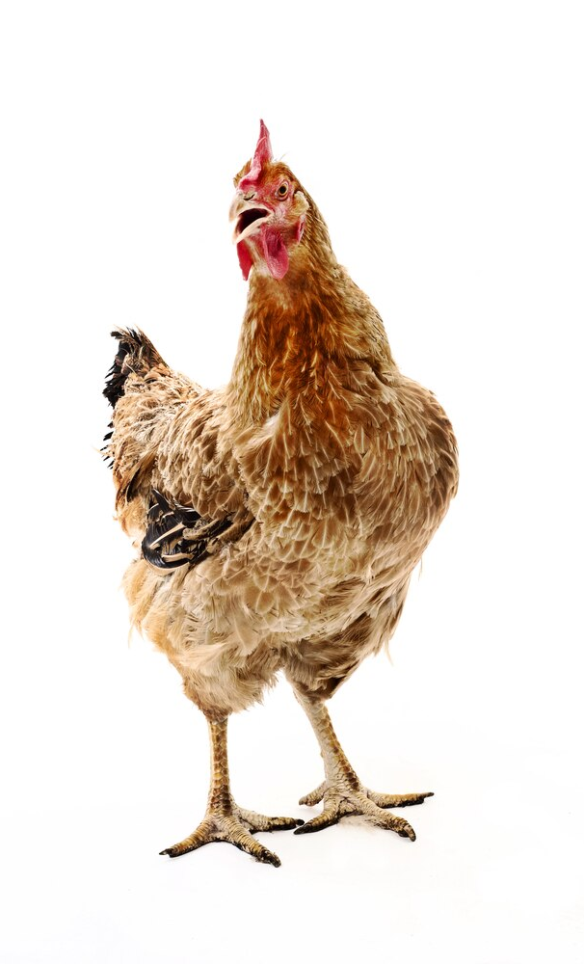
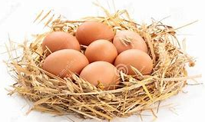
In What Context Are They Mentioned?
Proof of a Creator:
Contemplating the creation of Allah (SWT) increases our faith. It is mind-boggling to study the millions of animal species on Earth, and the amazing complexities of each animal community.
Muslims believe that all animals recognize their Creator and praise Him, even though we can not understand their language.
Benefits to Humans:
The Qur'an says that animals benefit humans in many ways.
They are mentioned as examples of Allah’s blessings upon us.
They can serve as great companions and are aesthetically pleasing to look at- therefore benefitting us psychologically and emotionally.
Animals provide us with nutritional benefits with their meat, milk and eggs.
We also benefit from their feathers, wool, hair and skin (leather) for making fibers, warm clothing, shoes, bags and rugs.
Since the beginning of time, humans depended on animals for transportation – before cars were invented, humans rode horses, donkeys and camels to get from one pace to another. Even today we ride these animals for recreational purposes.

Slide 7
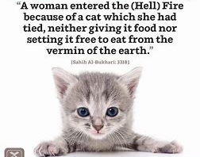
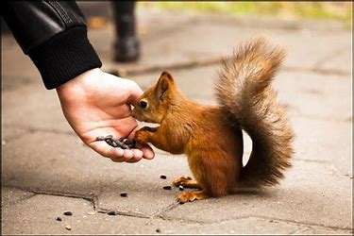
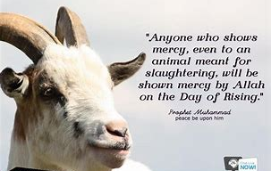
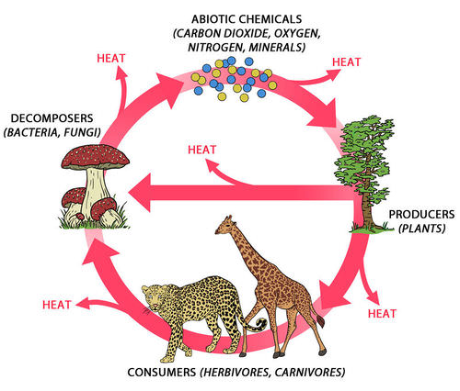
Our responsibility towards animals:
Allah (SWT) entrusted us as the care-takers of the Earth. It is our religious duty to treating animals with mercy. Animal cruelty is prohibited in Islam.
مَا مِنْ مُسْلِمٍ يَغْرِسُ غَرْسًا أَوْ يَزْرَعُ زَرْعًا فَيَأْكُلُ مِنْهُ طَيْرٌ أَوْ إِنْسَانٌ أَوْ بَهِيمَةٌ إِلَّا كَانَ لَهُ بِهِ صَدَقَةٌ
The Prophet (S) said:
“There is no Muslim who plants a tree or sows a seed and then a bird, or a person, or an animal eats from it, except that it is regarded as a charity for him.”
Animals are an integral part of the Earth's ecosystem:
Each organism in the ecosystem An ecosystem is a community of living and nonliving organisms working together. The air, plants, animals, soil and even bacteria are interconnected. They work together to support the ecosystem. Without animals, there would be dysfunction within the system and human life would be disrupted.

Slide 8
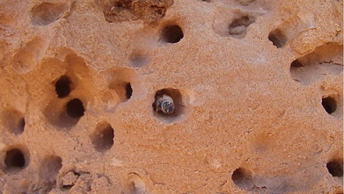
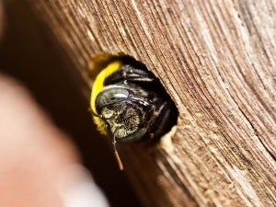
1. The Bee
Surat Al Nahl (#16)
Ayat 68, 69
In this Ayah, Allah (S) speaks of the bee in the “feminine” form, ordering “her” to take a home within the mountains and the trees and in the home she builds (of wax).
We know that bees build their hives from their own wax, but scientists now know that some bees (carpenter bees) build hives in wood and some can even drill into solid stone-just as the Ayah mentions.
During the Prophet (S)’s time, they did not have knowledge about the different types of bees.

Slide 9
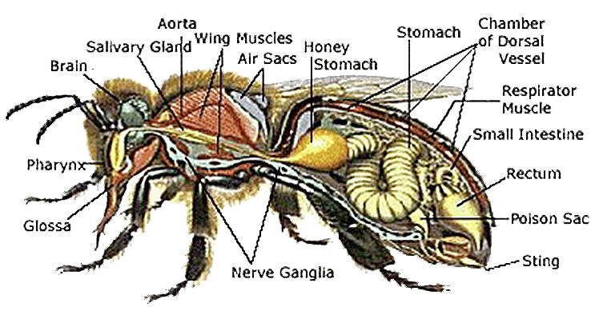
-The verse referred to above is all in the feminine tense. In the world of bees, it is a female’s world. The male has no real input apart from the reproduction process. The females are the workers, builders and defenders of the hive. How could the Prophet have known this fact if the Quran had not been the words of the Creator?? -The verse mentions “belly” in the plural tense: “bellies” Scientists now know that honeybees have an extra stomach dedicated for honey. An illiterate man 1400 years had no access to this knowledge, yet we find it in the Quran. -The verse mentions that the honeybees produce honey in many different colors. Around the world we find honey that is amber, gold, red and bronze- depending on the type of flower from which the pollen is extracted. The honey also differs in intensity and flavor. -The verse mentions that the honey has healing properties. Modern medicine teaches us that honey is a natural antibiotic, which helps heal wounds and burns, and boosts immunity and prevents scarring.
Then, eat of all fruits, and follow the ways of your Lord made easy (for you).” There comes forth from their bellies, a drink of varying color which has healing for mankind. Verily, in this is indeed a sign for people who think.”

Slide 10
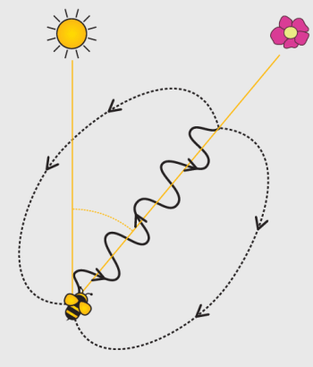
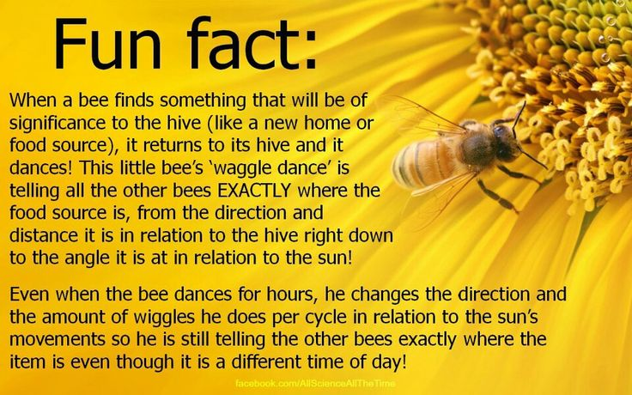
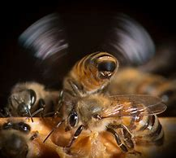
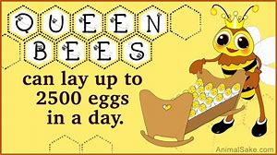
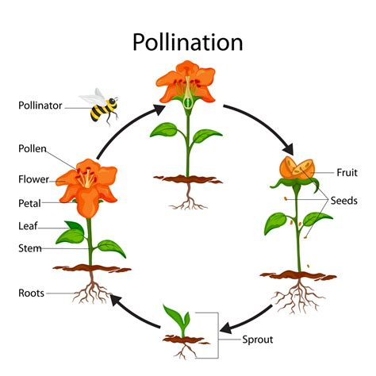
Amazzzzing Bee Facts….. (SubhanAllah)
*Bees flap their wings 11,000/minute to control the temperature of the
it at 92-93 degrees at all times. This is the loud buzz you hear!
* Without bees, half the plants would disappear.
Cross-pollination is essential for plant health.
It’s amazing that an insect the size of a thumbnail is so remarkable!
Who taught it what to do? Who programmed it to work as it does?
It’s creation is a benefit to us, but also a MIRACLE to ponder over Allah’s creation
and be humbled by His unique design.

Slide 11
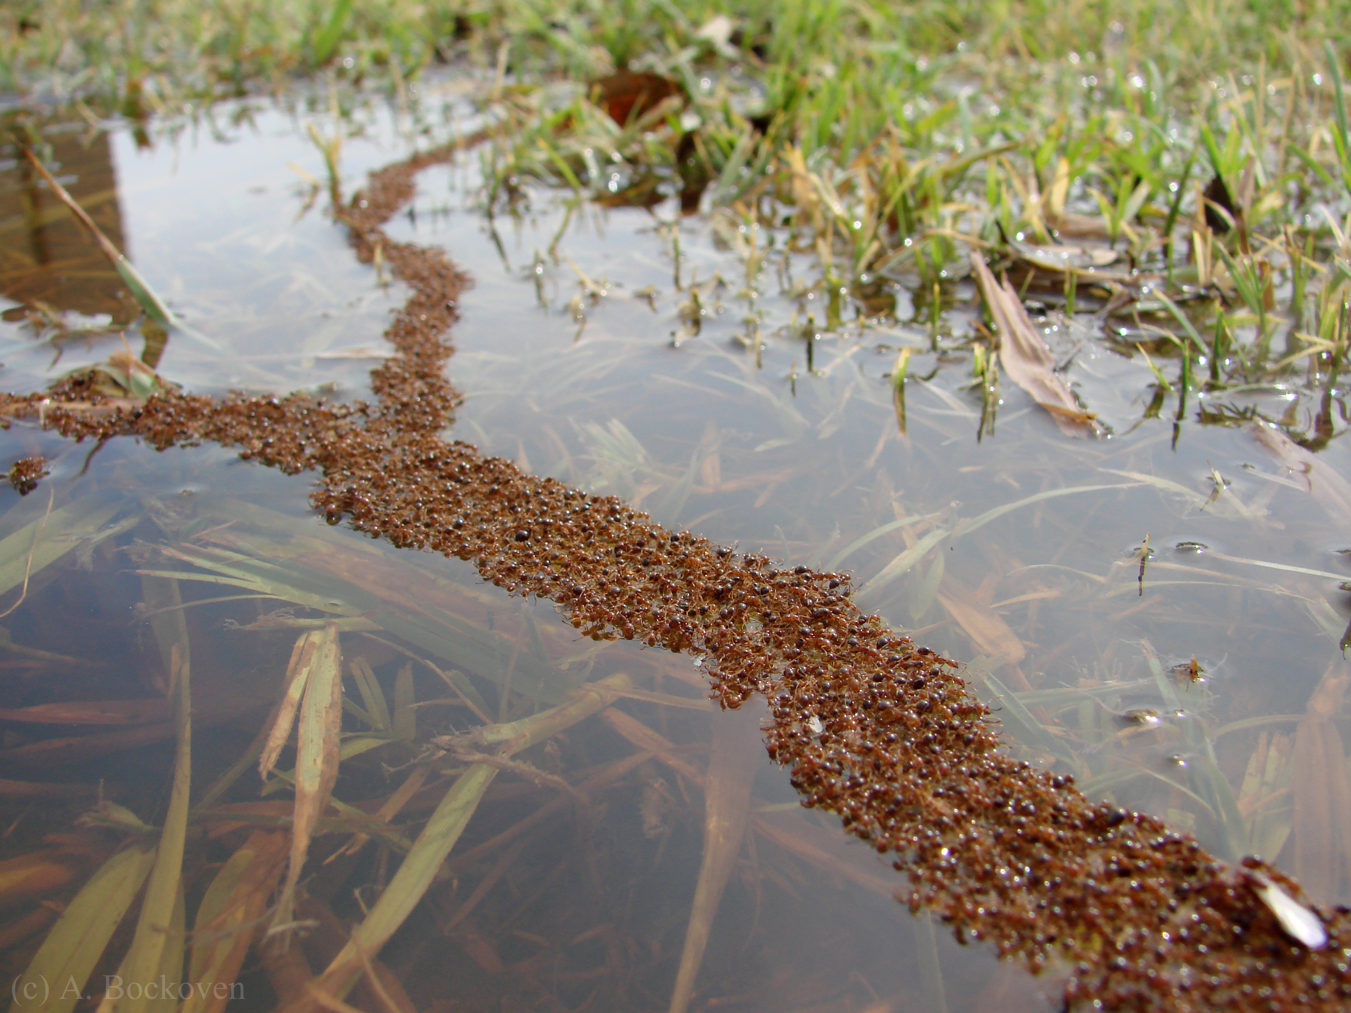
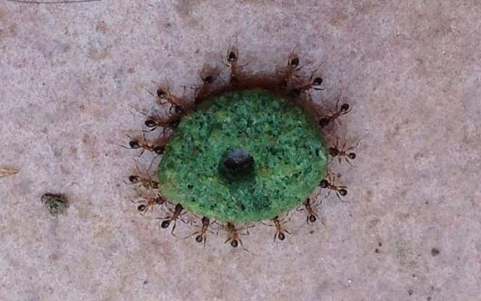
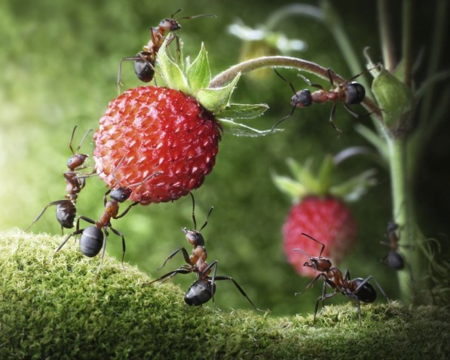
The Ant
- For each human on Earth there are 1.5 million ants.
There are 12,000 species of ants on Earth
Ants are capable of carrying objects approximately 30 times their own body weight with their mandibles (jaws). Relative to their size, their muscles are thicker than those of larger animals or even humans. We are God’s best creation, and at times it feels like we have troubles that weigh us down, but if we take the ant as a parable, then we really can find the inner strength, collectively, to get past the hurdles we face.
TEAMWORK makes the dream work. This could never be truer than with the ant. As we have mentioned, they can lift some serious weight, but what is more impressive, is the way in which they can work together to achieve great feats. Ants can join arms to create a living raft to facilitate movement across the water and protect their queen!

Slide 12
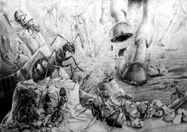
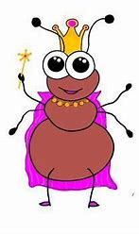
Ayat from Surat Al-Naml
Verse 18 of Surat Al Naml mentions the story of Prophet Sulieman as he is marching with his army. When they approached the ant colony a “female” ant warned the rest to take shelter so that Sulieman and his army would not “shatter” them unknowingly.
Scientists proved in 2009 that ants do have a language of their own and that the Queen ant
is the leader responsible for protecting her colony. We also know that due to the skeletal
structure of the ant, when it is stepped on, it is shattered rather crushed.
This is the exact description used by Allah in the Ayah above.
Suliman’s response to hearing this ant speak was that he smiled and thanked Allah for giving him this beautiful gift.
This is a duaa that is recited by all Muslims.

Slide 13
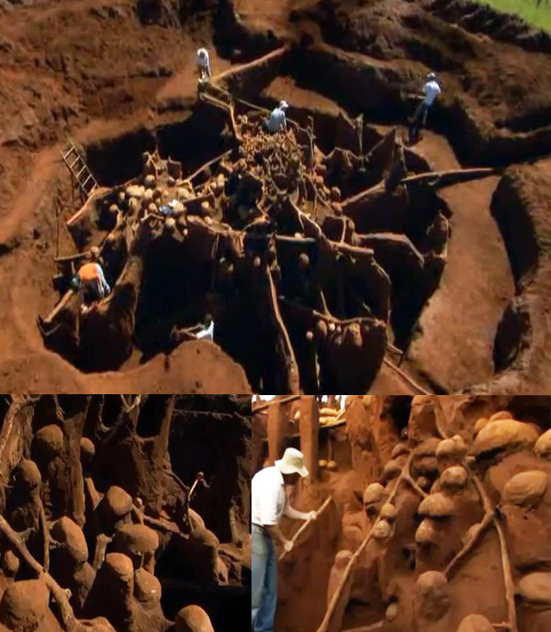
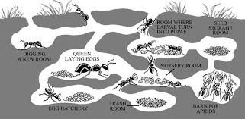
Socially speaking, ants are the most similar creature to humans
Interesting
Ant
Facts
They have highly organized societies-colonies
They live in groups and work together to solve problems
They cooperate in searching for food and taking care of the Queen ant.
They divide work based on the age of the ants.
They communicate by “talking” and by the use of chemical trails.
They have funerals/morn for their dead for days before burying them!
SubhanAllah!

Slide 14
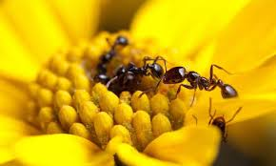
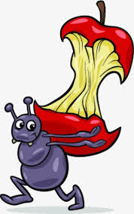
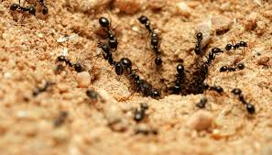
Benefits of Ants
*Their tunnels aerate the soil, allowing water and nutrients to flow to plant roots, helping them grow.
*In the process of collecting food, they help distribute seeds and pollinate plants.
*Their excretions (waste) change the chemistry of the soil for the better.
*They are decomposers- they eat organic waste, insects or other dead animals. They help keep the environment clean. ...
Ants are Allah’s natural Vacuum!

Slide 15
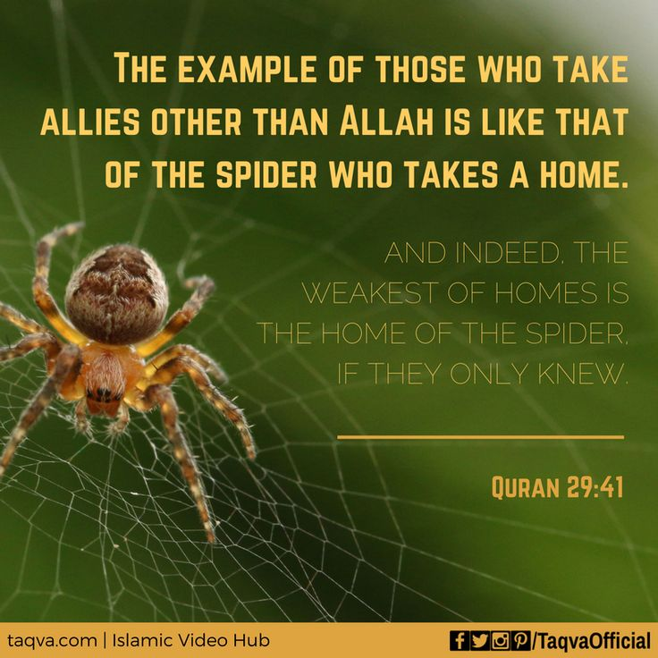
The Spider
“This is an example given by Allah, the Almighty, of the idolaters who revere gods besides Allah. The idolaters hope that those gods will assist them, provide for them, and they turn to them in times of hardship. In this regard, they are like the spider’s house, in its weakness and frailty, because by clinging to these gods they are like a person who holds on to a spider’s web and does not gain any benefit from that. Had they known this, they would not have taken protectors other than Allah. This is unlike the Muslim believer, whose heart is devoted to Allah and, in addition, does well in following Allah’s decrees. The Muslim has grasped the most trustworthy handle, the one that never breaks because of its strength and stability.”
- The spider is mentioned in the female pronoun ‘it’takhathat baytan” as being the “home builder”. It’s a scientific fact that the male does not assist in this job.
- When the ant and bee are mentioned in the Quran they are referred to in plural form- ants and bees live in communities and work together. However, the spider is mentioned in singular form – spiders live a solitary life, except when mating. Look at how specific the Quran is.

Slide 16
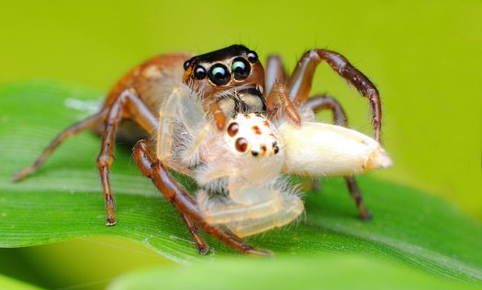
Interesting Facts: The weakness of the house: 1: Physical: The spider’s house, from the physical point of view, is the weakest house of all, because it is made out of a number of delicate silk threads. These threads are interwoven, leaving large separating spaces at most times. Therefore, they do not protect from the heat of the sun, or the extreme cold. These threads do not form adequate shade, nor protect from the rain, storming winds, or the dangers of attackers. This is despite the miraculous building of this house 2. Spiritual: The spider’s house, spiritually speaking, is the flimsiest of all houses, because it is deprived of all love and kindness, which are the pillars of any happy home. The female, in some types of spiders, kills the male as soon as the fertilization takes place. Being larger in size and more violent, the female kills the male and eats its body. In some cases, the female eats its youngsters mercilessly!!

Slide 17
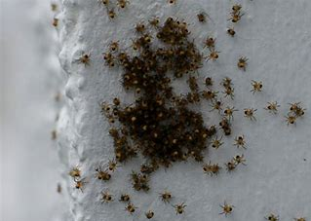
In some types, the female dies after fertilizing its eggs, which are usually fostered in a silk bag. When the eggs hatch, spiderlings come out to find themselves in a very crowded place inside the eggs bag. The siblings then start to fight for food, space or both. The brother kills its brother and sister, and the sister kills its sister and brother, until the fight ends with a few spiderlings remaining. This makes the spider’s house the most violent and ruthless house, lacking all forms of kinship.
Allah (SWT) sets it as a parable(example) in its weakness and frailty because it lacks the simplest form of kindness between the husband and wife, the mother and her children, the brother and his siblings, and the sister and her siblings.

Slide 18
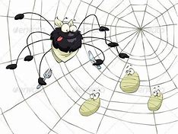
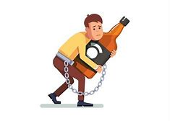
The house of the spider is not merely its dwelling place. Being the sticky net it is, it constitutes a trap for flying insects such as flies and others. These insects are a prey on which the spider feeds. Similarly, those idolaters who revere gods besides Allah, and call people to those revered gods, are in fact calling them to an artful trap which leads them to their death and destruction in this life and the next. Some people may even lure others to their traps with alcohol ,drugs, and the like. The example of the spider’s home is symbolic to these ways in which hunters trap and destroy their prey.
Symbolic Meaning

Slide 19
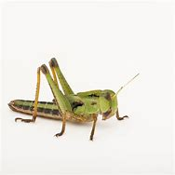
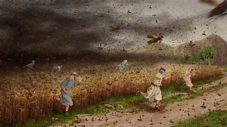
Locusts
Locusts are mentioned in the Quran in Surat Al-Araf Ayah 133:
فَأَرْسَلْنَا عَلَيْهِمُ الطُّوفَانَ وَالْجَرَادَ وَالْقُمَّلَ وَالضَّفَادِعَ
So We sent upon them the flood, and locusts, and lice, and frogs, and blood as distinct signs, but they were arrogant and were a criminal people.
Locusts are mentioned as one of the 7 plagues sent to the people of Firone (The Pharoah) who rejected the message of Musa (AS).
The plagues that were sent were:
Severe Drought
Sever Flooding
Swarms of locusts eating all the crops
Lice
Frogs invading the entire village
Water tuning to blood
Rijz: boils on their skin

Slide 20
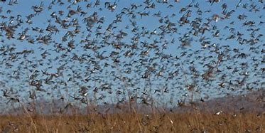
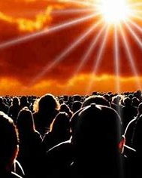
Locust are mentioned in Surat Al Qamar, Ayah #7:
خُشَّعًا أَبۡصَـٰرُهُمۡ يَخۡرُجُونَ مِنَ ٱلۡأَجۡدَاثِ كَأَنَّہُمۡ جَرَادٌ۬ مُّنتَشِرٌ۬
They will come out of the graves with their eyes looking down, like a large swarm of locusts.
This ayah describes the people’s situation on the Day of Judgement when everyone will come out of their graves to be judged.
Why does Allah (S) compare this scene of humans to swarms of locusts? Why locusts?
In the 20th Century, the use of micro cameras taught us a great deal about locusts. NASA satellite data is used to identify desert locust colonies in Africa. Scientists have discovered that locusts behave as a single body!
One swarm can reach up to 460 square miles long and wide, looking like a dark cloud approaching. One swarm can have up to 80 MILLION locusts!

Slide 21
The female locusts dig long tunnels underground, each laying up to 158 eggs. After 2 months, the larvae mature, hatch and emerge in a large group. Some locusts live underground in the dark for years and years before emerging to the surface. The Kuffar of Quraysh doubted that mankind will be brought back to life after dying and being buried in the ground.
The way locusts exist underground for so long, then suddenly emergence in HUGE numbers (all at the same time) resembles the resurrection of human beings on the Day of Judgement.
There is a similarity between the way we will all come out of our graves and way the locusts all come out of the ground.
The Quran made this comparison of billions of men and women coming out of their graves at a time when these technologies did not exist and scientists did not know about locusts living underground. SubhanAllah.

Slide 22
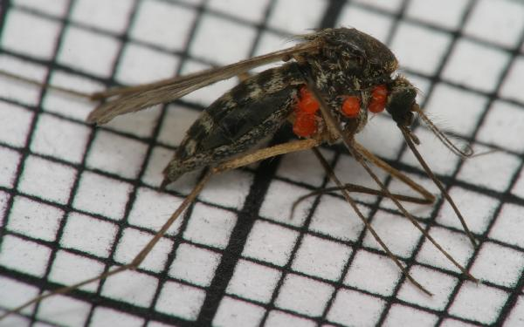
The Mosquito
Allah (S) mentioned the mosquito in the Qur’an in Surat Al Baqara, Ayah #26:
Indeed, Allah doesn’t shy away from using the example of a mosquito or what is above it. And those who have believed know that it is the truth from their Lord. But as for those who disbelieve, they say, "What did Allah use this as an example?" Many are misled by this and many are guided . And only the disobedient are misled.
- The Arabs were impressed with the Quran when it spoke of big animals. - When Allah (S) revealed a Surah describing the war horses, they were impressed because they loved horses. - However, when Allah spoke of the fly and the spider, the disbelievers were not impressed They laughed at those Ayat, asking why Allah would use these examples- if Allah was so great, then why would he mention such insignificant creatures?
They didn’t realize that even the smallest creation is a miracle and a sign of Allah’s existence.
So Allah revealed the Ayah:
Allah does not shy away from using the example of a mosquito and what is on top of it.
After the invention of the electric microscope (which magnifies by 400,000 X’s),
we have discovered hosts- small mites- that live on the female mosquito and take nutrition from her.
Note that the Ayah refers to the mosquito in the female form.
We also know that only the female mosquito sucks blood. This is because she uses the protein from our blood to nourish her eggs.)

Slide 23
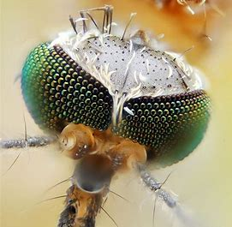
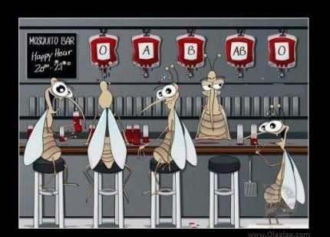
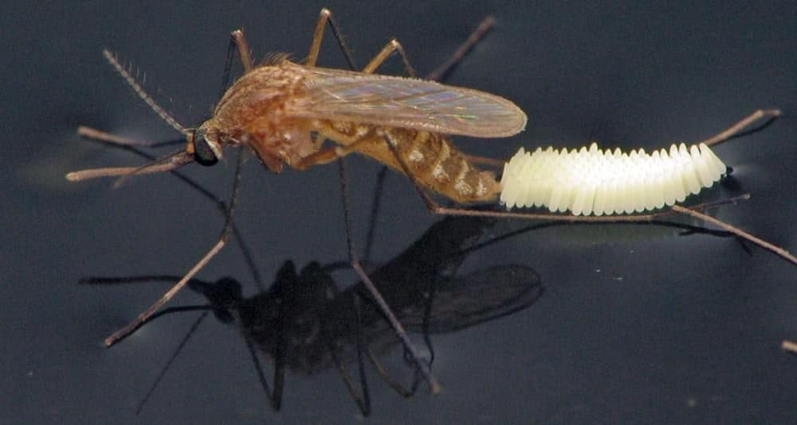
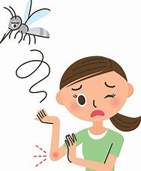
What makes the mosquito so amazing??
The female has a blood testing system. Not all blood types suit her, so she first takes a small sample, then if the blood is the right type, she sucks to her fill.
She has a system that dilutes blood. Our blood is too thick to go through her needle, so she dilutes it first.
She has a sedation device which protects her from being killed. She numbs you while she sucks your blood. By the time she is finished, the sedation wears off and you slap at the itch.
By then she is long gone.
Its head has hundreds of lenses, its “needle” has 47 sharp edges, and its hearts pumps clear “blood” forward and backward through the body.
Mosquitos have what no airplane has. They fly using thermal reception. They detect their surroundings through heat waves. They sense heat since they can’t see size or color. This system helps the female find her victims and determine the best place to lay her eggs.

Slide 24
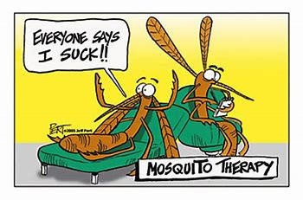
“This is the Creation of Allah. So show me what those other than Me have created. The disbelievers are in great denial” Luqman, Ayah 11
- Mosquito legs have claws that are used when they stand on rough surfaces and hooks for when they stand smooth surfaces.
There are over 3,ooo species of mosquitos. The female lives for one month and the males usually lives for a week.
Mosquitos flap their wings
600 X’s/Second.
Their sense of smell is 10,000 times greater than that of humans- they smell the CO2 we exhale from over 70 ft away!
These creatures are anything but insignificant. Learning about them forces us to ponder Allah’s creation
Allah speaks of such a small creature to show us the complexity of something that weights approximately 5 mg but is SO COMPLEX.
(You need 200,000 mosquitos to weight I lb!!)
The complexity of Allah’s creation is a type of proof that increases our faith in Him as the true Creator.

Slide 25
* Dogs are mentioned 5 times in the Quran. * Nowhere does Allah call them dirty or give any indication that they should be avoided.
The
Dog
In Surat Al Kahf:
Allah described the “Companions of the Cave” as youth who were rightly guided. They escaped an oppressive King who was forcing them to worship other than Allah.
They took refuge and hid in a cave.
Even though Allah does not mention the exact number of people, He does specifically mention that they had a dog with them and that the dog was guarding the entrance of the cave.
The story was not complete without the dog. This detail was not mentioned by accident. Every word in the Quran serves a purpose.
If dogs were prohibited by Allah (S), He would have made that clear in any one of the 5 Ayat in which they were mentioned.
We are encouraged to make use of all of Allah’s creations, just as those righteous youth of the cave had a dog as their companion and guardian.
Dogs can also be used to help us hunt as mentioned in Surat Al-Maidah, Ayah #4.
They ask you, [O Muhammad], what has been made lawful for them. Say, "Lawful for you are [all] good foods and [game caught by] what you have trained of hunting animals which you train as Allah has taught you. So eat of what they catch for you, and mention the name of Allah upon it, and fear Allah .

Slide 26
*Scientific studies show that just petting a dog can help sick people get better and reduce anxiety and stress. *Service Dogs have been very beneficial in helping the disabled, such as guiding the blind or deaf.
So why do Muslims keep away from owning dogs as pets, but they keep cats and other animals??
Dogs are not very clean animals. They do not clean themselves after they relieve themselves, and they can not stop themselves from panting.
This affects the Tahara (purity) of one’s home. One of the requirements for prayer is that our body, clothes and place of prayer are pure. Urine, feces, and the saliva of the dog are Najasa (impurities) and therefore we risk the perfection of our prayer when dogs are present in that space. There is no problem keeping a dog as a watch dog/guard dog/hunting dog because they will not be roaming around the home spreading najasah.
Allah knows best in His wisdom why dog saliva is considered
different than that of other animals such as cats.

Slide 27
The S N A K E
The snake is referenced several times in the Quran in connection to Prophet Musa (AS) and his famous staff.
The staff turning into a snake was one of his miracles to the Pharaoh of Egypt.
And [he was told], "Throw down your staff." But when he saw it writhing as if it was a snake, he turned and ran and did not return.
[Allah said], "O Moses, approach and fear not. Indeed, you are safe.”
The snake has held various meanings throughout history, but for the Egyptians, the people of Musa, it was viewed as a representation of royalty and deities.
Firone’s sorcerers knew how to create chemical reactions that allowed pieces of rope to move, mimicking slithering snakes. In response, Allah allowed Musa’s staff to turn into a REAL snake that ate all the other fake snakes. When the sorcerers saw this, they recognized it as a true miracle, and instantly believed in the message of Musa.

Slide 28
Amazing Snake Factssss…
- The word “cobra” means “hooded.” Some cobras have large spots on the back of their hood that look like eyes to make them appear intimating even from behind.
- Snakes smell with their tongue.
The venom from a Brazilian pit viper is used in a drug to treat high blood pressure
In some snake species, the heart is not found at a fixed point in the body. Instead, it keeps on moving around in order to make room for a prey when it is swallowed by the snake.
Most snakes are not harmful to humans and they help balance the ecosystem by keeping the population of rats, mice and birds under control.
- Some snakes have over 200 teeth. The teeth aren’t used for chewing but they point backward to prevent prey from escaping the snake’s throat.
Snakes cannot chew, so they must swallow their food
whole. They are able to stretch their mouths very wide
because they have a very flexible lower jaw. Snakes can
eat other animals that are 75%–100% bigger than their
own bodies.

Slide 29
Why did Allah (S) create creepy things like bugs? Harmful things like bacteria? Thing that can be used for violence, like weapons? How are these things created FOR me?
IF EVERYTHING ON Earth was created FOR us….
Why does Allah (S) create harmful things?
Things that scare us?
Things we are not allowed to eat/do?

Slide 30
Evil is created in order to show the beauty of what is good. For instance: **If there were no diseases, it would be impossible to know what a great blessing health is. **If there was no darkness, the value of the light could not be understood. ** If there was no evil in the world, the superiority of the good would not be understood.
#1.
Everything is recognized by it’s opposite!
*Happiness is recognized through sadness.
*Good is recognized through evil.
*Cold is recognized through heat.

Slide 31
On the other hand, we have all experienced little snapshots of what Jenna is like: Beautiful landscapes: trees, flowers, mountains, waterfalls. Great food and drinks Different forms of entertainment Feelings of happiness, contentment and love. Allah (SWT) gave us these examples to help us understand what we are working towards for our next lives. This life is only temporary and is NOT our final destination.
If Allah can create fear on Earth, what kind of fear can He create on the Day of Judgement?
#2.
Everything on Earth is a representation of Allah’s power, and a test of our actions.
We have all experienced pain, and fear.
We have all seen some type of ugliness in the world.
We all know how scary/destructive fire can be.

Slide 32
The Crow
For a long time people thought that birds were unintelligent creatures, but scientists now declare that the crow, in specific, is a very intelligent bird.
Its level of intelligence can be compared to that of a 7-year-old child. While several species use tools, crows are the only non-primates that can make new tools.
In addition to using sticks as spears and hooks, crows will bend wire to make tools, even if they have never encountered wire before. They watch what we do and learn from us.
Crows have been seen to drop nuts in traffic lanes, so the cars will crack them open. They will even watch traffic lights, only retrieving the nut when the crosswalk sign is lit.
Crows have been known to memorize restaurant schedules and garbage days, to take advantage of prime scavenging times.

Slide 33
Qabeel admitted that he was not even as intelligent as that crow, who taught him to bury the dead body of his brother Habeel.
Crows mourn their dead, surrounding the courpse and squaking loudly. Scientists have observed that crows later avoided the territories where dead crows had been found.
1400 years ago, in Surat Al Ma’idah, Ayah #31, the Holy Quran mentioned the crow as a ‘teacher’ who taught man how best to bury the dead:
“Then Allah sent a crow digging the ground, to show him how to cover his brother's corpse. He (Qabeel) said, "Woe to me! I was unable to be like this crow and bury my brother's corpse." And he became full of regrets.

Slide 34
The Whale
The whale is mentioned in the Quran in reference to Prophet Yunus (AS). This Prophet was sent to the people of Naynawah, who worshiped idols.
P. Yunus became fed up with his people and fled the city without the permission of Allah(SWT). While aboard a ship that was taking him away from the city, he was thrown overboard.
Imagine being in the situation of Prophet Yunus:
As far as the eye can see is water and you are in the middle of it. In the middle of nothingness, pitch black darkness all around you. You have no form of technology with you. If you screamed, no one could hear you. No one knows you are here or if you are even alive. You are surrounded by all the creatures and beasts of the wide seas. To make matters worse, a whale swallows you whole. You are now inside the whale’s murky belly, surrounded by the remains of all the dead creatures it has eaten. The stench of its intestines lurks around your nostrils as you struggle to stand straight while covered in its saliva. You can see nothing. Even if you were to somehow escape the belly of the whale you would be in the middle of the sea with nowhere to go and would most likely drown anyway.
What would you do????

Slide 35
The Quran mentions exactly what P. Yunus did while he was in this predicament. He continued to repeat a duaa over and over again in repentance to Allah for the mistake he had made:
فَنَادَى فِي الظُّلُمَاتِ أَنْ
لاَ إِلٌهَ إِلاَّ أَنْتَ سُبْحَانَكَ إِنِّي كُنْتُ مِنَ الظَّالِمِينَ
“So then he cried out in the darkness:
'There is no one worthy of worship except for You, glory be to You, surely I have wronged myself.
This duaa is one we should all keep close to our hearts.
It is the duaa of the hopeless, when one has been blinded by all the darkness in their life; this is the duaa that provides the light for one who wishes to see. To call out with the same words of P. Yunus in all humility you yourself become the lantern.
We are encouraged to use this duaa when
we commit sins or need Allah’s help.

Slide 36
How did Allah (SWT) respond???
“So then We responded to him (Yunus) and
saved him from the grief, and in this way,
We always rescue the true believers.
Prophet Yunus’ call was answered, and Allah ordered the whale to take him to shore, to
bring him to land alive and safe. He was very sick so Allah cured him and allowed him to go back to his city.
He found that, by Allah’s grace, his people left idol worshipping and continued to follow his teachings until the day he died.
This story is an example to show us that even in the darkest depths of the ocean, one was so sure and trustworthy in the love of Allah that he knew there was no way Allah would ever leave him.
LESSON: Whatever you are going through right now, whatever darkness you are surrounded by, if you look to Him, there is no way Allah will leave you

Slide 37
The Donkey (Story of Uzair)
*The story of Uzair and his donkey is mentioned in Surat Al-Baqara and Surat At-Tawbah.
*Some scholars believe he was a Prophet of Allah(SWT) who was sent to Bani Israeel after P. Musa (AS).
*He was blessed with memorizing the Torah and had good knowledge of Allah’s teachings.
Uzair’s story happened at a time when Bani Israeel began to leave the teachings of Musa (AS).
This happened some time between P. Suliman and P. Zakariyah.
The Babylonians destroyed Palestine and killed thousands from Bani Israeel. Jerusalem became a ghost city.
Uzair was crossing across this city on his donkey. The city was ruined! Everything was destroyed.
He saw bones and remains everywhere.
He took a break under a tree to eat a snack.
He though to himself: How could Allah bring back life after death?
Surat Al-Baqara, Ayah #259
: | Like the one who passed by a city which was in ruins. He wondered, “How could Allah bring this back to life after its destruction?” So Allah caused him to die for a hundred years then brought him back to life. Allah asked, “How long have you been asleep?” He replied, “Perhaps a day or part of a day.” Allah said, “No! You have remained here for a hundred years! Just look at your food and drink—they have not spoiled. Look at ˹the remains of˺ your donkey! We have made you into a sign for humanity. And look at the bones ˹of the donkey˺, how We bring them together then clothe them with flesh!” When this was made clear to him, he declared, “Now I know that Allah is Most Capable of everything.”
أَوْ كَالَّذِي مَرَّ عَلَىٰ قَرْيَةٍ وَهِيَ خَاوِيَةٌ عَلَىٰ عُرُوشِهَا قَالَ أَنَّىٰ يُحْيِي هَٰذِهِ اللَّهُ بَعْدَ مَوْتِهَا ۖ فَأَمَاتَهُ اللَّهُ مِائَةَ عَامٍ ثُمَّ بَعَثَهُ ۖ قَالَ كَمْ لَبِثْتَ ۖ قَالَ لَبِثْتُ يَوْمًا أَوْ بَعْضَ يَوْمٍ ۖ قَالَ بَلْ لَبِثْتَ مِائَةَ عَامٍ فَانْظُرْ إِلَىٰ طَعَامِكَ وَشَرَابِكَ لَمْ يَتَسَنَّهْ ۖ وَانْظُرْ إِلَىٰ حِمَارِكَ وَلِنَجْعَلَكَ آيَةً لِلنَّاسِ ۖ وَانْظُرْ إِلَى الْعِظَامِ كَيْفَ نُنْشِزُهَا ثُمَّ نَكْسُوهَا لَحْمًا ۚ فَلَمَّا تَبَيَّنَ لَهُ قَالَ أَعْلَمُ أَنَّ اللَّهَ عَلَىٰ كُلِّ شَيْءٍ قَدِيرٌ
Surat Al Baqara

Slide 38
To set an example, Allah made him sleep there for 100 years. He woke up and saw that his donkey was dust and bones, but his food was fresh and untouched.
He thought he had just taken a quick nap, but when he walked around, he saw an entirely new city in the place of the one that had been destroyed.
Allah sent him an angel in human form who asked him: “How long have u slept?” Uzair replied: “A day or half a day”
The angel replied: “No, you slept 100 years. Look at how your food and drink is untouched, and look at your donkey which we will make a miracle for the people”
In front of Uzair’s eyes, the donkey came back to life as if nothing had happened!
*LESSON*
If Allah can revive a dead animal and recreate an entire village, why do people find it hard to believe that Allah can revive us all on the Day of Judgment ???
Uzair thanked Allah for the lesson and continued his journey back home. When he arrived, nobody recognized him and he did not recognize anything around him. The people had started following the rule of the Persian King who rebuilt their city. They forgot the Torah, and only knew stories they had heard from their parents and grandparents…stories of a man named UZAIR who had been the only pious man to memorize the Torah but had died years ago….

Slide 39
Uzair tried to tell these people HE IS that pious man from their stories, but nobody believe him.
Uzair kept insisting, so the people went to the oldest woman in their city. She was 120 years old and was 20 years old when Uzair had gone missing. She had gone blind in her old age.
Uzair came to her and Allah allowed him to give her her sight back, as a miracle to the people. When the woman opened her eyes, she saw Uzair and recognized him immediately (he did not changed while he was asleep)…!
- As further proof of his identity, Uzair also rewrote the Torah for them word by word.
The Jews say, "Ezra is the son of Allah “,
Christians say, “Jesus is the son of Allah."
That is their statement from their mouths; they imitate the saying of those who disbelieved [before them]. May Allah destroy them; how are they deluded?
Everyone began talking about the miracle that happened to Uzair and he began to teach the people about the rules of the Torah and taught them about Allah (S).
Unfortunately, some of Bani Israel started saying Uzair is the son of Allah….because of the miracles surrounding him!! They did not follow the Torah and years later, the King of Syria ordered that all Torahs be burnt, and P. Musa’s Torah was lost, and changed.

