Slide 1
Surat Al-Fatiha (The Opening)
Created by Mrs. Banan Obeid

Slide 2
The Opening Surah of the Quran = the opening Surah of our Salah
Summarizes our Religion
Describes Allah
(SWT)
Describes our relationship with him

Slide 3
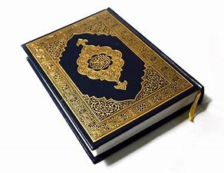
Al- Fatiha Nicknames
AlSaba’ Al Mathanee:
The 7 Repeated
Ummul Kitab: The Mother of the Book
Al Hamd:
The Praise
Al Salah:
The Prayer
Al Ruqyah:
The Cure

Slide 4
How many times a day do we read this Surah??
Prophet Muhammad (S) says:
“It is the 7 Praised Ones.
It is the greatest Surah of the Quran that I have been given.”
What does he mean by ???
Angel Jibreel was sent from the sky to congratulate the Prophet for being given 2 lights that no other Prophet had been given:
Surat Al Fatiha and the last Ayah of Surat Al-Baqara
Question:

Slide 5
For a Surah we read so often, don’t you want to know what you are saying? What are you saying? Why are you repeating it over and over? Himself says: “I have divided salah in between me and my slave into 2 halves, and my slave shall receive anything he asks for” What are we asking for What does He mean by 2 halves
Answer:
17 times a day!!!

Slide 6
Al Fatiha is a conversation with Allah. He responds after every Ayah
When you talk to your friend on the phone, you don’t just talk to yourself.
The other person has to respond, or else it isn’t a conversation.
In the same way, when we pray, we have to imagine Allah (S) responding to us after every Ayah we recite.
So….What are we saying and what does He say?

Slide 7
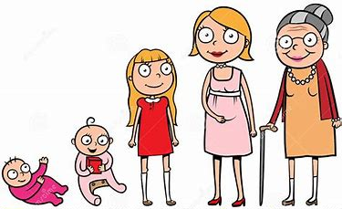
In the Name of Allah
We start every Surah with calling on Him.
We start every action in our lives with His Name.
Any act that is attached to Allah’s name is blessed.
It connects you to Him.
.
Ayah
#1
The Gracious
The Merciful
Everyone has some idea about God…but we can only use our own imaginations to guess what a God is like. That’s why Allah teaches us about his characteristics so we can know Him as He is.
He loves us and is Merciful with us. Handles us with care, takes care of our matters.
I can’t do anything without His help- can’t chew my food, swallow my food, digest my food, or benefit from my food without His will. My entire life is in His hands.

Slide 8
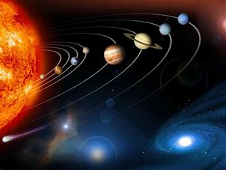
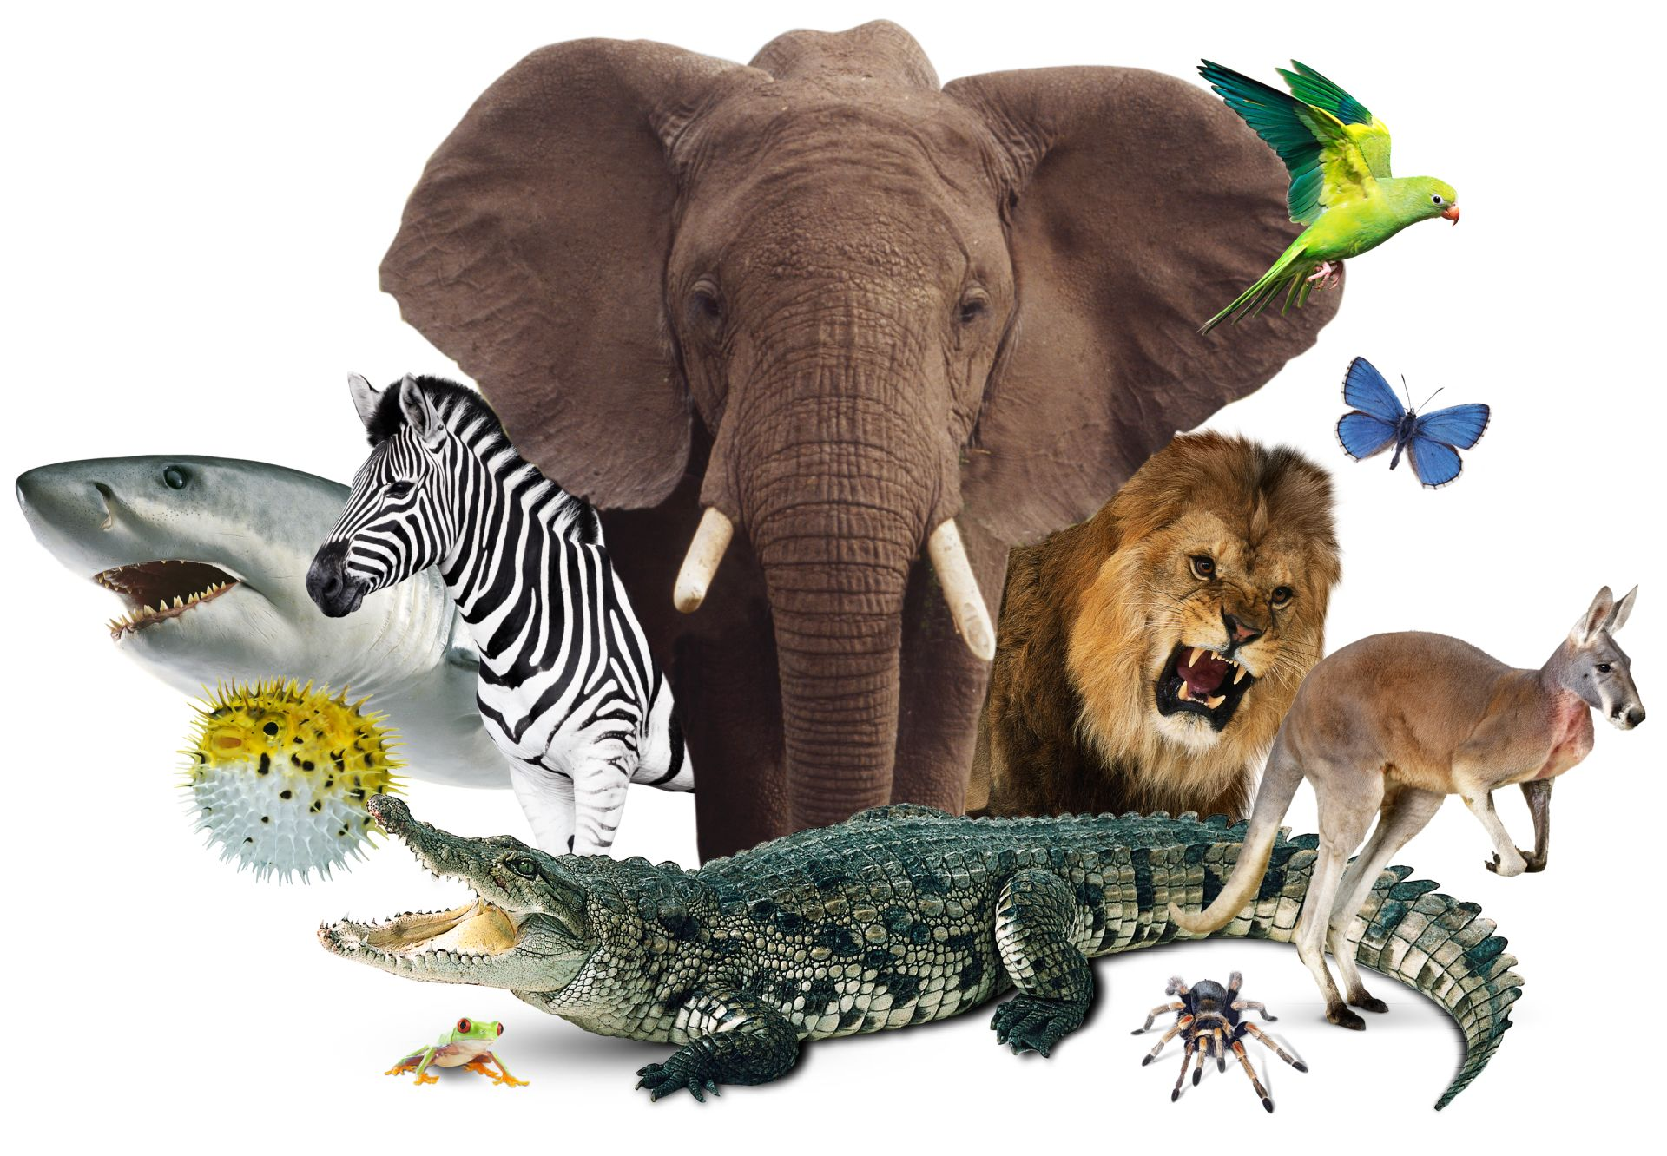
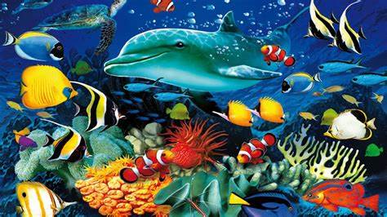
Ayah
#2
All Praise to
Allah
I start salah by admitting that Allah is worthy of being praised.
Even if something happens and we don’t like it, we still say Alhamdulillah, because He knows what is best for us.
We remind ourselves of this throughout the day so we can always be thankful for what we have.
Lord of the WORLDS
I admit He is Master and I am Slave (our relationship)
I admit He is Lord of every World- those I know about and some I may not know about.

Slide 9
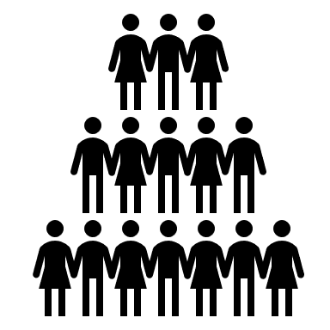
On the Day of Judgment every nation will have a flag. Prophet Muhammad said: “My nation’s flag will be Hamd حمد”
Ummah/Nation of Muhammad (AS)
حمد
Praise/Thanks

Slide 10
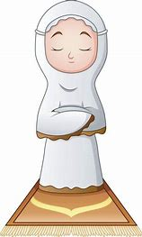
We just praised Him. How does Allah respond??
Even though He is Lord of all the Worlds, He heard your statement. He responds to you.
He appreciates your appreciation.
“Slave of Allah” is the most honorable title.
“My slave has praised Me”

Slide 11
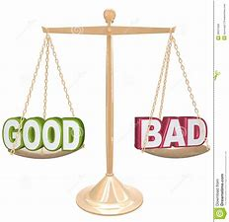
Ayah
#3
The Gracious
The Merciful
My slave has glorified me.
BALANCE:
Yes, He’s Merciful, but that doesn’t mean He won’t punish
We remind ourselves that we will be held accountable for our actions.
My slave has recognized my power
Ayah
#4
The Owner of the Day of Judgment

Slide 12
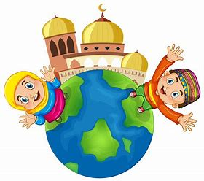
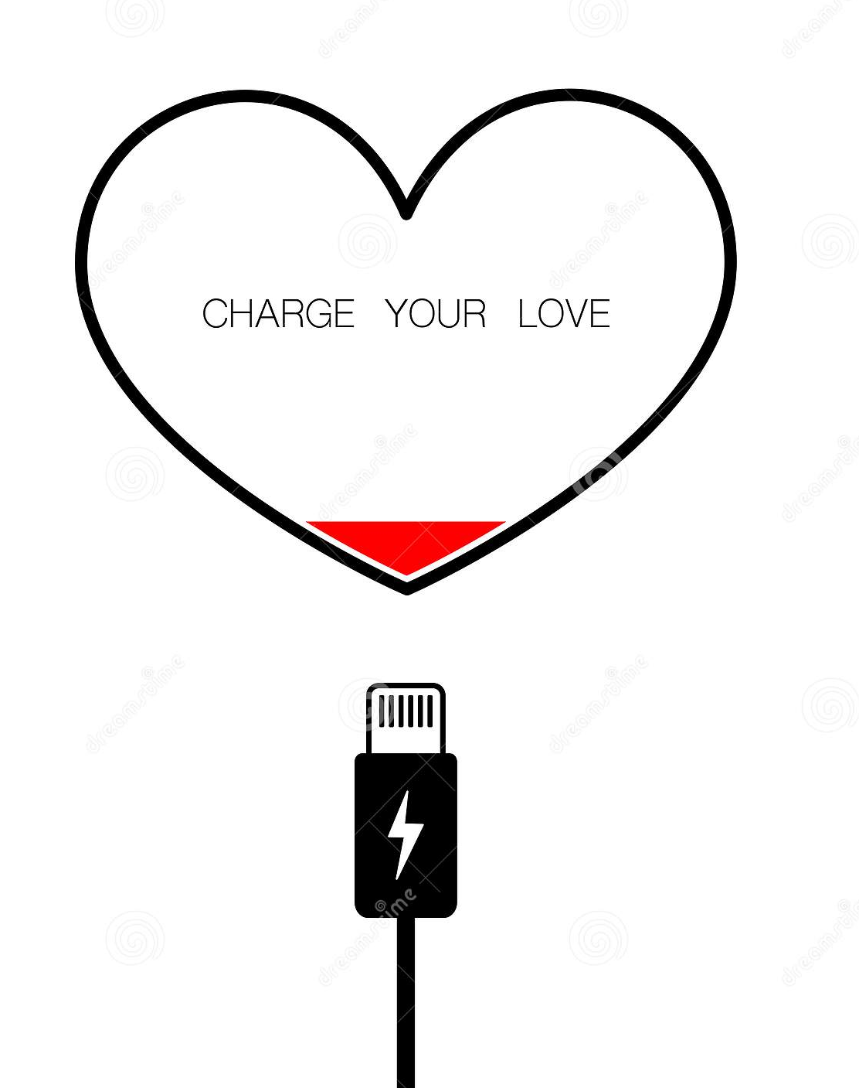
What did I learn about Allah in the first 4 Ayat ?
He is Merciful and Cares for us.
He is praised and thanked.
He is our Master and we are His slaves
He owns and cares for all the Worlds.
He owns the Day of Judgement.
We must remember this throughout the day.
Just like we charge our electronics to keep them running properly, our Salah is a recharge for our hearts-connecting us to the One who Created us.

Slide 13
Ayah
#5
You alone we worship
You alone we ask for help
This is a 2-way street.
We worship Allah
And Allah helps us.
This is between Me and My servant.
My servant shall have what He asks for.

Slide 14
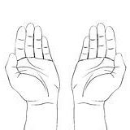
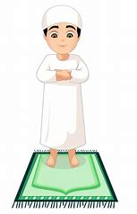
Ayah #6
Guide us on the Straight Path
Even though we believe we are on the correct path, we still ask Allah every day to keep us guided.
We ask him to keep us from making the wrong decisions.
Guidance is continuous!!

Slide 15
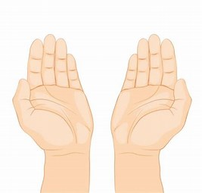
Before answering, Allah (S) waits for us to mention which path we are asking for in the LAST AYAH:
Ayah
#7
The path of those who earn your favor.
Not the path of those you are angry with, or those who are lost.
People who don’t know the truth
People who know the truth, but choose not to follow it
AMEEN
This is for My servant.
My servant shall have what he asks for.
We end the Surah with “AMEEN” because the last Ayah we recited was a DUAA.
We asked and Allah(S) responded.

Slide 16
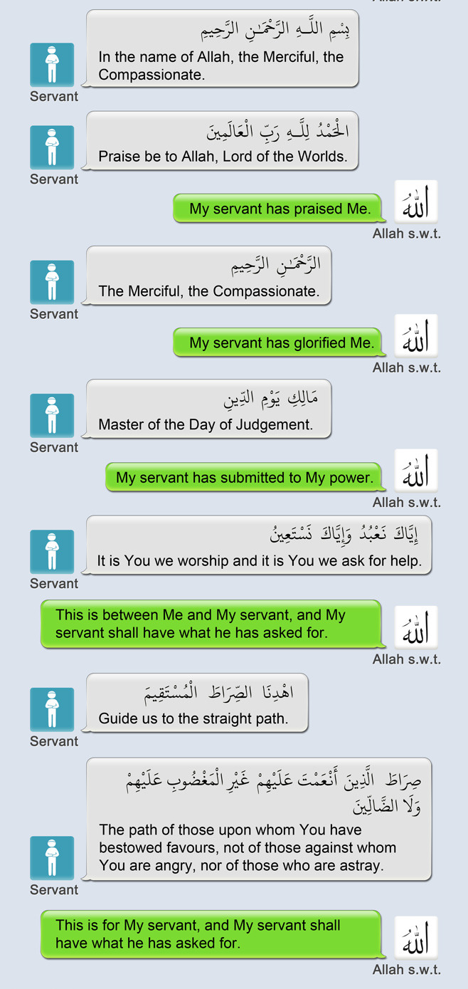
Summary of Al-Fatiha Conversation with Allah (S)

